Slide 1
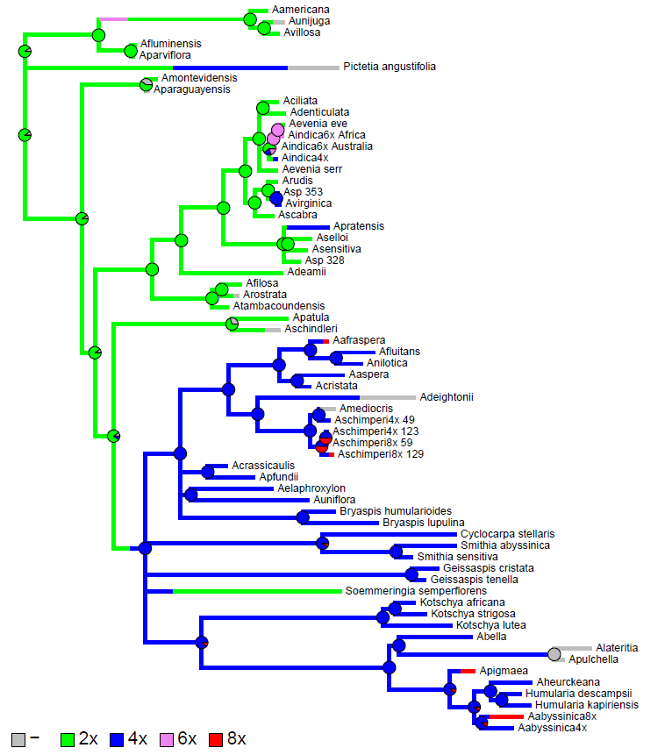
ITS + matK tree
Ploidy level:

