Slide 1
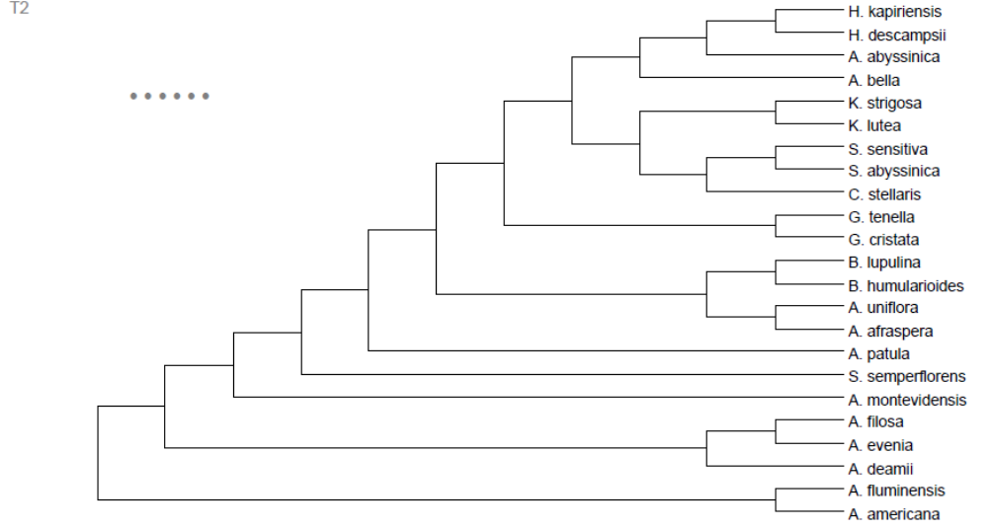
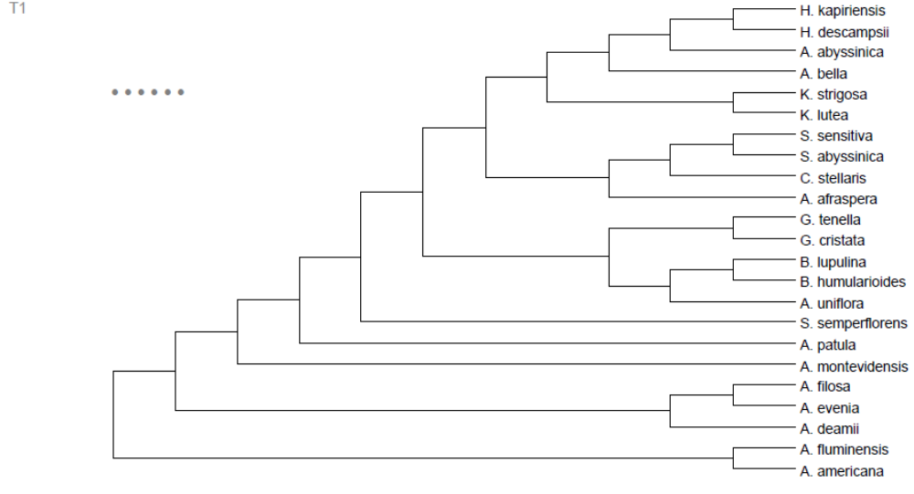
a
No allopolyploidisation hypothesis using tree topology with group A (T1)
Score: 207
b
No allopolyploidisation hypothesis using tree topology with group B (T2)
Score: 196

Slide 2

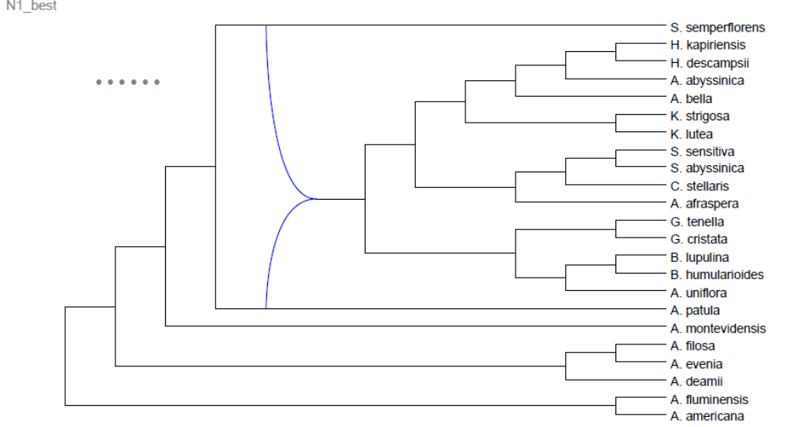
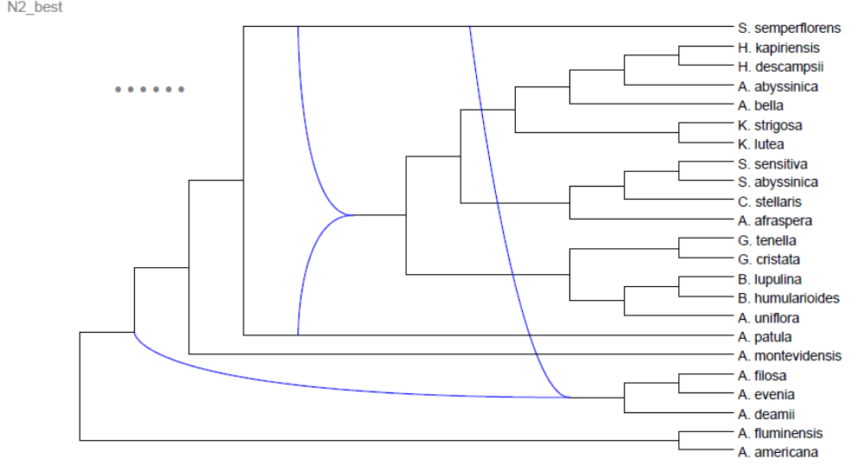
c
One-allopolyploidisation hypothesis using tree topology with group B (N1-best)
Score: 175
d
Two-allopolyploidisation hypothesis using tree topology with group B (N2-best)
Score: 169

