Slide 1
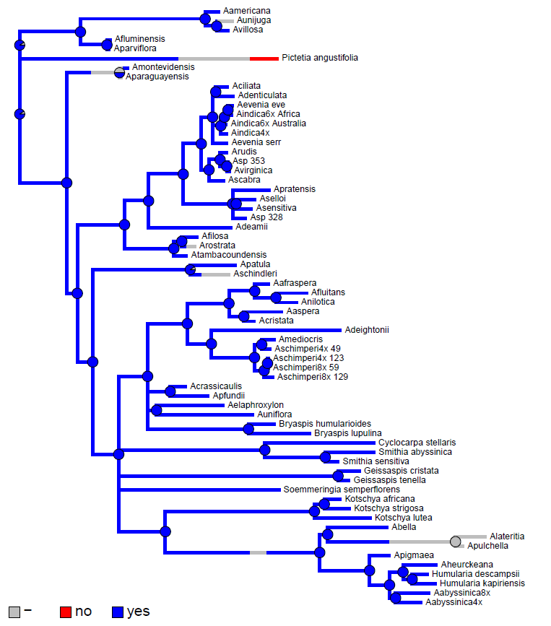
ITS + matK tree
Adventitious root primordia:

