Slide 1
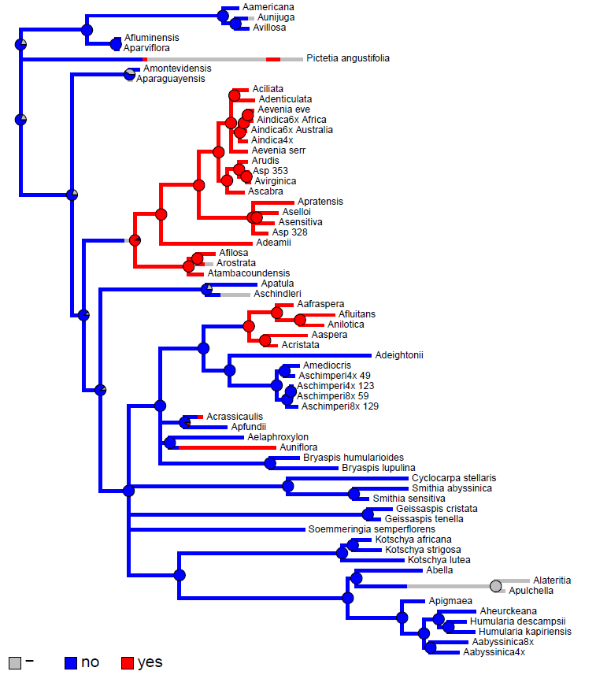
ITS + matK tree
Stem nodulation:

