Slide 1
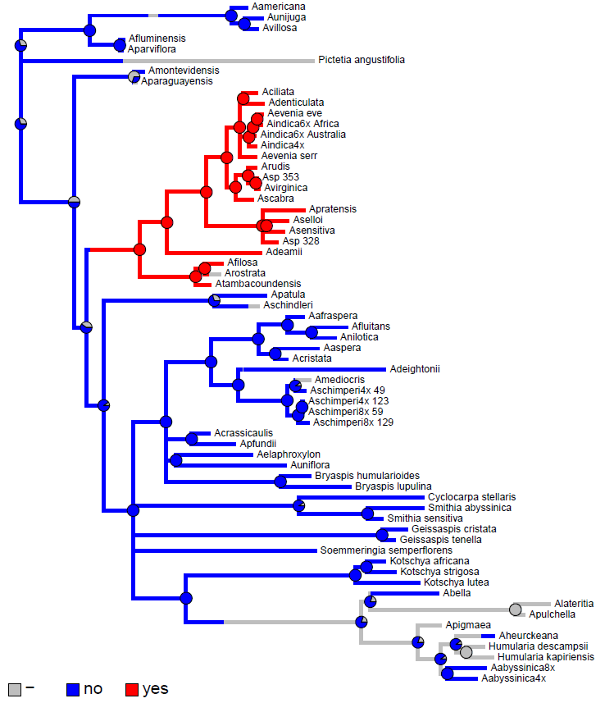
ITS + matK tree
Nodulation with the Bradyrhizobium strain ORS278:

