Slide 1
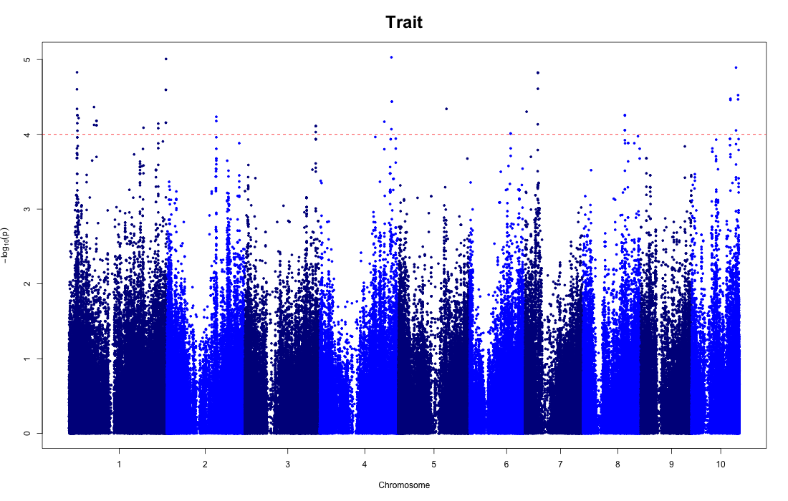
Vascular bundle area

