Slide 1
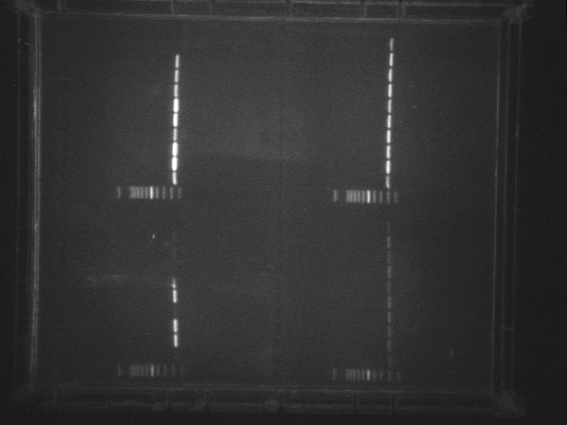

25 PCR cycles
30 PCR cycles
Ladder
Ladder
Event 1 (C)
Event 1 (C)
Event 3 (C)
Event 3 (T)
Event 3 (C)
Event 3 (C)
Event 3 (T)
Event 2 (C)
Event 2 (C)
Event 1 (T)
Event 2 (C)
Event 3 (T)
Event 1 (T)
Event 3 (T)
Event 2 (C)
Event 2 (T)
Event 3 C)
Event 2 (T)
B73
Water
B73
Water
Zmm22 marker
EIF4A marker
(control)

