Slide 1
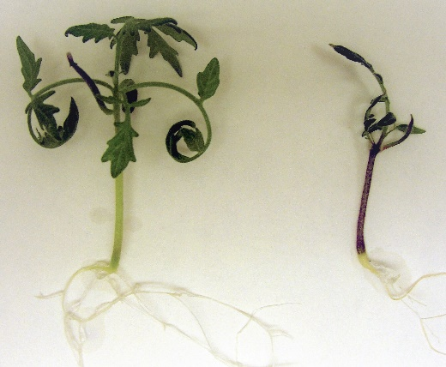
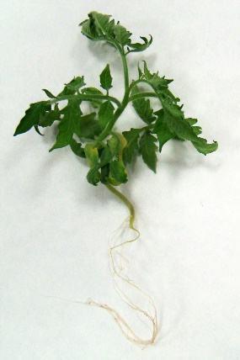
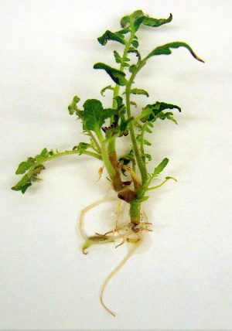
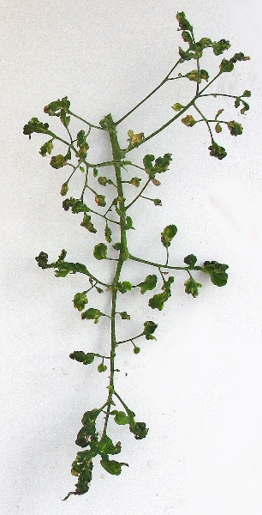
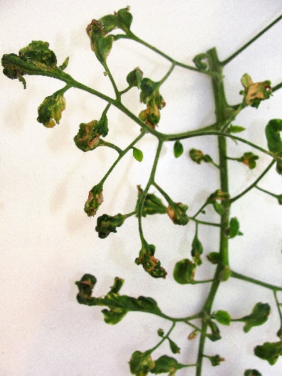
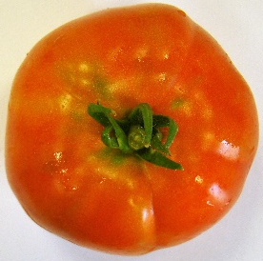
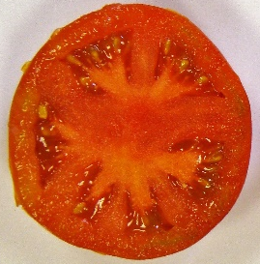
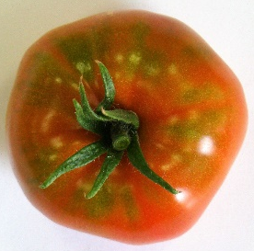
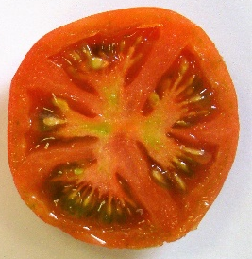
Additional file 8: Figure S5
a
b
c
Line | Nº flowers per inflorescence | Nº fruits per inflorescence | Fruit ∅ (cm) | Fruit weight (cm) | Fruit set (%)
WT | 7,16 ± 0,40 (a) | 3,68 ± 0,24 (a) | 6,68 ± 0,21 (a) | 131,97 ± 8,67 (a) | 51,51 ± 3,17 (a)
Mutant | 6,57 ± 0,26 (a) | 2,38 ± 0,17 (b) | 4,67 ± 0,15 (b) | 65,11 ± 4,48 (b) | 36,39 ± 2,77 (b)
d

