Slide 1
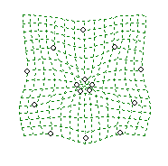
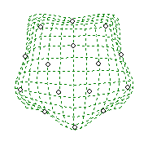
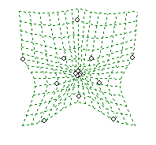
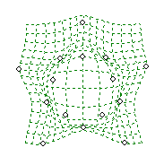
(a) N. tabacum–0.2 million years old
(d) Section Polydicliae–1 million years old
PC2
sylv ♀
tab 095-55
tab 51789
tab ‘Chulu’
tab SR1
syn tab QM
syn tab TH37
tomtform ♂
PC2
obtus ♀
clev
quad 9047
quad TW18
x obtus 1
x obtus 2
x obtus 5
atten ♂
PC1
PC1
(b) N. rustica—0.2 million years old
(e) Section Repandae—4.5 million years old
PC2
pani ♀
rust asi
rust pav
syn UxP
syn F₁
syn rust S₀
syn rust S₁
undu ♂
PC2
sylv ♀
neso
nudi
repa
stock 9747
stock TW126
obtus ♂
PC1
PC1
(c) N. arentsii—0.2 million years old
Figure S2. Reconstructed versus extant progenitor midpoints in floral limb shape for (a) N. tabacum, (b) N. rustica, (c) N. arentsii, (d) section Polydicliae, and (e) section Repandae. Convex polygons include the flower averages of each accession; diploids have solid lines, allotetraploids have dashed lines, and homoploids have dotted lines. The grey triangle in the top right-hand corner of the floral limb shape plots represents physically impossible shapes. Reconstructed progenitors are marked with dotted circles and the reconstructed progenitor midpoint is a square with a dotted black outline. Colored lines connect progenitor midpoints with allopolyploid means (solid=extant; dashed=reconstituted). Lines only drawn for extant midpoint for synthetic polyploids. If reconstructed phenotype similar to extant, only one set of lines is present (a) and (c). Accession abbreviations are found in Figure S6.
PC2
undu ♀
aren
wigan ♂
PC1

