Slide 1






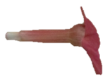








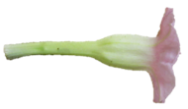
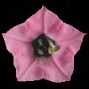



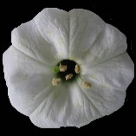

‘
’
5cm
Figure S5: Convergent evolution analyses based on color traits only. Shifts in color across the branches of the tree represent shifts in floral traits. Brightly colored branches denote suites of similar floral characters that have arisen independently in the evolution of Nicotiana; each color represents a different convergent regime. Green = the ‘green’ regime, purple = the ‘magenta/purple’ regime, red = the ‘pink’ regime, and blue = the ‘UV white’ regime. The colors outlining the boxes with flower photographs correspond to these colors. Gray branches on the tree represent shifts in floral traits that were not placed into a convergent regime (they have a single origin). Flower photographs are to scale; scale bar = 5 cm.

