Slide 1
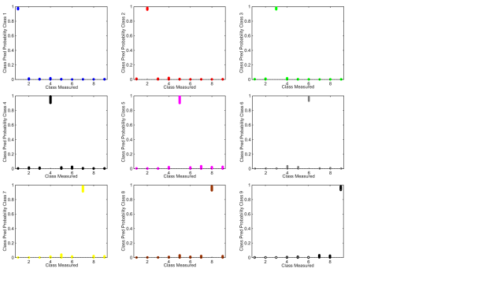
Figure S4: Class predictive probability results for individual spectral classes for development
(in order DS01-DS09).

