Slide 1
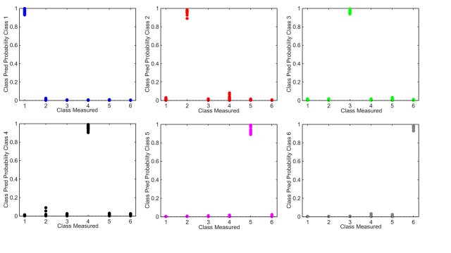
Figure S6: Class predictive probability results for individual spectral classes for ripening
(in order RS01-RS06).

