Slide 1
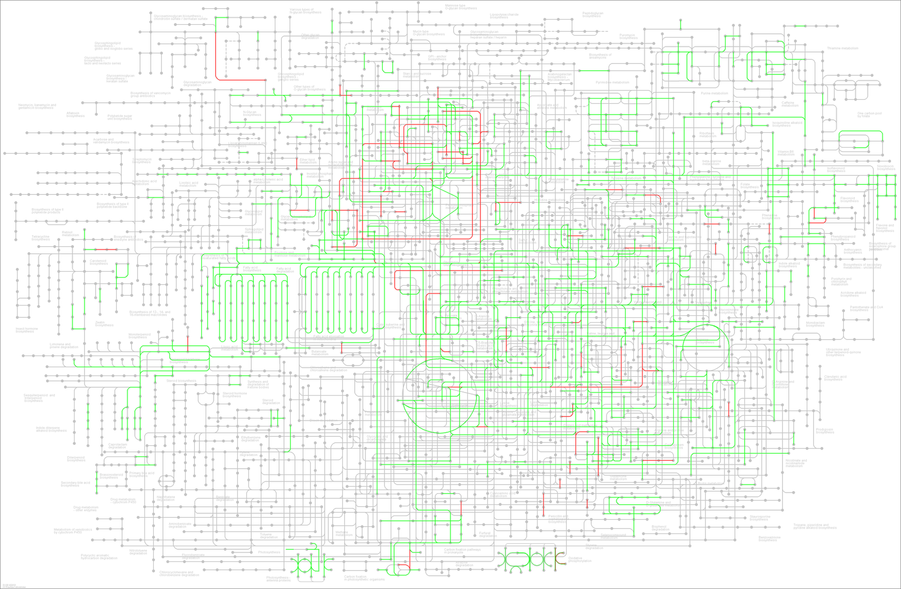
10masl Metabolic pathways
Nucleotide metabolism
Lipid metabolism
Carbohydrate metabolism
Amino Acid metabolism
Energy metabolism
Biosynthesis of other secondary metabolites
Metabolism of other Amino Acid
Additional file 5: Figure S3

