Slide 1
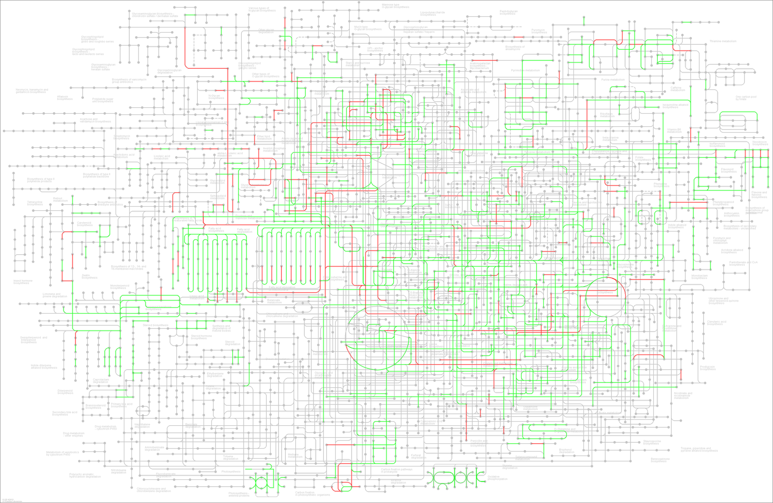
200masl Metabolic pathways
Nucleotide metabolism
Carbohydrate metabolism
Amino Acid metabolism
Lipid metabolism
Energy metabolism
Biosynthesis of other secondary metabolites
Metabolism of other Amino Acid
Additional file 6: Figure S4

