Slide 1
Supplementary Table1. Sequences of the primers used in this study
Primer name | Primer Sequence(5’-3’) | purpose
E4-F | CGGGATACAGTTCGGATGGGC | EST
E4-R | TTGCATAGCCAAGGATGTTACCAGC
SpSUT4-F1 | CGGGATACAGTTCGGATGGGC | 3’RACE 5’RACE
SpSUT4-F2 | ACGTGCAGGAGCTCGGAATCCC
SpSUT4-R1 | AGTGAGATCGGCGAGAAGAG
SpSUT4-R2 | ACTCCAATCAGCGGCTGAACTA
IbSUT4-F | ACTAAATCGGAACCCTAAAGG | Amplification IbSUT4 full length
IbSUT4-R | GGAGAATCATTCACTAAAATCAATG
SUT4m-F | CATCGATATGCCGGAAGGGGAGCGG | Functional analyse
SUT4m-R | CCCCGGGTTAAGGGAGAATCTTTGGCTTG
SUT4G-F | ACGCGTCGACATGCCGGAAGGGGAGCGG | Subcellular localization
SUT4G-R | GGACTAGTACAGGGAGAATCTTTGGCTTGTCAACT
oeSUT4-F | GGGTACCATGCCGGAAGGGGAGCGGC | Over-expressing IbSUT4 in Arabidopsis
oeSUT4-R | GTCGACCTTAAGGGAGAATCTTTGGCTTGTCA
Atactin-F | ATGACTCAGATCATGTTTGAGACC | qRT-PCR/RT-PCR
Atactin-R | TCAGTAAGGTCACGACCAGCAA
Ibactin-F | CTGGTGTTATGGTTGGGATGG
Ibactin-R | GGGGTGCCTCGGTAAGAAG
AtFT-F | TAGTAAGCAGAGTTGTTGGAGACG
AtFT-R | GGGAAGGCCGAGATTGTAGAT
ABI3-F | CAATCGTCTCCTCAGCCCTCT
ABI3-R | ATGCACCAGAAGAGTCGTCA
ABF2-F | CACAGCACCAACGCCTAAAGC
ABF2-R | ATCGCAACAGCAACAGCCAATC
ABF4-F | ATCTGCTGTTGTTGCTGCTGAAG
ABF4-R | ACTGCTGCTGGCGGCTTAG
SnRK2.2-F | TGGAATATGCTGCTGGTGGAGAACTTTATGAG
SnRK2.2-R | TGGTTGGGAATGAAGAACAGAAGACTTGAGAG
SnRK2.3-F | TCTGGCGGTGAACTTTACGAGCGGATTTG
SnRK2.3-R | CCTGACGAAGCAGTACCTCTGGAGCGATG
ABI1-F | TCCGCTTCCTTGCCATCTCAC
ABI1-R | GTCTCACATCTTCGTCGCTAACTG
PYL8/RCAR3-F | GGATAATCAGTGTAGCTCTACGC
PYL8/RCAR3-R | ATCTTCTCACAAGTGACCACAC
QSUT4-F | AGCTTCGACGAGCAGAGAAC
QSUT4-R | TAACGCCCATCCGAACTGTATC

Slide 2
Supplementary Table 2. Count the number of lowering plants.
Sample | Total number of plants | Number of flowers | Flowering ratio (%)
WT | 26 | 12 | 46
SUT4-1 | 26 | 18 | 69
SUT4-7 | 26 | 16 | 61
SUT4-10 | 26 | 14 | 53

Slide 3
Supplementary Table 3. The cis-element of IbSUT4 promoter
Cis-element | Sequence | Function
ABRE | CACGTG/ACGTG | involved in the abscisic acid response
LTR | CCGAAA | involved in low-temperature response
AuxRR-core | GGTCCAT | auxin-responsive element
CGTCA-motif | CGTCA | involved in the MeJA-response
MYB | CAACAG/CAATTG/ CAACCA | involved in plant growth and abiotic stress

Slide 4
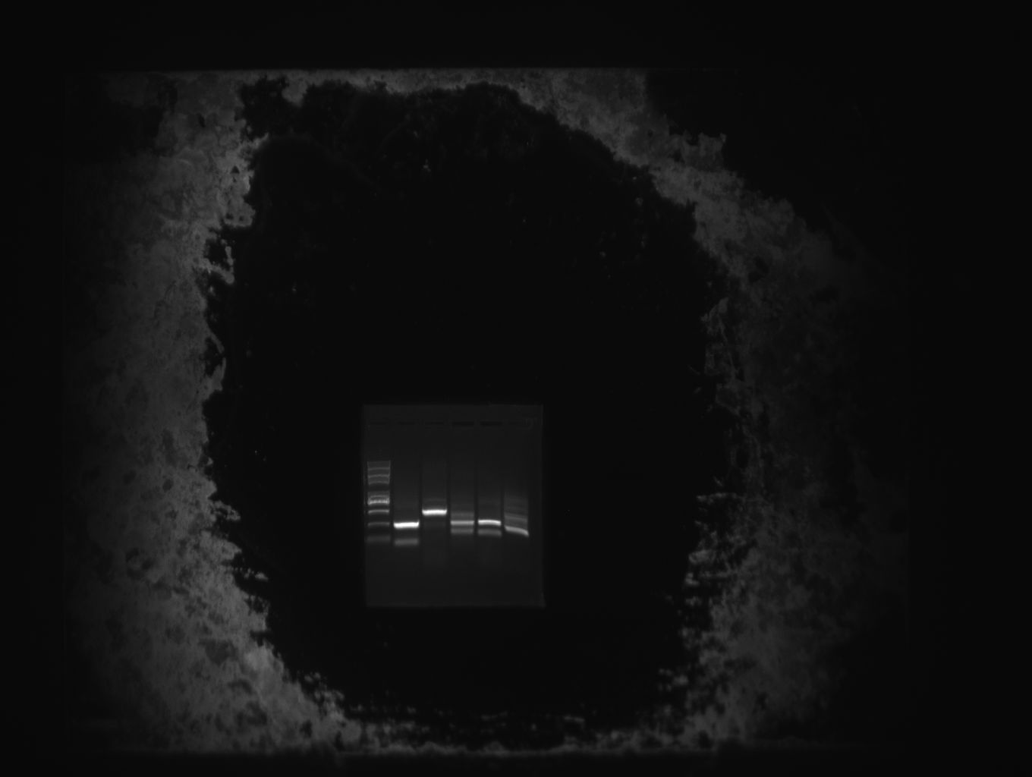
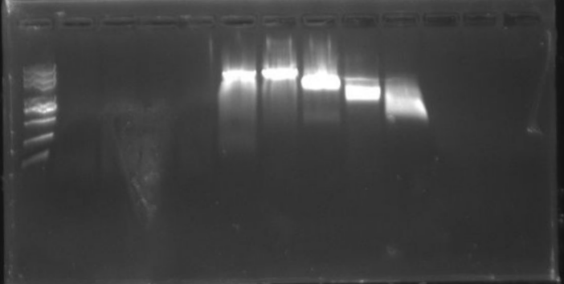
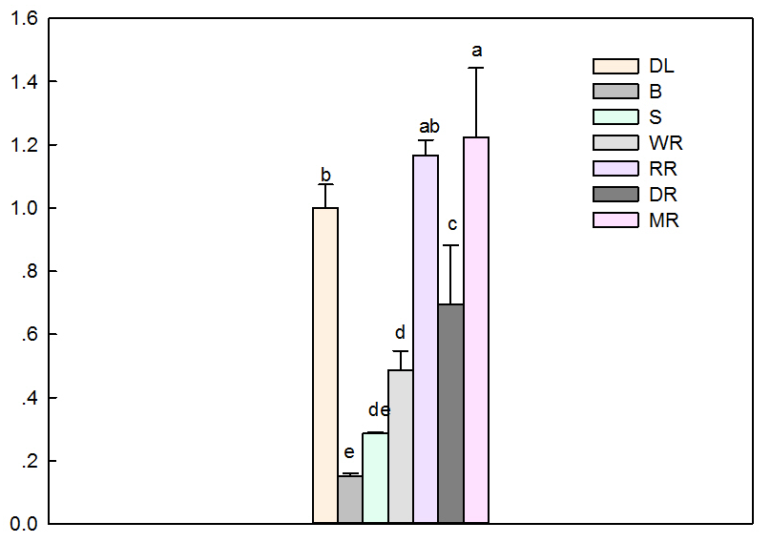
A B
Marker EST Marker 3’RACE 5’RACE
5000bp
3000bp
5000bp
2000bp
3000bp
1000bp
2000bp
750bp
1000bp
500bp
750bp
500bp
250bp
250bp
100bp
100bp
C
IbSUT4
Relative expression level
Figure S.1

Slide 5
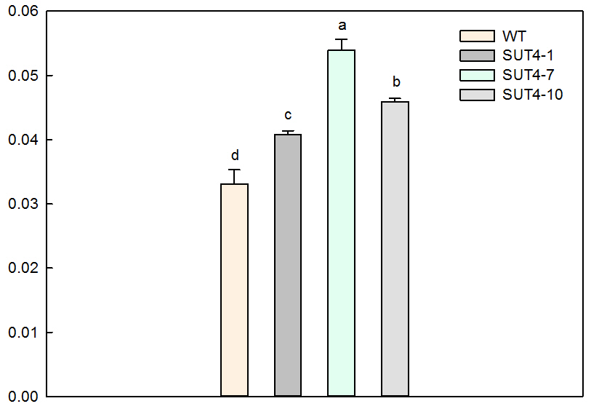
Average optical density IntDen/Area
Figure S.2

Slide 6
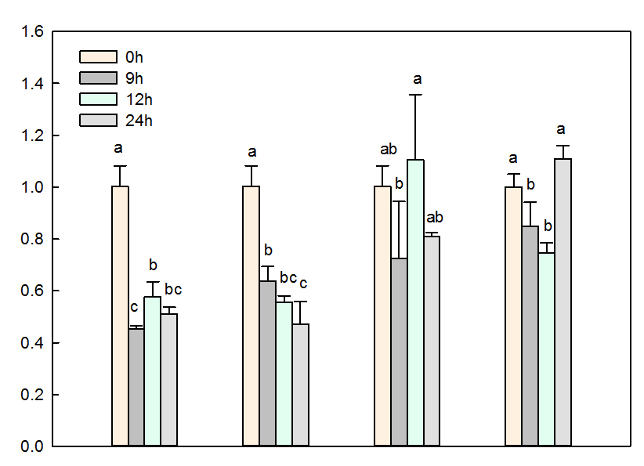
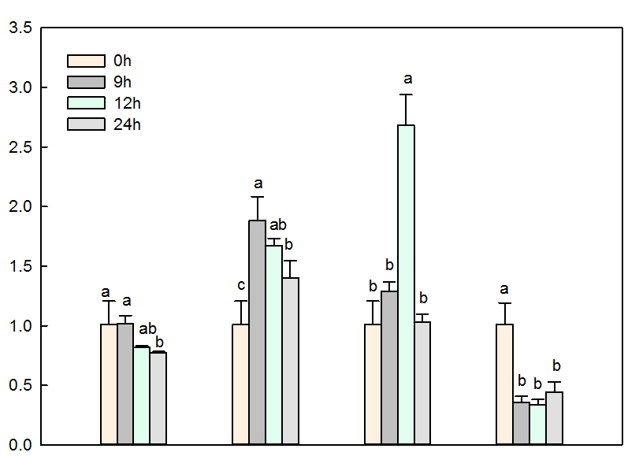
Relative expression level in leaves
A
IbSUT4
Relative expression level in roots
4°C NaCL Mannitol ABA
B
IbSUT4
4°C NaCL Mannitol ABA
Figure S.3

