Slide 1
Step 1: Integration of target site into modular vector system
Annealed oligo
encoding target
gRNA backbone
L0
BpiI T4 DNA Ligase
target
gRNA backbone
L0
Step 2: Assembly of transcriptional units for gRNA expression and nuclease expression
Pol III Promoter
target
Pol II Promoter
gRNA backbone
Nuclease
Ter
L0
L0
L0
L0
L0
BsaI T4 DNA Ligase
BsaI T4 DNA Ligase
Pol III Promoter
target
Pol II Promoter
gRNA backbone
Nuclease
Ter
L1
L1
Step 3: Assembly of multigene construct
Pol II Promoter
Pol II Promoter
Pol III Promoter
target
Selectable marker
Ter
Nuclease
Ter
gRNA backbone
L1
L1
L1
BpiI T4 DNA Ligase
Pol II Promoter
Pol II Promoter
Pol III Promoter
target
Selectable marker
Ter
Nuclease
Ter
gRNA backbone
L2
Fig. S2 A flowchart diagram illustrating assembly of level 2 constructs with gRNAs expressed under
individual Pol III promoters.

Slide 2
Step 1: Integration of target site into modular vector system
Annealed oligo
encoding target(s)
tRNA
sgRNA backbone
1-6 x L0
BpiI T4 DNA Ligase
target
tRNA
sgRNA backbone
1-6 x L0
Step 2: Assembly of transcriptional units for gRNA expression and nuclease expression
Pol III Promoter
target
Pol II Promoter
tRNA
sgRNA backbone
Nuclease
Ter
L0
1-6 x L0
L0
L0
L0
BsaI T4 DNA Ligase
BsaI T4 DNA Ligase
Pol III Promoter
Polycistronic sgRNA/tRNA
Pol II Promoter
Nuclease
Ter
L1
L1
Step 3: Assembly of multigene construct
Pol II Promoter
Selectable marker
Ter
Pol II Promoter
Nuclease
Ter
Pol III Promoter
Polycistronic sgRNA/tRNA
L1
L1
L1
BpiI T4 DNA Ligase
tRNA
sgRNA backbone
tRNA
sgRNA backbone
/.../
tRNA
sgRNA backbone
Pol II Promoter
Selectable marker
Ter
Pol II Promoter
Nuclease
Ter
Pol III Promoter
Polycistronic sgRNA/tRNA
L2
Fig. S3 A flowchart diagram illustrating assembly of level 2 constructs with gRNAs expressed as
tRNA-sgRNA polycistronic units.

Slide 3
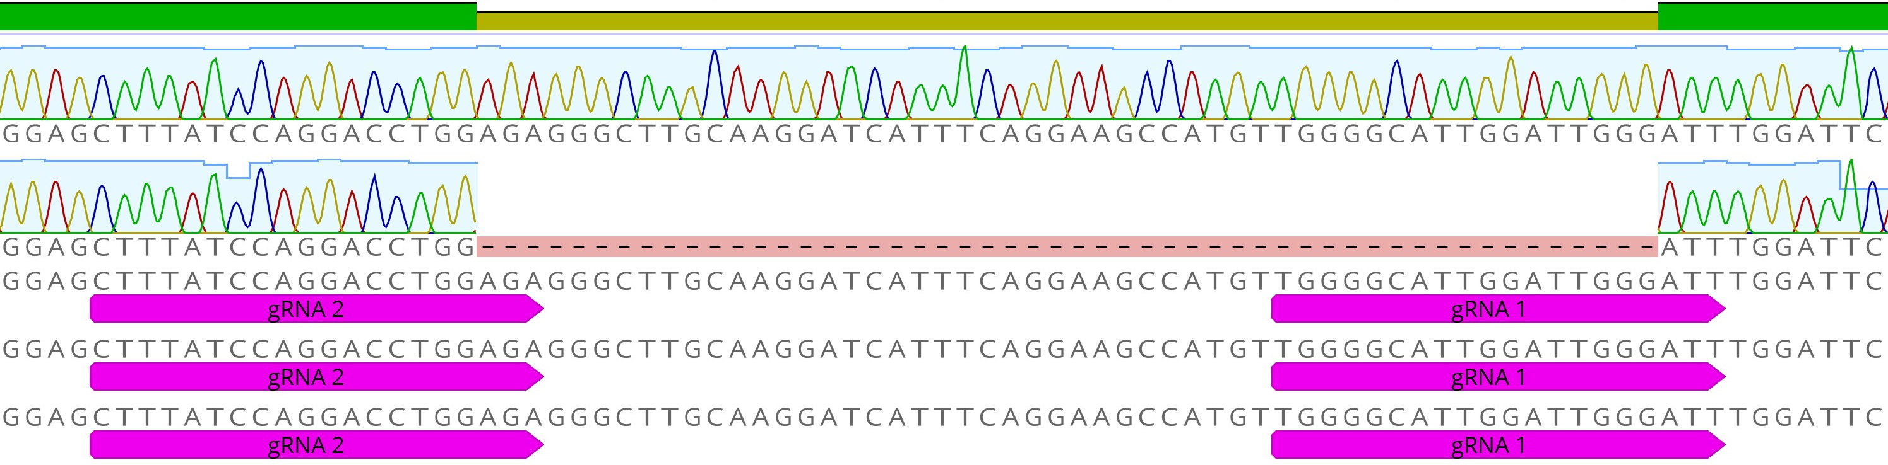
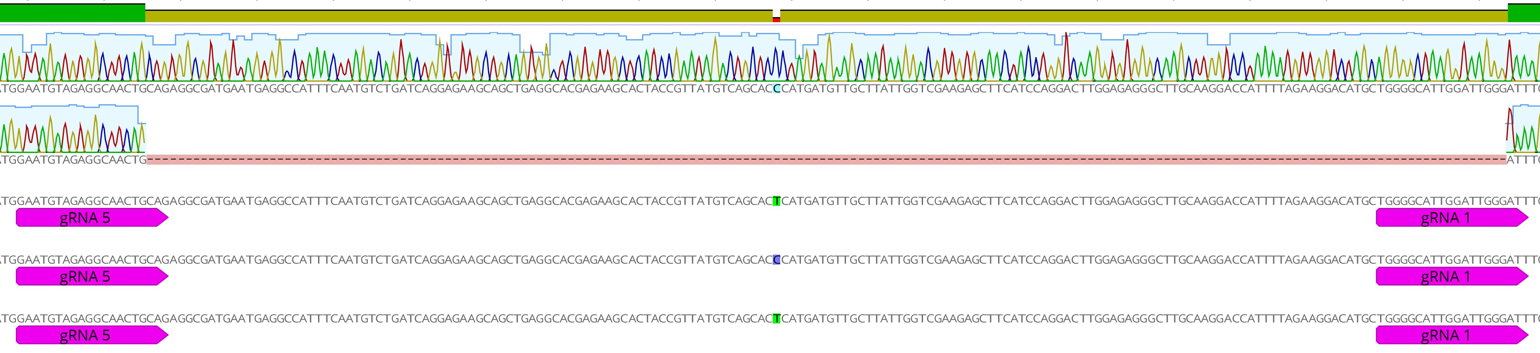
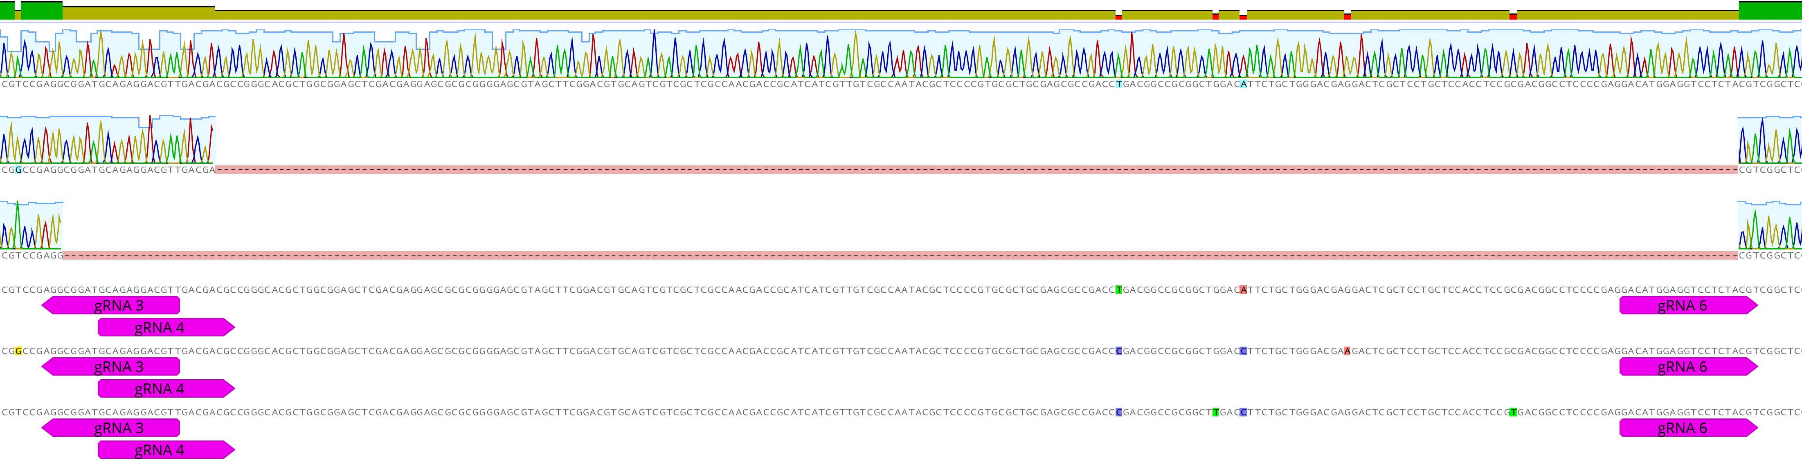
Target gene 1
Identity
WT
52 bp deletion
A genome
B genome
D genome
Target gene 2
Identity
WT
178 bp deletion
A genome
B genome
D genome
Target gene 3
Identity
WT
220 bp deletion
242 bp deletion
A genome
B genome
D genome
Fig. S4 Sanger sequencing reads illustrating gene deletions induced by CRISPR/Cas in wheat protoplasts.

Slide 4
Target gene 1
Target gene 2
Target gene 3
empty lane
empty lane
empty lane
pFH67
pFH23
NTC
pFH66
pFH67
pFH23
NTC
pFH66
pFH67
pFH23
NTC
M
-
M
-
M
pFH66
-
650 bp
500 bp
400 bp
300 bp
200 bp
100 bp
Fig. S5 The unprocessed image of the DNA gel presented in Fig. 6b. ‘M’ is the DNA marker; ‘NTC’ is the
no template control.

