Slide 1
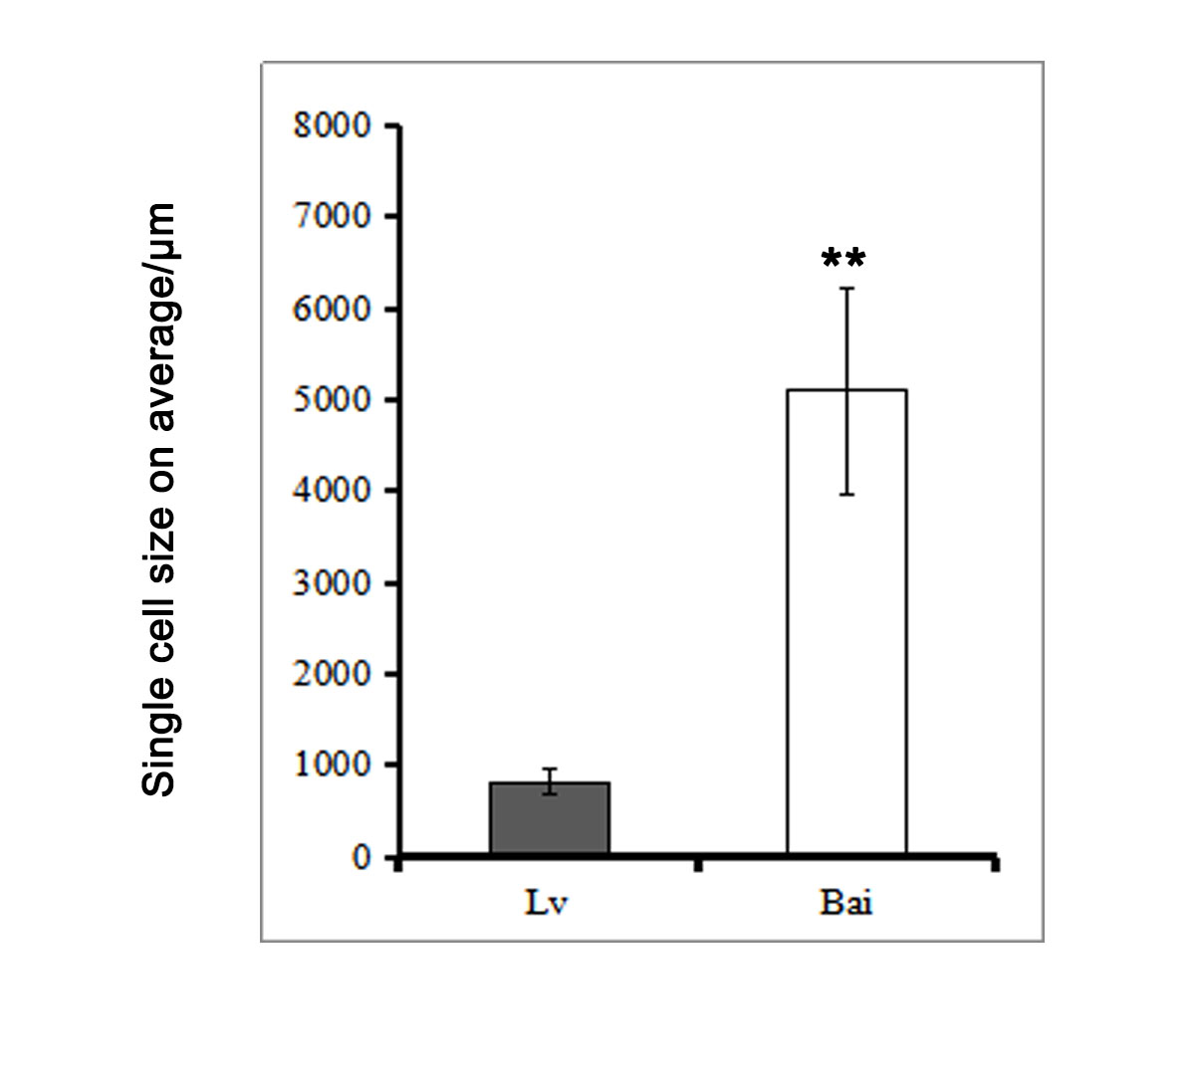
Figure S1. Single cell on average between Lv and Bai.

