Slide 1
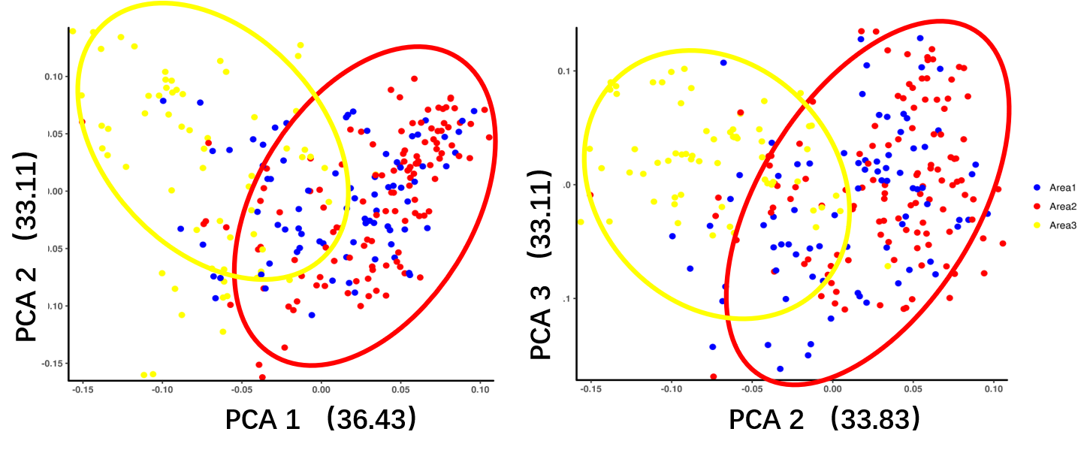
A
B
Additional files 2: Figure. S1. Population structure of the soybean germplasm collection. Area1 represents the soybean lines from Jilin province, Area2 represents the soybean lines from Heilongjiang province, Area3 represents the soybean lines from Liaoning province.

