Slide 1
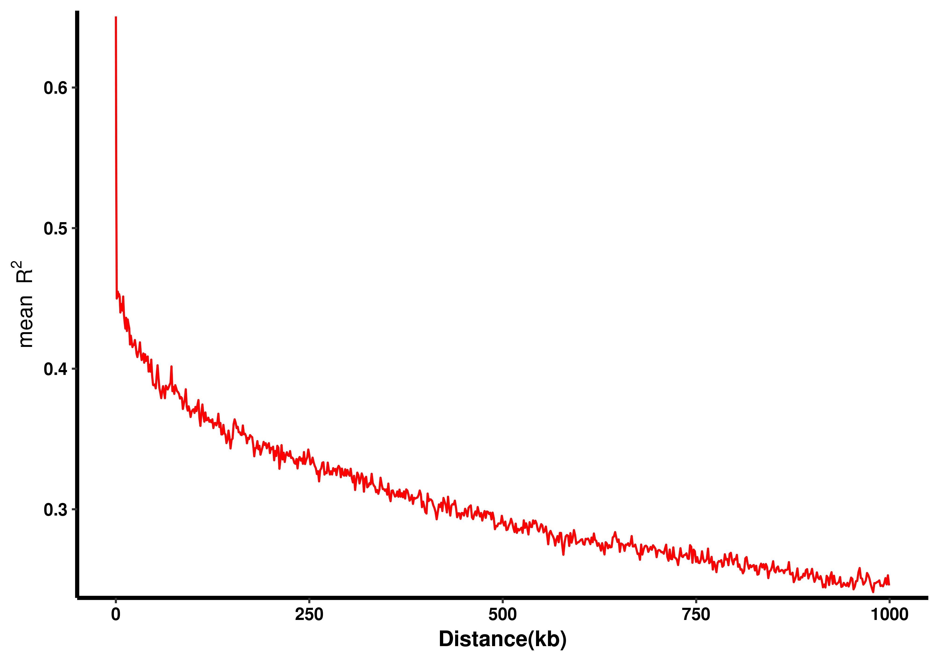
Additional files 4: Figure. S2. Genome-wide linkage disequilibrium (LD) decay for all 260 accessions. R² indicates the squared allele frequency correlations between all pairs of SNP markers. The X-axis indicates the distance between marker pairs.

