Slide 1
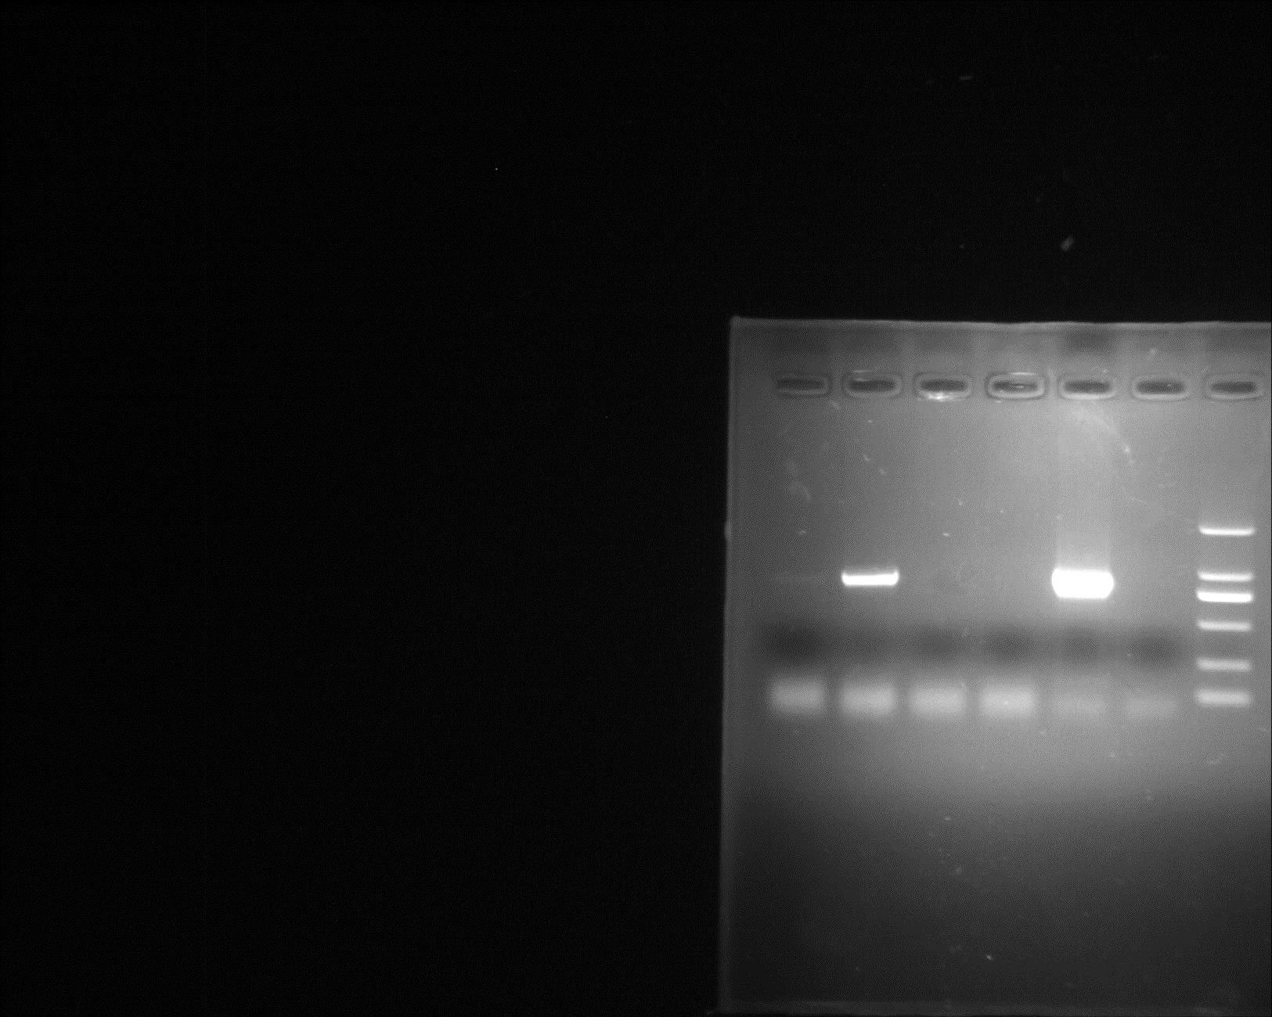
Additional file 2: Fig. S2
a
b
BSMV::TaWRKY42-B₁₉₈
1000 bp
750 bp
1 2
BSMV::00 PC Mock Marker
Infiltrated
leaves
Additional file 2: Fig. S2 The target fragment of TaWRKY42-B for BSMV-VIGS.
(a) Sequence of the target fragment of TaWRKY42-B in BSMV-VIGS. (b) Detection of BSMV::TaWRKY42-B₁₉₈ vector in infiltrated N. benthamiana. BSMV::00 was used as a negative control and BSMV::TaWRKY42-B₁₉₈ plasmid served as a positive control (PC). Lane 1 and 2 showed the PCR produces of BSMV::TaWRKY42-B₁₉₈ vector in two infiltrated leaves, respectively.

