Slide 1
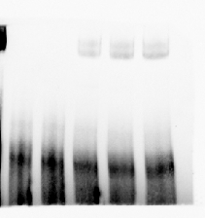
Additional file 6: Fig. S6
a
AtLOX1 Promoter
P3
ATG
-605
-473
b
Probe-labeled
MBP
MBP-TaWRKY42-B
Competitor
-
-
-
+
-
-
-
-
-
+
100×
-
+
200×
+
Protein
probe
complex
1.0
1.21
1.26
P3
Additional file 6: Fig. S6 TaWRKY42-B can’t directly bind to promotor of AtLOX1.
(a) Diagram of probes against AtLOX1 promoter region for EMSA. (b) The interaction between TaWRKY42-B and promoter region of AtLOX1 was analyzed by EMSA. TaWRKY42-B-MBP fusion protein mixed with labeled probes, and 100× or 200× unlabeled probes served as competitors. The presence (+) or absence (-) represented specific probes existence or not. Numbers above the top of the bands indicate the relative binding strength of TaWRKY42-B-MBP fusion protein and labeled probes after normalization to control group.

