Slide 1
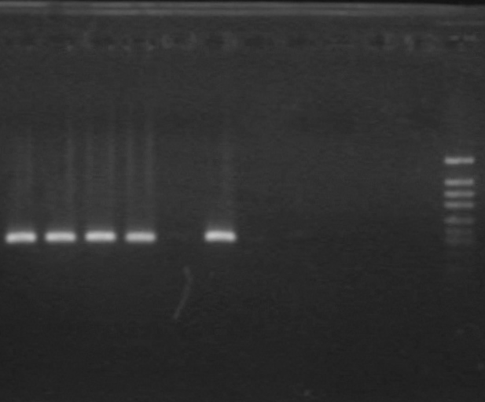
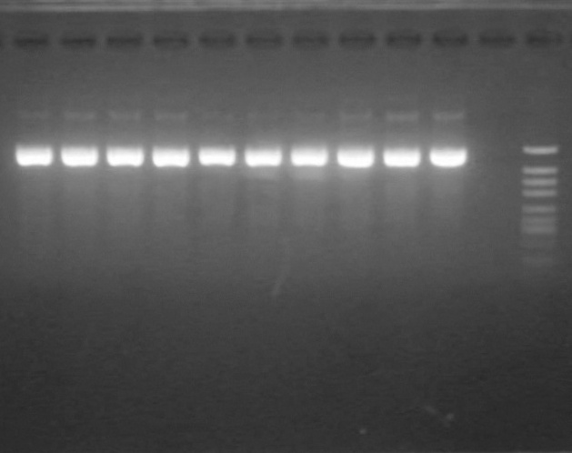
No template
orf20_{NK-198-4}
Marker
orf20_{NK-198-3}
orf20_{NK-198-4}
orf20_{TK-81}
orf20_{NK-305-1}
orf20_{NK-305-2}
orf20_{NK-219-2}
orf20_{NK-219-3}
orf20_{NK-198-2}
orf20_{PI 615522}
#19-#20
0.2
Hyg
0.7
Fig. S3. Agarose gel (2%) electrophoresis of PCR products with a primer set specific to RF-Oma1 copies that has potential to generate 200 kDa protein complex containing preSATP6 and a primer set targeting hygromycin resistance gene (Hyg). Marker sizes of DNA fragments were shown at the right (kbp). Binary vectors including each of RF-Oma1 copies were used as template. Those RF-Oma1 encoding 200-kDa generative protein and non-generative protein are colored with red or blue, respectively. Hygromycin resistance gene is a constituent of binary-vector backbone, thus amplification of its DNA fragment is considered as positive control.

