Slide 1
TA-33BB-CMS
Sample application failed
p1p4
p1p4
p1p4
p1p1
p1p1
p1p1
p4p4
p4p4
Sample application failed
p4p4
A
1236
1024
720
480
242
146
66
B
1236
1024
720
480
242
146
66
Uncropped images used for Figure 2 Immunoblot analysis of total cellular proteins from immature anthers collected from a BC₂F₂ population derived from TA-33BB-CMS x NK-198. Protein samples were electrophoresed in Blue Native polyacrylamide gels (4-16%). Size markers (kDa) are shown on the left. Sugar beet line or DNA marker types are shown at the top; genotypes p1p4 and p1p1 are heterozygous and homozygous forms of NK-198 Rf1, respectively. Genotype p4p4 is a homozygous recessive (i.e. rf1rf1). Immunoblots were probed with anti-preSATP6 (panel A) or anti-COXI (panel B).

Slide 2
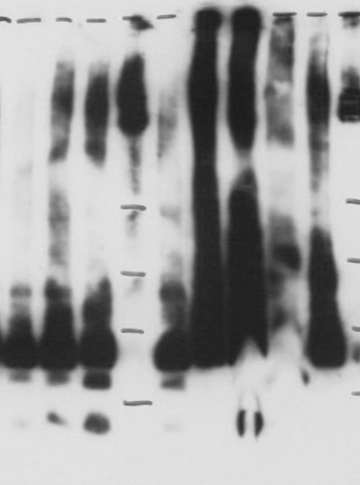
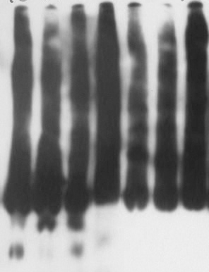
orf20_{NK-198-4}
orf20_{NK-198-3}
orf20_{NK-198-2}
orf20_{NK-198-1}
orf20_{TK-81}
orf20_{NK-198-2}
orf20_{TK-81}
orf20_{PI 615522}
orf20_{NK-219-2}
orf20_{NK-219-3}
1024
720
480
242
146
Uncropped images used for Figure 3 Immunoblot analysis of crude mitochondrial proteins extracted from transgenic cell lines. Protein samples were electrophoresed in Blue Native polyacrylamide gels (4-16%). Size markers (kDa) are shown in the center. FLAG-fused construct names are shown at the top. An arrow indicates the location of a 200-kDa band that is the hallmark of post-translational interaction with preSATP6.

Slide 3
A
1
2
3
4
5
B
1
2
3
4
5
1236
1024
720
480
242
146
66
C
1236
1024
720
480
242
146
66
Uncropped images used for Figure 4 Immunoblot analysis of total cellular proteins from immature anthers collected from TA-33BB-CMS (lanes 1 and 5), NK-198 (lane 2), TA-33BB-CMS x PI 615522 (lane 3) and TA-33BB-CMS x PI 518644 (lane 4). Protein samples were electrophoresed in Blue Native polyacrylamide gels (4-16%). Size markers (kDa) are shown on the right. Immunoblots were probed with anti-preSATP6 (panels A and B) or anti-COXI (panel C). Exposure times to X-ray film were 10 sec and 1 min for panels A and B, respectively.

