Slide 1
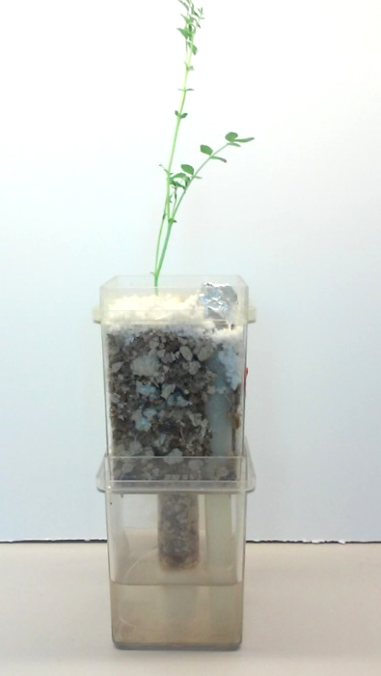
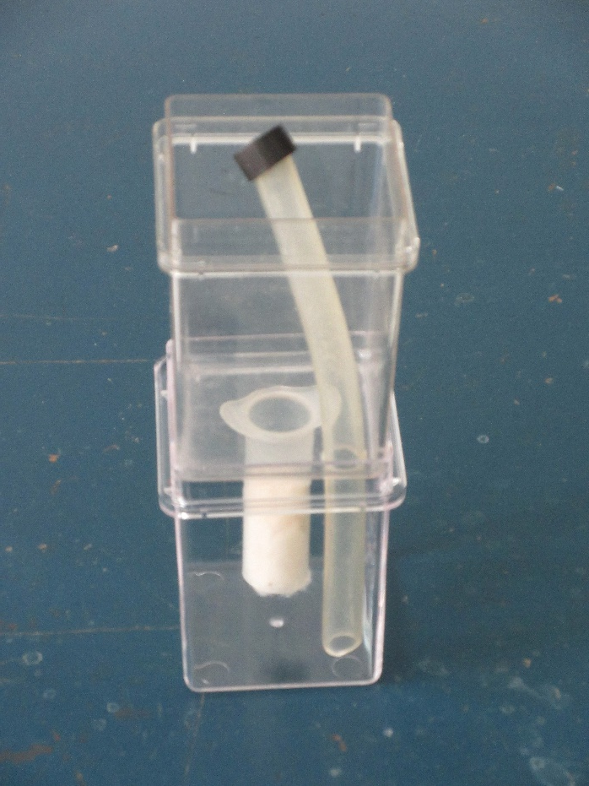
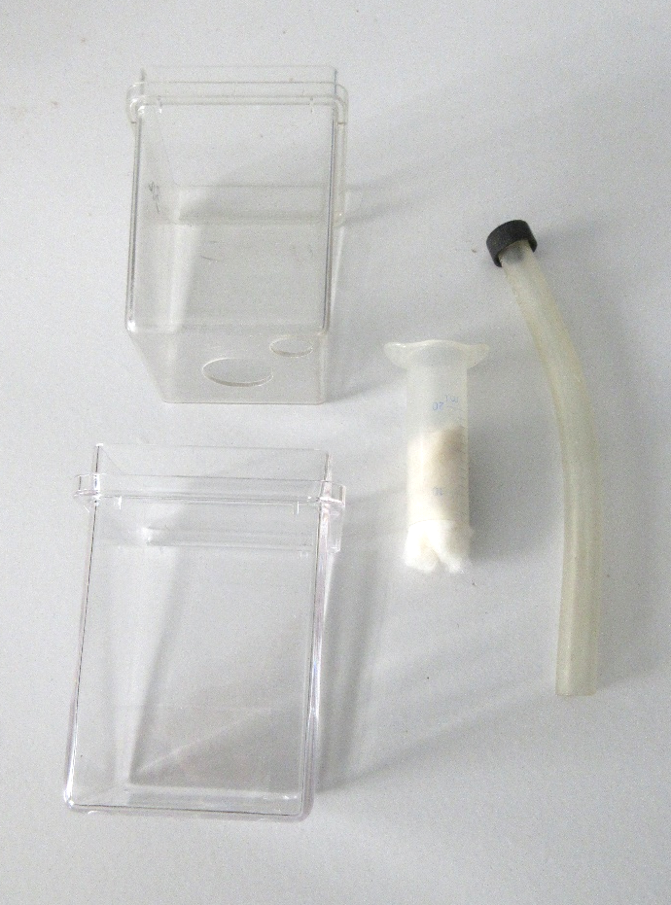
A)
B)
C)
1
2
1
1
2
2
4
4
3
4
3
3
Notes:
Supplementary Figure S3. The Leonard Jar assembly used in this study. The upper and lower chambers are made from polycarbonate “Magenta TM GA7 vessels” (Sigma-Aldrich).. A) Fully assembled Leonard Jar with chickpea seedling. B) Fully assembled Leonard Jar without plant or planting substrate. C) Disassembled components of Leonard Jar. 1) Top magenta box with two holes cut in the bottom. 2) Tubing allowing adding nutrient solution to bottom magenta box. 3) Bottom magenta box with no holes in it. 4) Syringe with tip cut off and partially stuffed with cotton. Nutrient solution from the bottom magenta box wicks upward through the syringe into the top magenta box.

