Slide 1
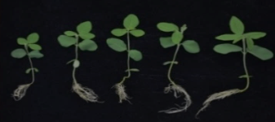
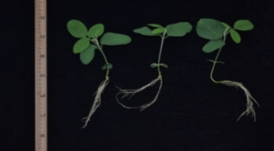
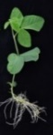
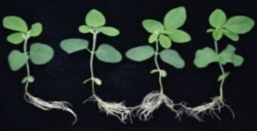
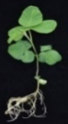

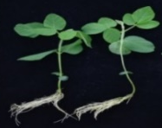

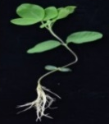
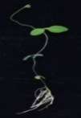
a
b
c
3
3
1
2
4
6
1
2
3
4
5
6
1
2
4
5
6
5
7
8
9
10
11
7
8
9
10
11
12
7
8
9
10
11
12
12
13
14
15
13
14
15
16
17
13
14
15
16
17
16
17
18
19
20
21
22
18
19
20
21
22
18
19
20
21
22
1: PI232990 2: PI81767 3: PI518283 4: PI257434 5: PI153277 6: Williams 82
7: QH 34 8: W1112 9: GR8836 10: JiDou 17 11: PI506592 12: PI416892
13: PI479752 14: ZhongHuang 13 15: DN 50 16: JiYu 47 17: 11 Fu
18: 11 Mu 19: 1 Fu 20: 1 Mu 21: FC19976-2 22: PI522228
Fig. S1 The measurement of salt tolerance in 22 soybean accessions. a, Phenotypic that before salt treatment. b and c, Phenotypic differences of normal and salt treatment, respectively. Bar=5cm.

