Slide 1
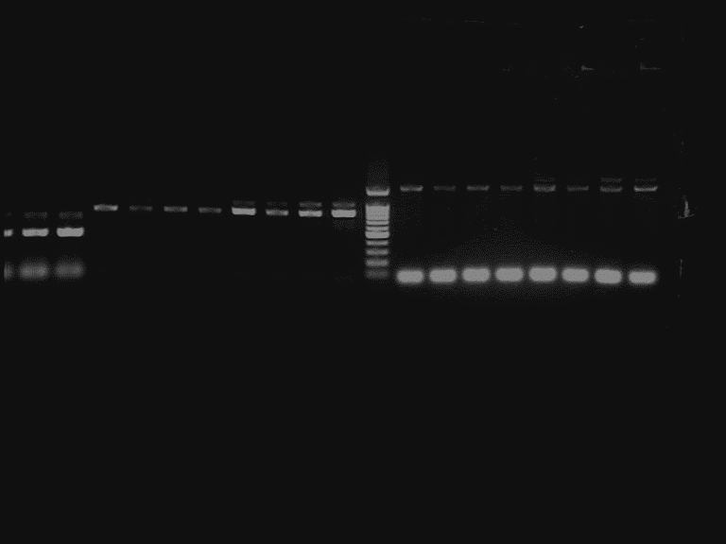
Repeat 1
Root Leaf Shoot
BjCET1

Slide 2
Repeat 2
Root Leaf Shoot
BjCET1

Slide 3

Repeat 1
Root Leaf Shoot
BjACTIN

Slide 4

Repeat 2
Root Leaf Shoot
BjACTIN

