Slide 1
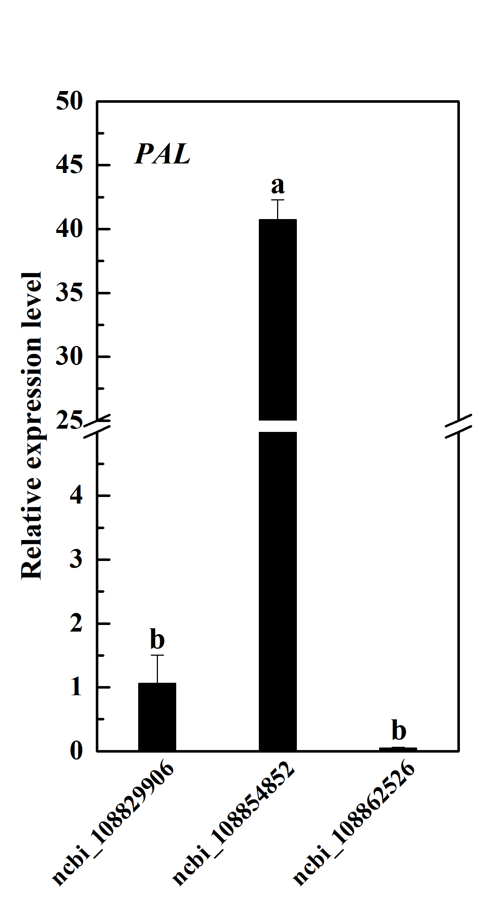
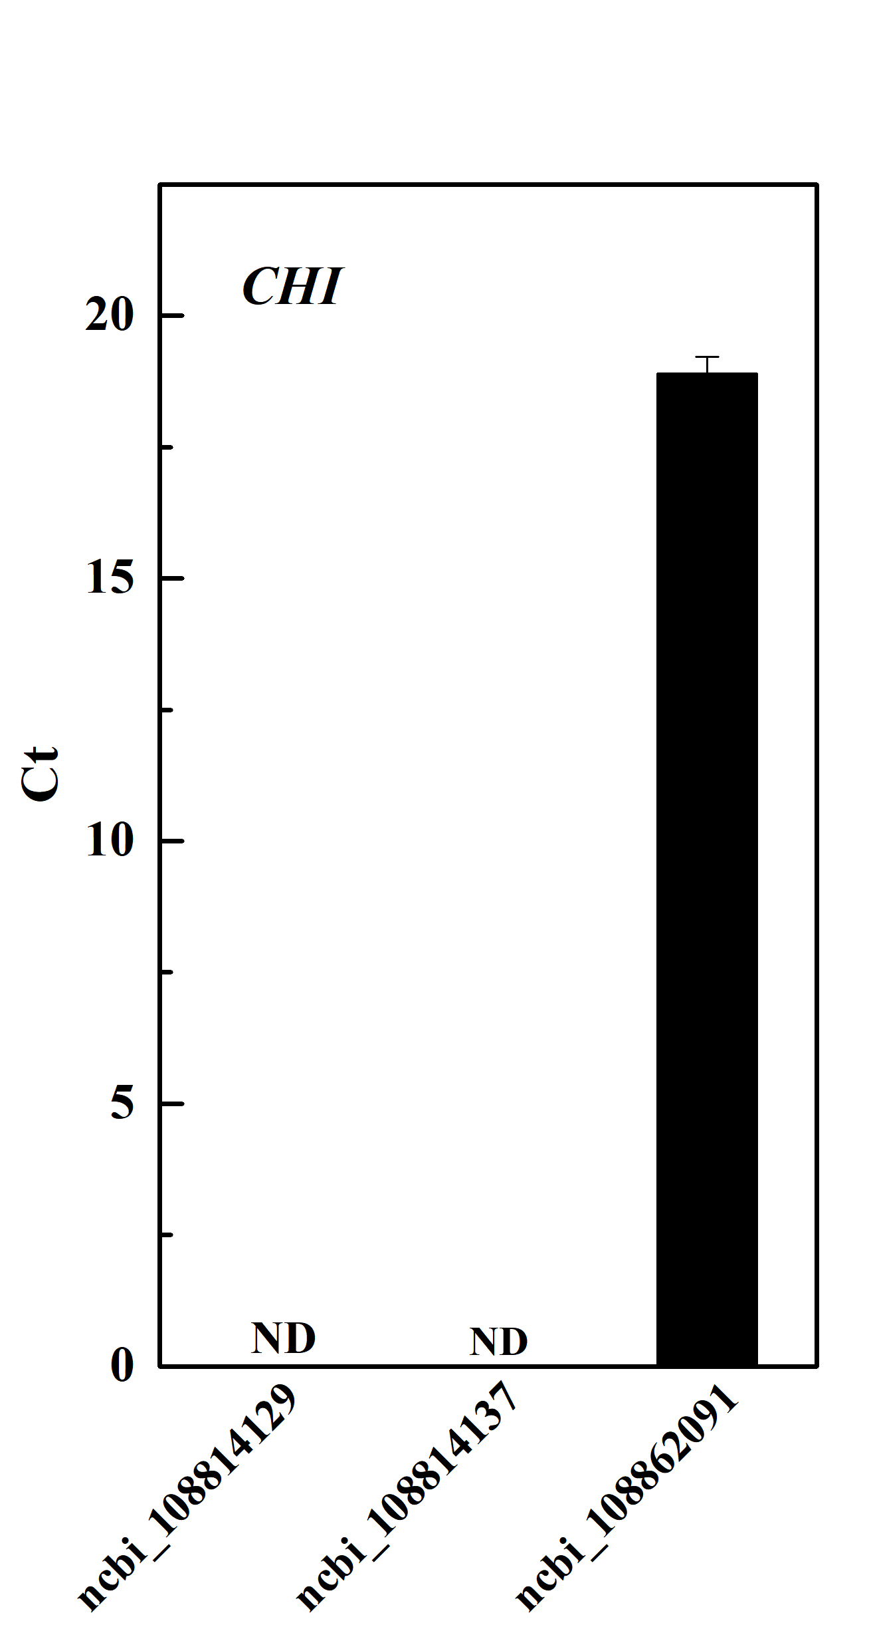
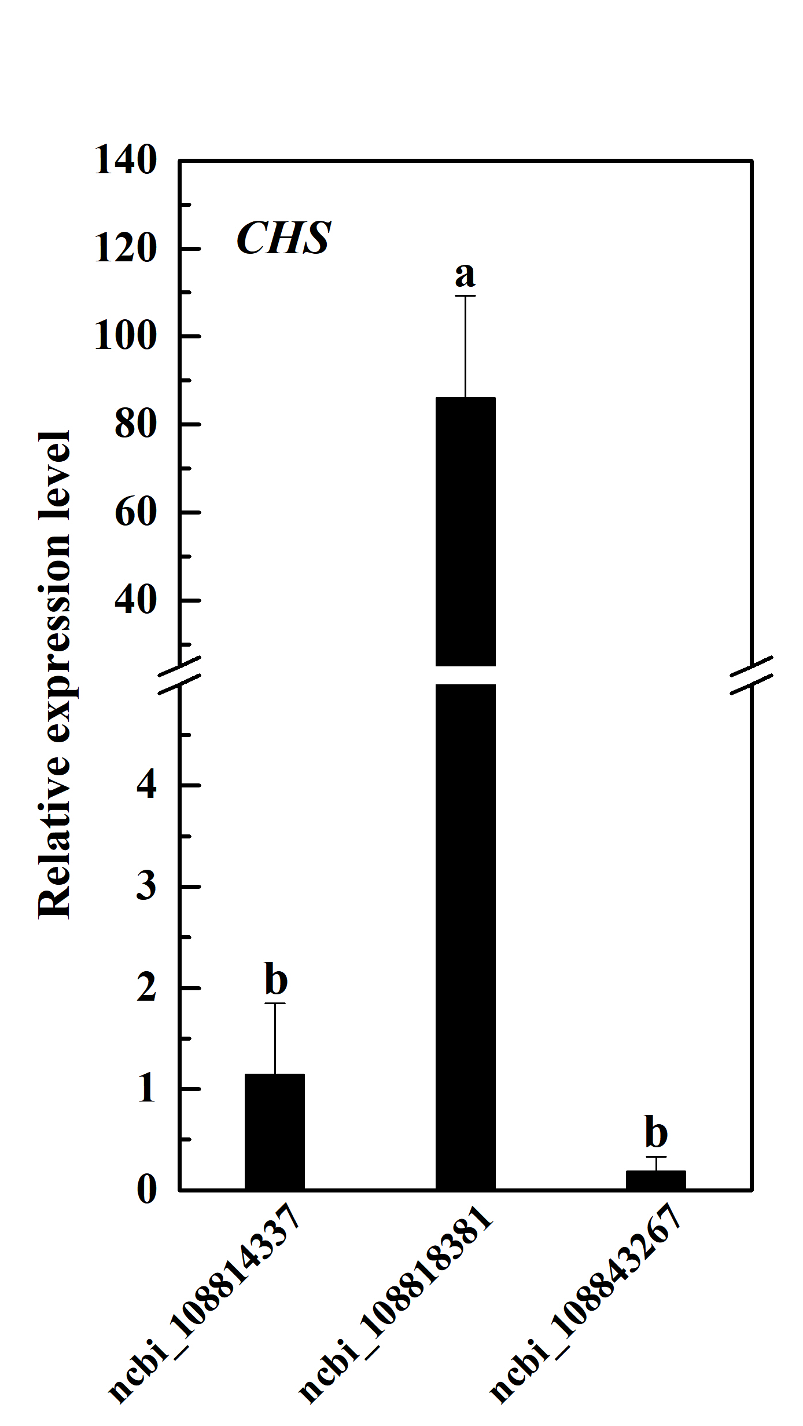
Fig. S1. The expressions of the key PAL, CHI and CHS key genes in radish hypocotyls. The values are means ± standard deviation (SD) of the three independent experiments with at least three replicates for each. Different letters indicate significant differences at P<0.05.

Slide 2
Table S1. The expression levels of anthocyanin biosynthesis related structure genes. FPKM values were obtained from radish hypocotyl RNA-seq data. Gene members with relatively high expression levels were highlighted in bold font.
Gene family | Gene ID | FPKM | Gene family | Gene ID | FPKM
PAL | ncbi_108812387 | 135.873 | CHS | ncbi_108847017 | 451.800
 | ncbi_108829906 | 188.670 |  | ncbi_108847407 | 389.743
 | ncbi_108838754 | 24.840 |  | ncbi_108847534 | 2.380
 | ncbi_108854852 | 238.767 | F3H | ncbi_108852668 | 0.001
 | ncbi_108855076 | 55.373 |  | ncbi_108805892 | 1313.673
 | ncbi_108857697 | 13.540 | DFR | ncbi_108826061 | 2388.957
 | ncbi_108862526 | 444.773 |  | ncbi_108848622 | 4.900
CHI | ncbi_108814129 | 373.050 |  | ncbi_108852246 | 0.050
 | ncbi_108814137 | 208.957 | ANS | ncbi_108811185 | 0.001
 | ncbi_108816078 | 0.537 |  | ncbi_108813755 | 0.001
 | ncbi_108830048 | 56.610 |  | ncbi_108824497 | 5.013
 | ncbi_108862091 | 204.657 |  | ncbi_108838202 | 0.001
CHS | ncbi_108814337 | 730.230 |  | ncbi_108842289 | 15.287
 | ncbi_108818381 | 848.847 |  | ncbi_108843686 | 1755.357
 | ncbi_108833356 | 0.240 | LDOX | ncbi_108848981 | 652.323
 | ncbi_108843267 | 1123.800 | UFGT | ncbi_108821920 | 265.513

Slide 3
Table S2. The nucleotide sequence of primers used in the qRT-PCR.
Gene Name | Primer forward | Primer reverse
Actin | 5’ GCTCAGTCCAAGAGAGGTATTC 3’ | 5’GCTCGTTGTAGAAAGTGTGATG 3’
PAL | 5’GAATTTAACCGCTTCCAACA3’ | 5’AAGCTCAGAGCAGTAAGAAG 3’
CHS | 5’CGACAGGAGAAGGGTTGGAG 3’ | 5’ACCATAGATAGCGAGGCCG 3’
CHI | 5’AACGTTCCCTCCTGGTGCTT 3’ | 5’TTTTCCCGTTTCAGGAATGC 3’
F3H | 5’CAAAATGCCCTCAGCCTGAT 3’ | 5’GCTTGTAAACCACCGACTTGGT 3’
DFR | 5’GGATCTGCAGGTTTAACTGA 3’ | 5’TGCGACTATCTGTTTTCTCG 3’
ANS | 5’ACGTAAGCGCTTTGACCTTCA3’ | 5’ATCGAATCGGGAACGCATT 3’
UF3GT | 5’TGTCAGATCGTTTTGGTTCC 3’ | 5’GATTCTTCCTCACTTTCTCAC 3’
LDOX | 5’GTTTGCAGCTTTTCTACGAGG 3’ | 5’TGAGCAAAAGTCCGTGGAGG 3’
PAP1 | 5’TGAGTAAGAAACATGAACCAGGC3’ | 5’GCCGTTGTTAACCGTGAAGGA3’
PAP2 | 5’ATGGAGAAGGCAAATGGCATCAAG3’ | 5’CCAGCAATCAAGGACCACCTATTTC3’
NOA | 5’GAACCAATCCGCAGAGTACG3’ | 5’CCATTCAGCACCAGAAGTGC3’
NIA | 5’GTGAACTCATCACCACAGGA3’ | 5’CACGTGGGTTGACTAAAGCTA3’

