Slide 1
Fig. S1 Nucleotide sequence of the StGI.04 fragment used to generate the aGI 'Désirée' lines and its alignment to the corresponding region of StGI.12.

Slide 2
**
Fig. S2 Growth and tuberisation parameters of aGI-repressed lines compared to the non-transformed 'Désirée' (DES) control. Height of the plants and earliness of tuberisation was tested 7 weeks after transferring the plants from in vitro culture into pots. Tuber yield and distribution of tuber sizes were determined at the end of the vegetation period. In general, 9-11 plants/line were tested with exeption of aGI55 and DES out of which 5 and 19 plants were tested, respectively. The significant difference (Student t-test, p < 0.01) compared to the control is labelled by two asterisks. SD; short day growth condition.

Slide 3
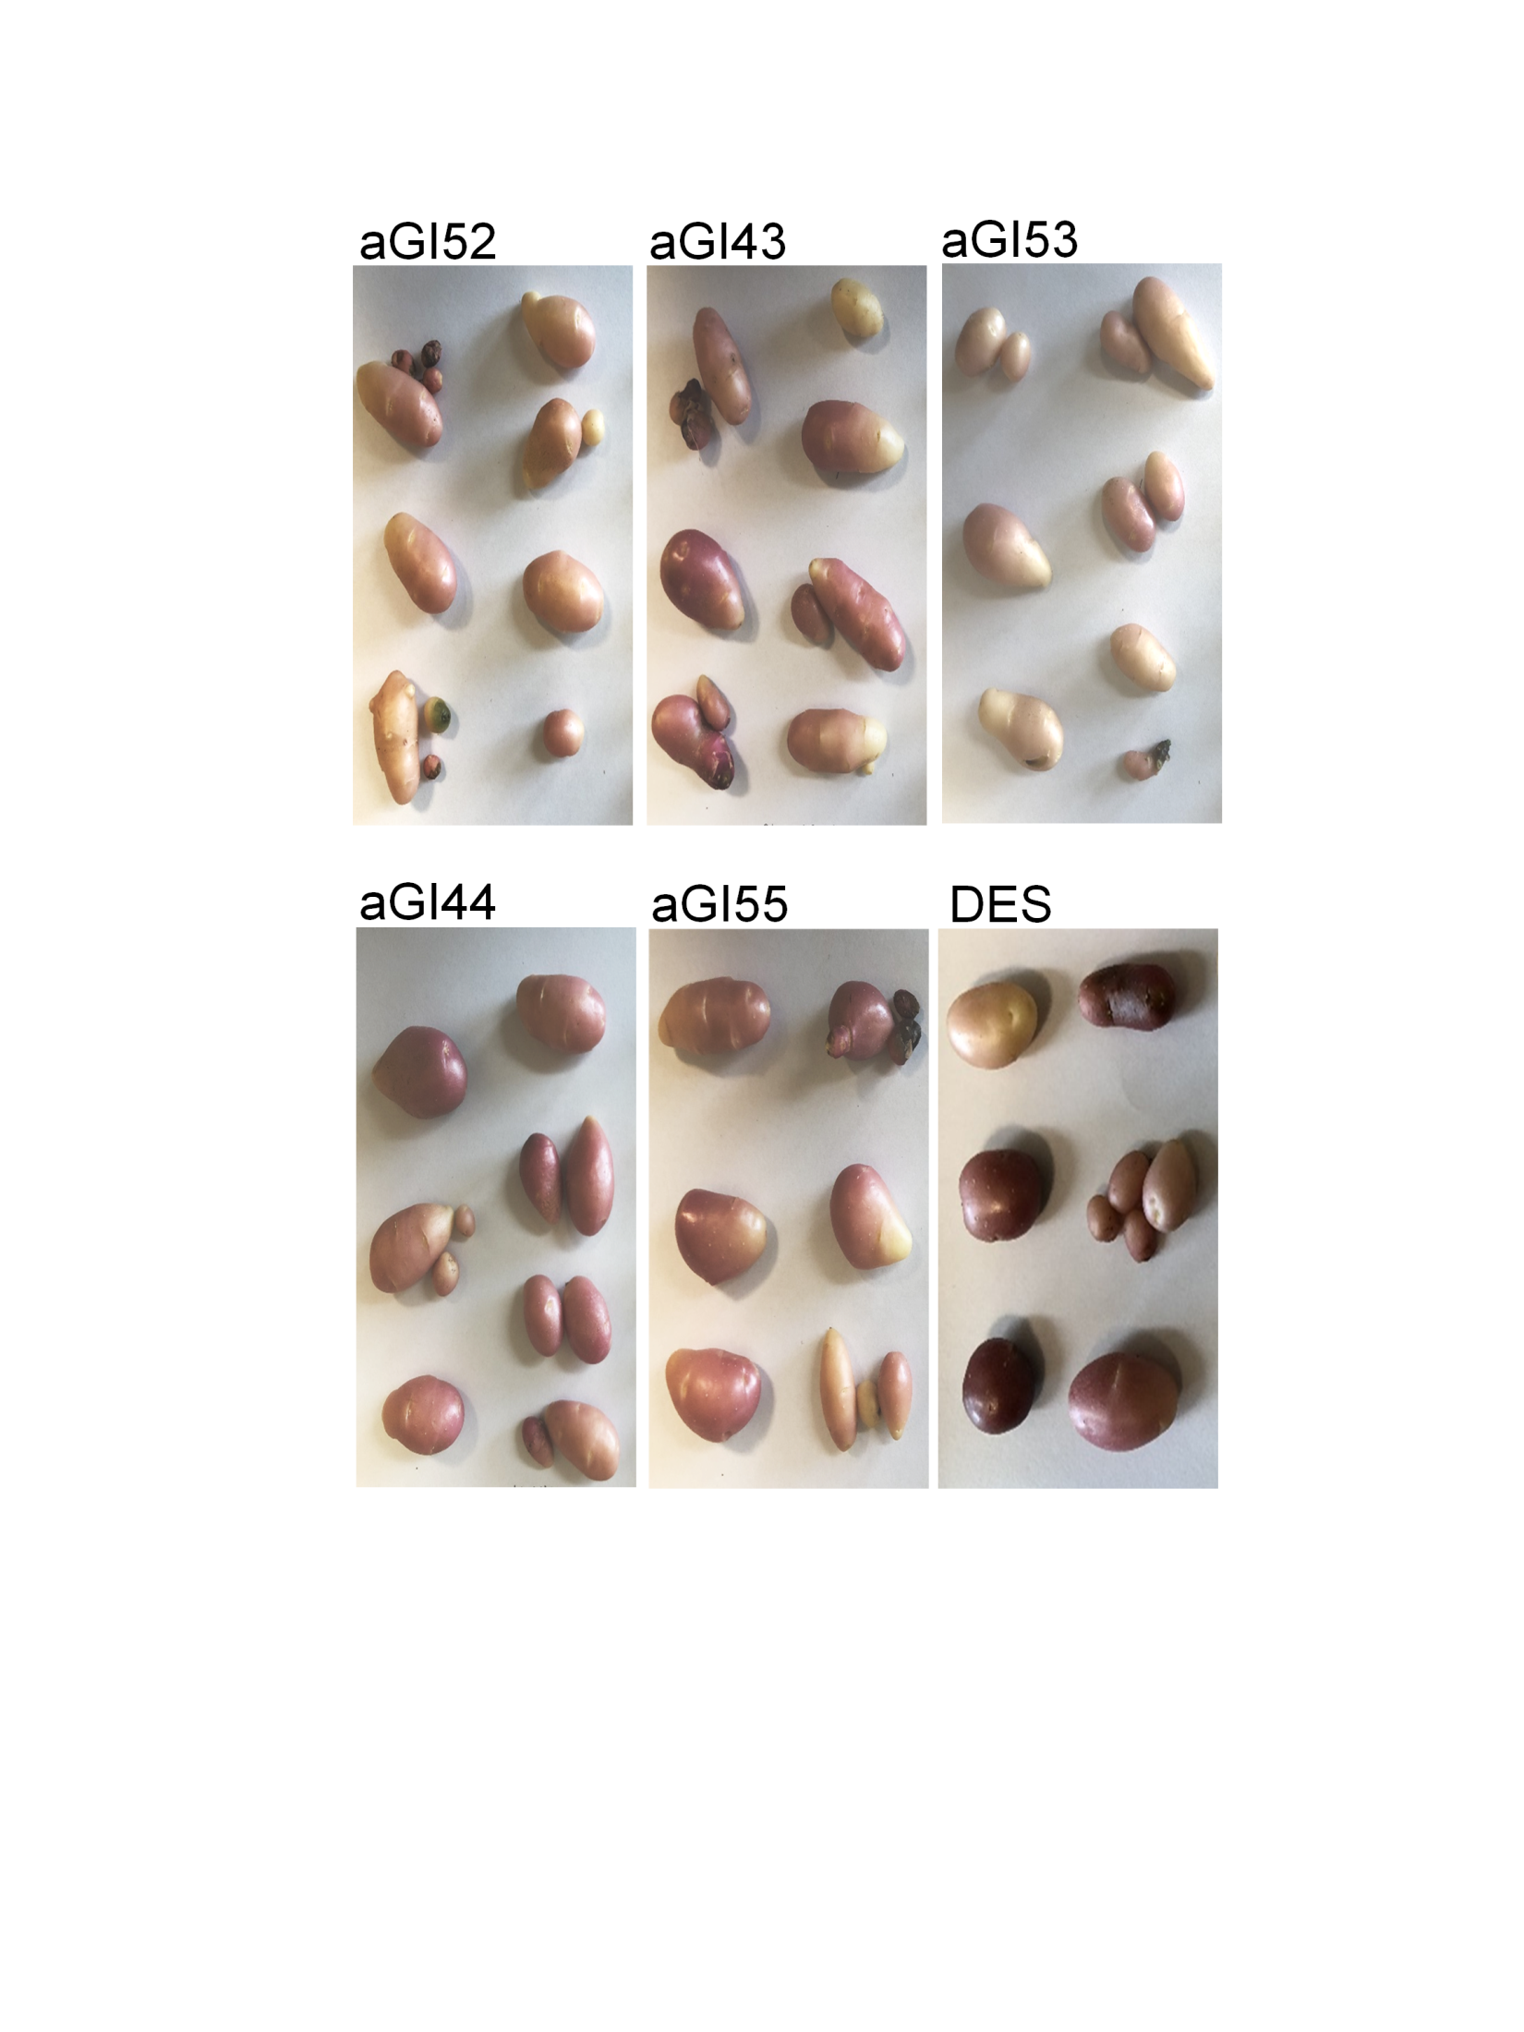
(a)
aGI52
aGI44
aGI43
aGI55
aGI53
DES
(b)
*
*
**
Fig. S3 Morphology of mature tubers collected from 6-7 plants/line grown in a greenhouse in pots (a). Anthocyanin content of tubers related to the non-transformed 'Désirée' (DES) control (b). Significant differences between the aGI lines and DES were detected by Student t-test and labelled by * (p < 0.05) and ** (p < 0.01).

Slide 4
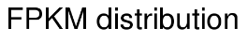


I
Fig. S4 Boxplot showing the FPKM distributions and a table presenting the distribution of FPKM intervals.

Slide 5
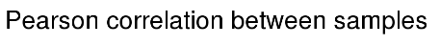

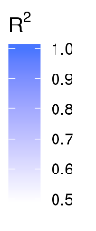
Fig. S5 Heatmap of the correlation coefficients between samples.

Slide 6
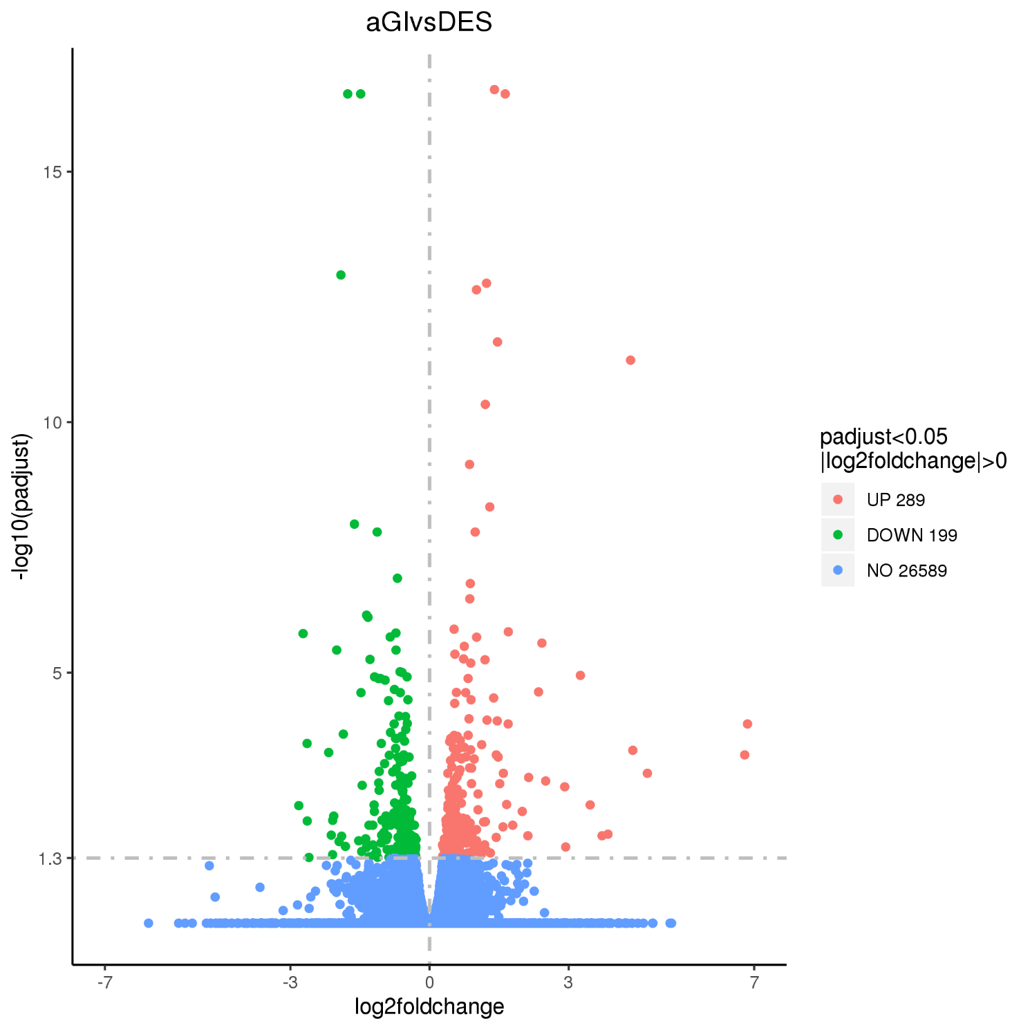
Fig. S6 Vulcano plot for differentially expressed genes. The x-axis shows the fold change in gene expression between different samples. The y-axis shows the statistical significance of the differences. Significantly up- and down-regulated genes are in red and green, respectively. Genes, which are not expressed differently between aGI52 and 'Désirée' leaves are in blue.

Slide 7
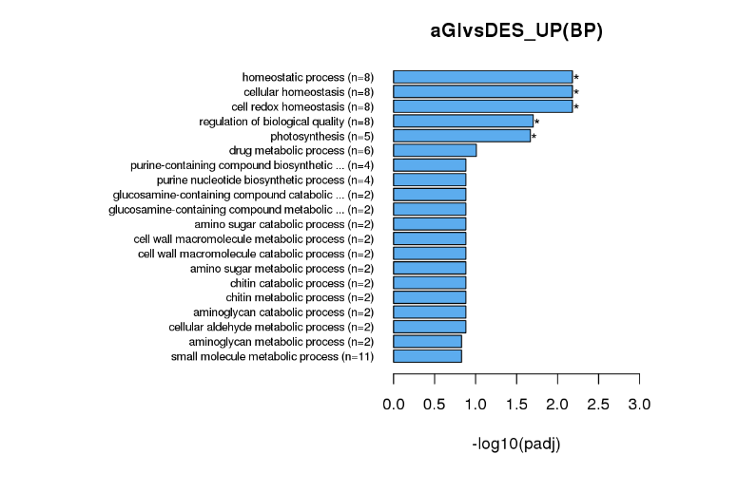
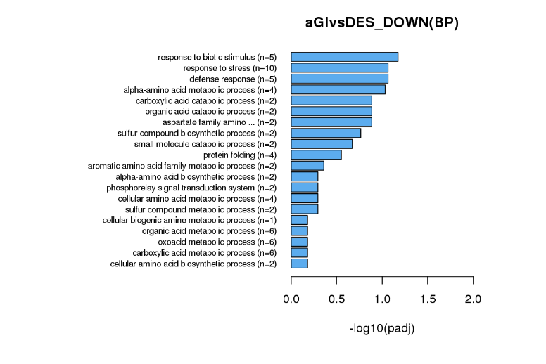
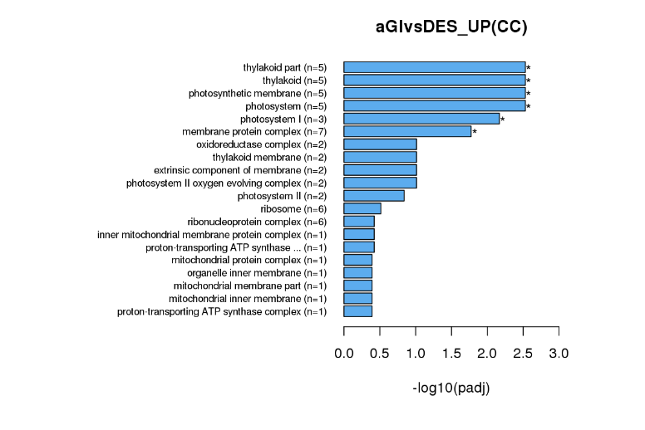
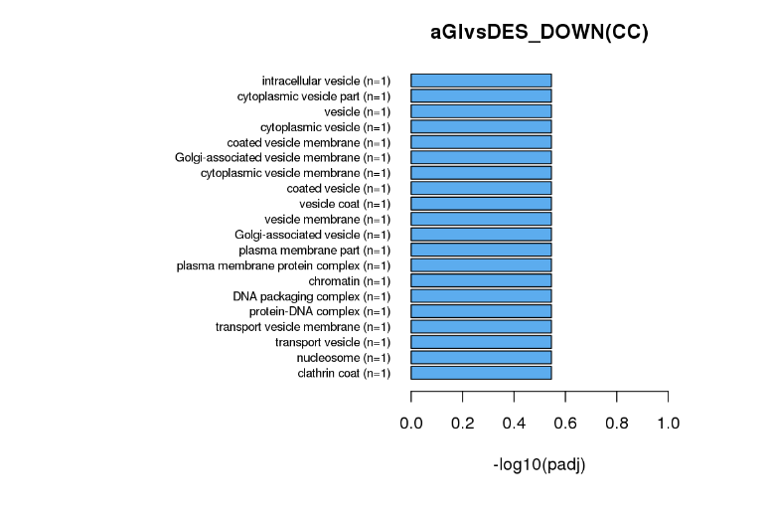
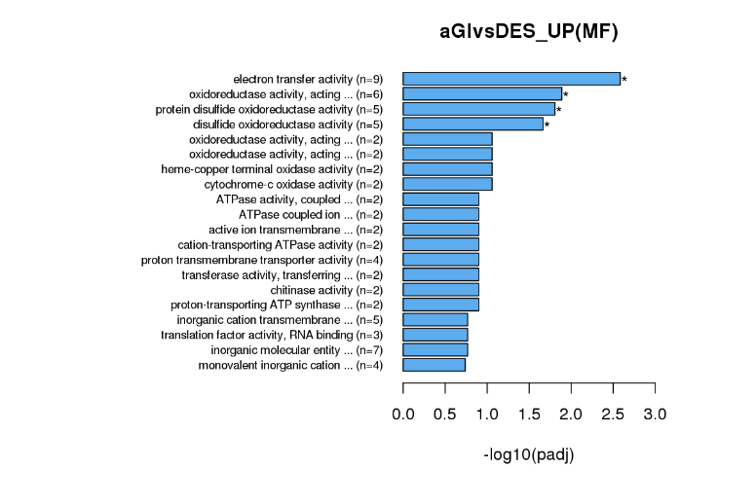
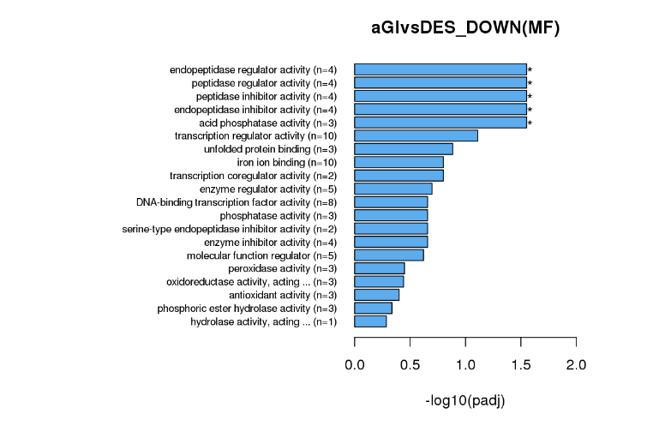
Fig. S7 Gene onthology (GO) functional classification. Number of DEGs is shown in parenthesis. The significently enriched GO terms are marked by asterisks. BP, biological process; CC, cellular component; MF, molecular function.

Slide 8
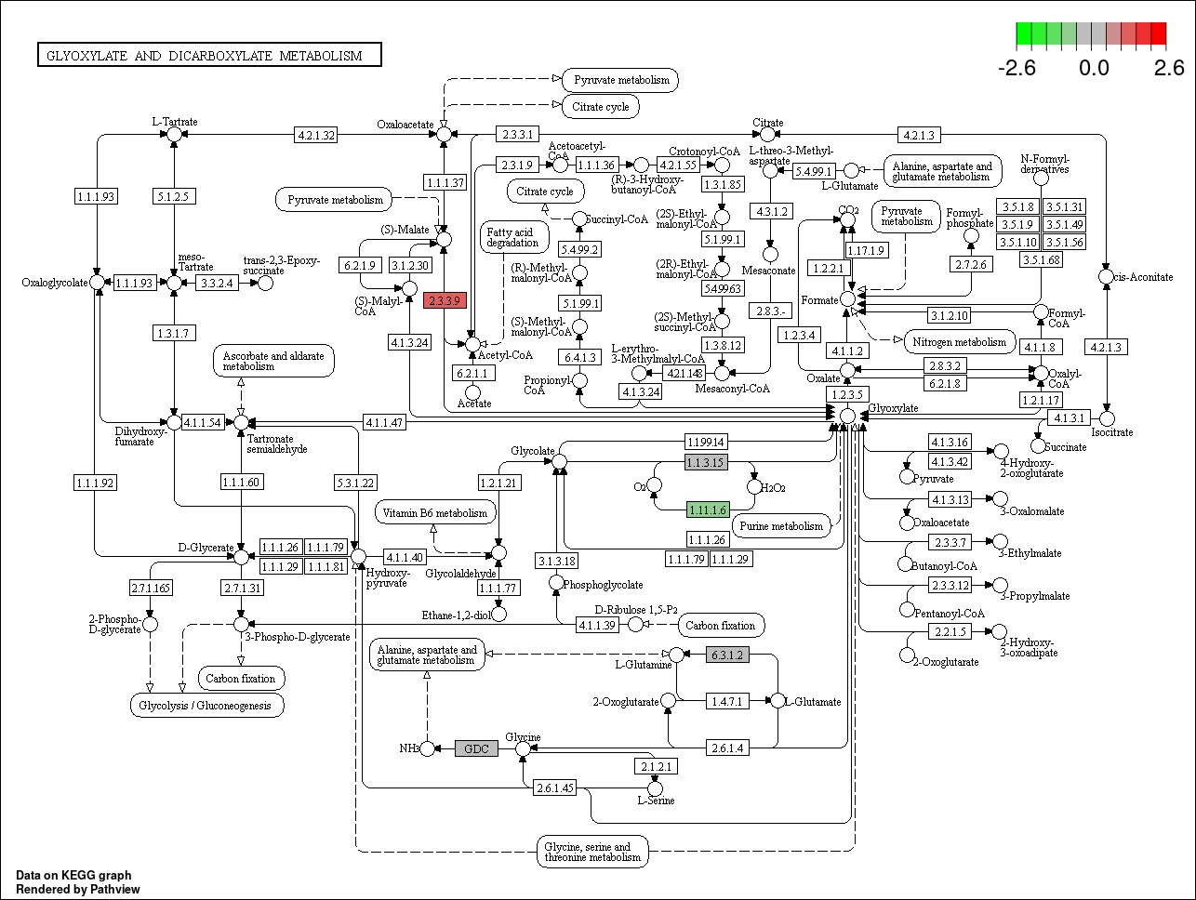
Fig. S8 KEGG pathway of glyoxalate and dicarboxylate metabolism showing the up- and down-regulated genes in aGI52 leaves compared to 'Désirée' leaves in red and green, respectively. 2.3.3.9, malate synthase; 1.11.1.6, catalase.
Reference:
Kanehisa M, Goto S. KEGG: Kyoto Encyclopedia of Genes and Genomes. Nucl Acids Res. 2000;28:27-30. https://doi.org/10.1093/nar/28.1.27

Slide 9
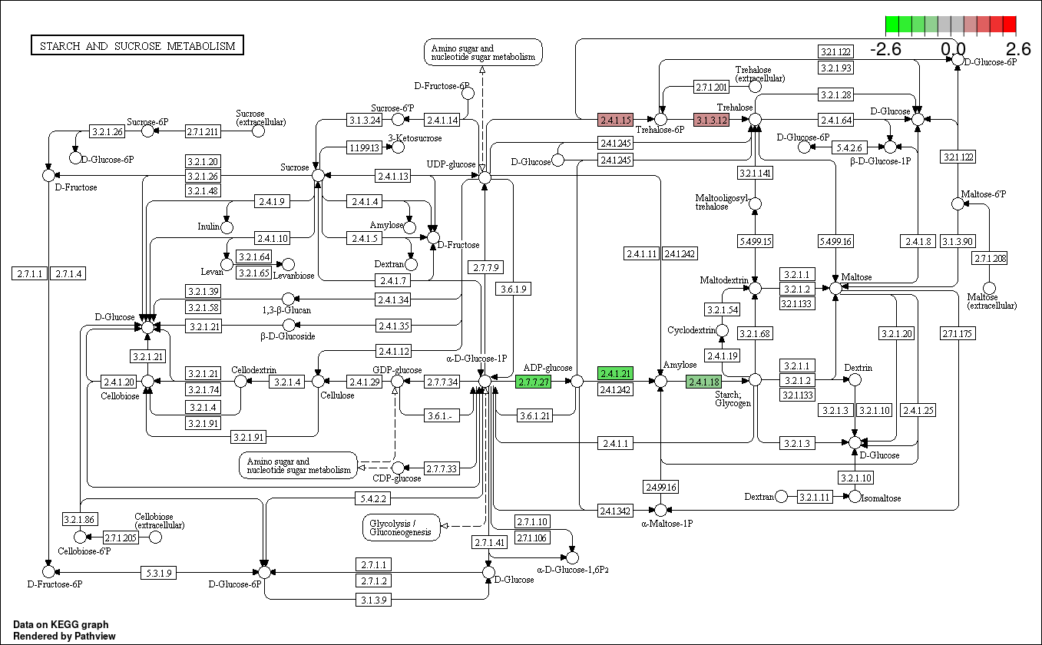
Fig. S9 KEGG pathway of starch and sucrose metabolism showing the up- and down-regulated genes in aGI52 leaves compared to 'Désirée' leaves in red and green, respectively. 2.4.1.15, trehalose-6-phosphate synthase; 3.1.3.12, trehalose-6-phosphate phosphatase; 2.7.7.27, glucose-1-phosphate adenylyltransferase; 2.4.1.21, starch synthase; 2.4.1.18, 1,4-alpha-glucan branching enzyme.
Reference:
Kanehisa M, Goto S. KEGG: Kyoto Encyclopedia of Genes and Genomes. Nucl Acids Res. 2000;28:27-30. https://doi.org/10.1093/nar/28.1.27

Slide 10
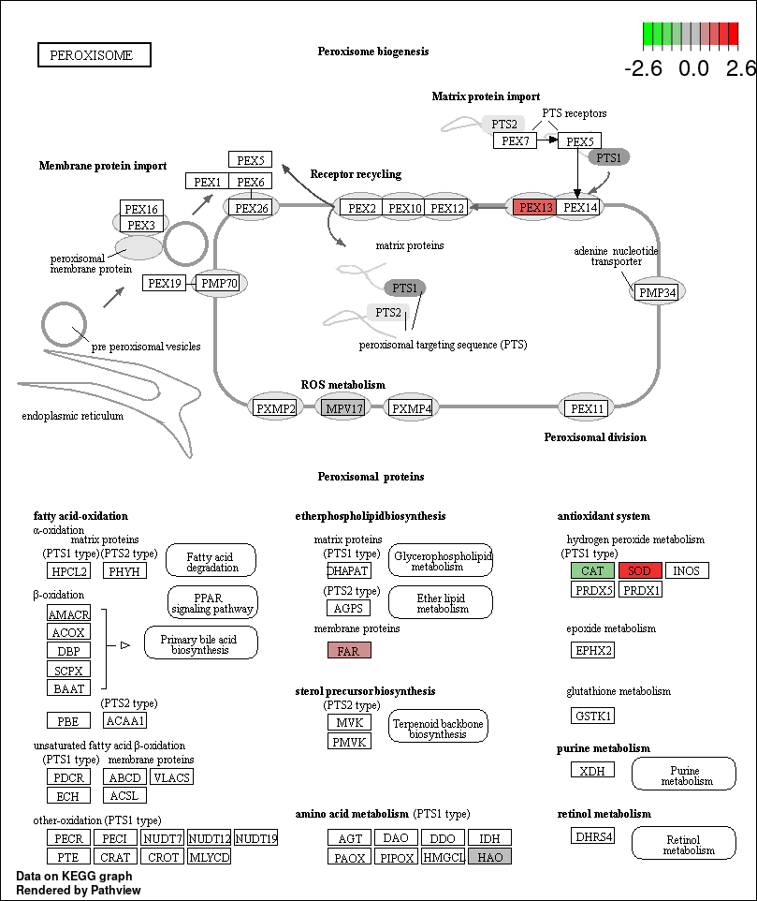
Fig. S10 KEGG pathway of peroxisome showing the up- and down-regulated genes in aGI52 leaves compared to 'Désirée' leaves in red and green, respectively. PEX13, peroxin-13; CAT, catalase, SOD, superoxide dismutase; FAR, alcohol-forming fatty acyl-CoA reductase.
Reference:
Kanehisa M, Goto S. KEGG: Kyoto Encyclopedia of Genes and Genomes. Nucl Acids Res. 2000;28:27-30. https://doi.org/10.1093/nar/28.1.27

Slide 11
Fig. 11. Sequence aligment of
StMYB-Hv1-related proteins
Notes:
Gm.like IAlPSPNrlpIVEdk------LtpNsksktldId-idLnc
CcMYB4 IAlPSPiyrlaVvEdkptTpn---sEsaktWdmnnidLnc
Gh.like IAfPSspIkNIIEESQQKiASIVTNDEEEEYTVPTLlLFR
Gh.like5a IAfPSspIkNIIEESQQKTASIVTNDEEEQYTVPTLlLFR
Gh.like5b IAfPSspIkNIIEESQQKTASIVTNDEEEQYTVPTLlLFR
Gr.like6b IAfPSspIkNIIEESQkKTASIVTNDEEEQYTVPTLlLFR
Gh.like6a IAfPSspIkNIIEESQQKTASIVTNDEEEQYTVPTLlLFR
Gh.like6b IAfPSspIkNIIEESQQKTASIVTNDEEEQYTVPTLlLFR
V.unnamed1 ttsslPDLN------------LnlNvgapsknyPnktq--
J.like IAvPSPaVNtatlEtrpencdasatgEvrseTlPaLlLFl
V.unnamed2 IAvPSPaVNtatlEtrpencdasatgEvrseTlPaLlLFl
St.Hv1 pirslPDLN----------------------slPsihp--
N.like pigslPDLN----------------------slPsihp--
Sl.like3 VtsslPDLN----------------------slP------
Sl.like1 ItssllDLN----------------------lIP------
Sl.like2 ItssllDLN----------------------lIP------

Slide 12
XbaI
BamHI
SmaI
KpnI
NotI
EcoRI
SstI
p35S
tnos
tnos
nptII
LB
pnos
RB
pCP60
12.42 kb
nptIII
Fig. S12 Map of the binary vector pCP60. LB, left border; RB, Right border; nptII, neomycin phosphotranspherase II; nptIII, neomycin phosphotranspherase III; pnos, nos promoter; tnos, nos terminator; p35S, CaMV35S promoter. Restriction enzyme recognition sites in the multicloning site are indicated in the map.

