Slide 1
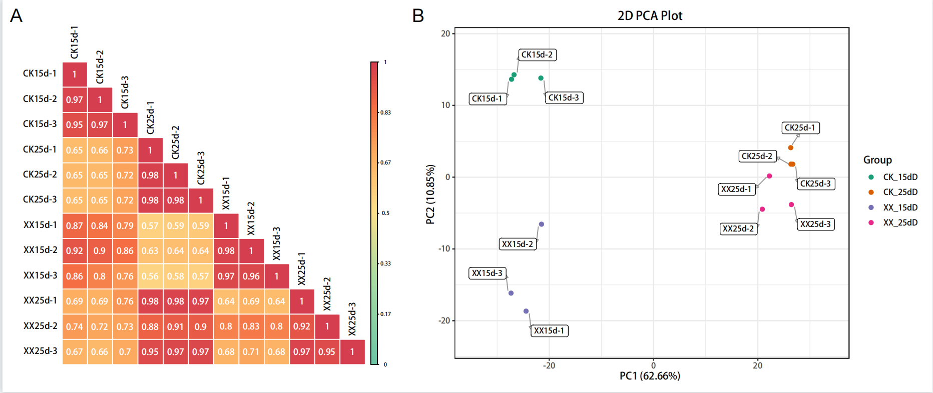
Figure S1. Qualitative analysis of metabolomics data. (A) Heatmap showing Pearson correlation coefficients among all samples. (B) Principal component analysis (PCA) of all samples.

Slide 2
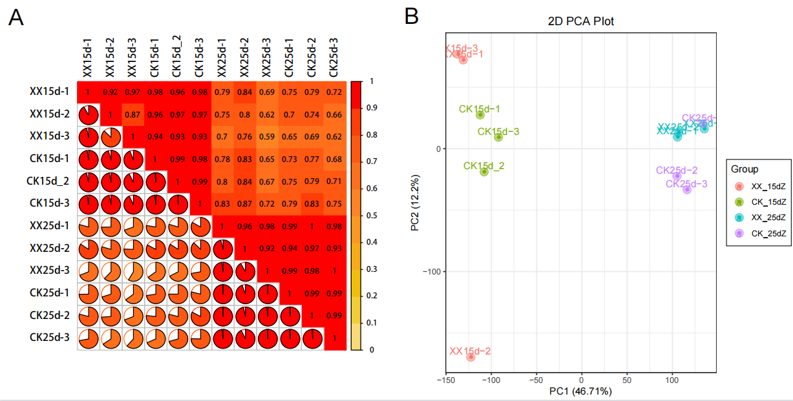
Figure S2. Qualitative analysis of transcriptomics data. (A) Heatmap showing Pearson correlation coefficients among all samples. (B) Principal component analysis (PCA) of all samples.

Slide 3
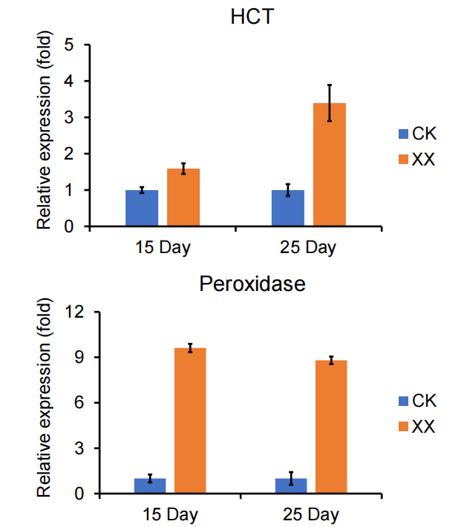
Figure S3. qRT-PCR validation on the expression of genes HCT and peroxidase. Relative expression levels were calculated using β-actin as an internal control. XX indicate uniconazole treatment, and CK indicate control.

