Slide 1
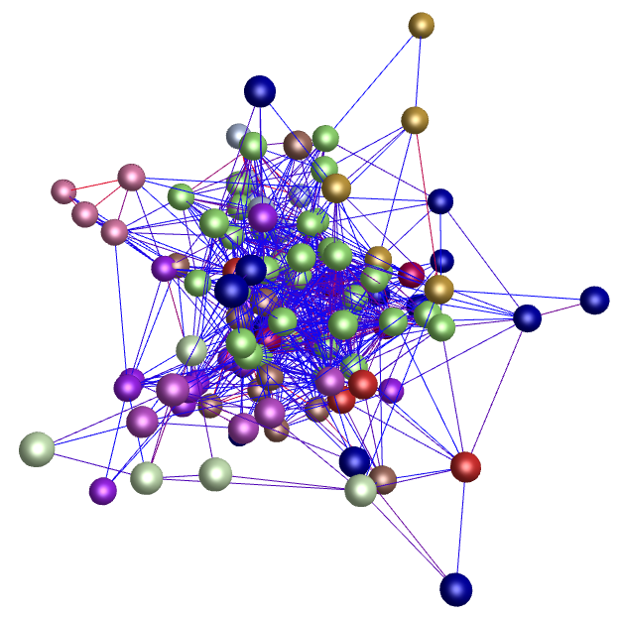
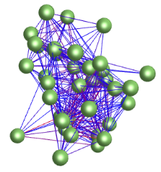
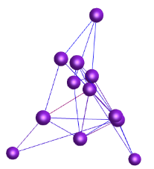
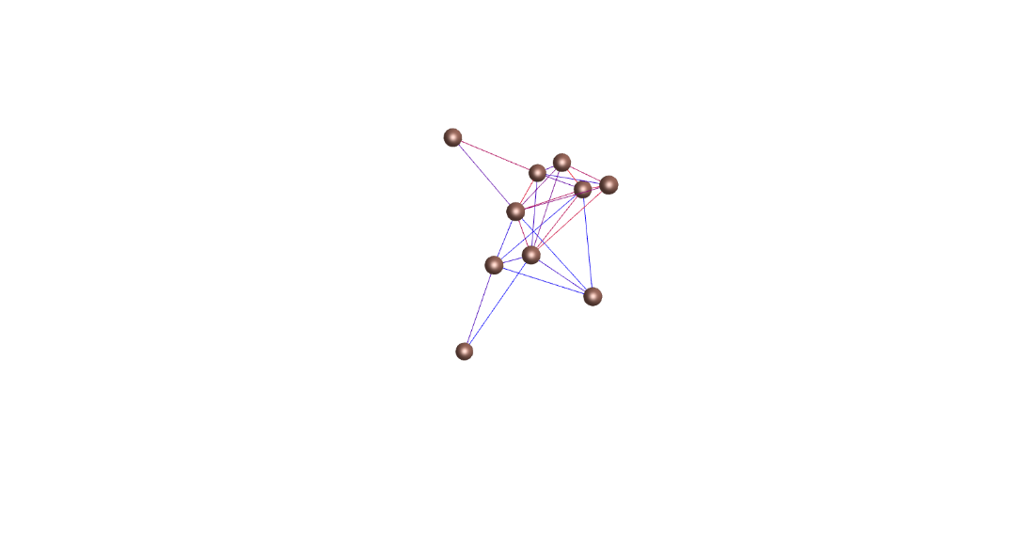
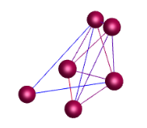
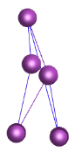
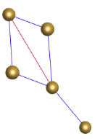
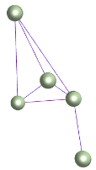
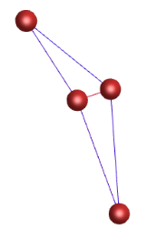
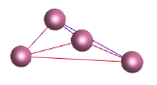
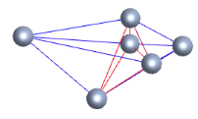
a
b
c
d
117 PgHDZ gene transcripts
117 PgHDZ gene transcripts
117 random unknown transcripts
117 random unknown transcripts
Number of nodes
Number of edges
5.0E-02
1.0E-02
1.0E-03
1.0E-04
1.0E-05
1.0E-06
1.0E-07
1.0E-08
5.0E-02
1.0E-02
1.0E-03
1.0E-04
1.0E-05
1.0E-06
1.0E-07
1.0E-08
p-value for network construction
p-value for network construction
e
f
A
A
100 PgHDZ gene transcripts
100 PgHDZ gene transcripts
B
100 random unknown transcripts
A
100 random unknown transcripts
B
A
Number of nodes
A
A
Number of edges
A
B
A
A
A
B
B
B
B
A
B
B
B
B
A
A
A
A
A
B
B
B
B
B
5.0E-02
1.0E-02
1.0E-03
1.0E-04
1.0E-05
1.0E-06
1.0E-07
1.0E-08
5.0E-02
1.0E-02
1.0E-03
1.0E-04
1.0E-05
1.0E-06
1.0E-07
1.0E-08
p-value for network construction
p-value for network construction
Figure S4. The co-expression network of the PgHDZ gene transcripts expressed in four-year-old plant roots of 42 cultivars. (a) The co-expression network of the PgHDZ gene transcripts constructed at p ≤ 5.0E-02. (b) Ten clusters of the co-expression network. (c and d) The co-expression network formation tendency of the PgHDZ gene transcripts presented by the number of nodes (c) and the number of edges (d). (e and f) Statistics of the co-expression network formation tendency of the PgHDZ gene transcripts presented by the number of nodes (e) and the number of edges (f). The 100 PgHDZ and unknown transcripts were randomly selected with 20 bootstraps. The capital letter represents that the difference between PgHDZ and random unknown transcripts was significant at p ≤ 1.0E-02.

