Slide 1
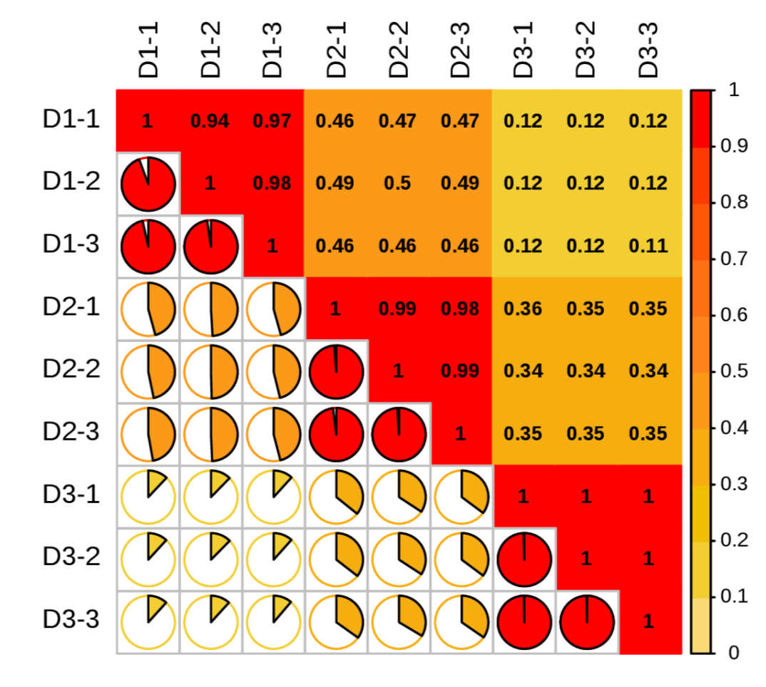
Cd-d10-1
Cd-d10-2
CK-d0-1
CK-d0-3
Cd-d10-3
CK-d0-2
Cd-d0-1
Cd-d0-2
Cd-d0-3
CK-d0-1
CK-d0-2
CK-d0-3
Cd-d0-1
Cd-d0-2
Cd-d0-3
Cd-d10-1
Cd-d10-2
Cd-d10-3
Fig. S1. Correlations analysis of samples. Control (CK-d0), stressed plants at the end of Cd treatment (Cd-d0) and ten days after the end (Cd-d10).

Slide 2
Fig. S2. Distribution of transcripts and unigenes lengths.

Slide 3
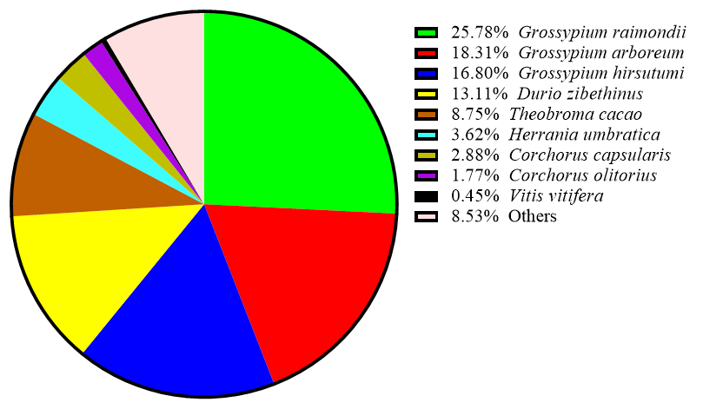
Fig. S3. Similarity rate of unigenes to known genes in other species

Slide 4
A
B
Fig. S4. HCA and PCA analysis of RNA-seq data of samples. Control (CK-d0), stressed plants at the end of Cd treatment (Cd-d0) and ten days after the end (Cd-d10).

Slide 5
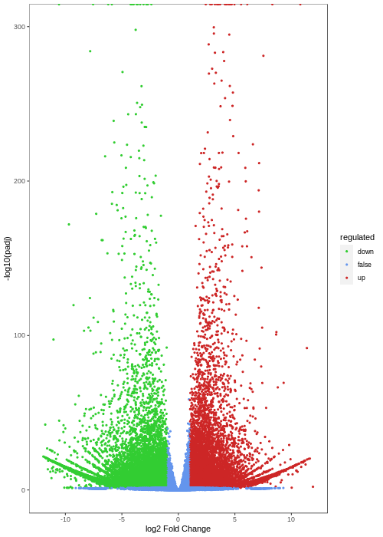
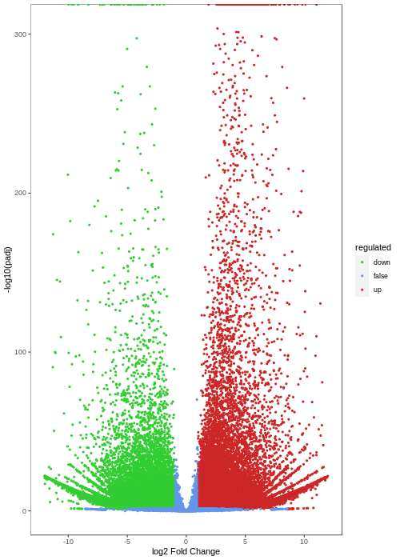
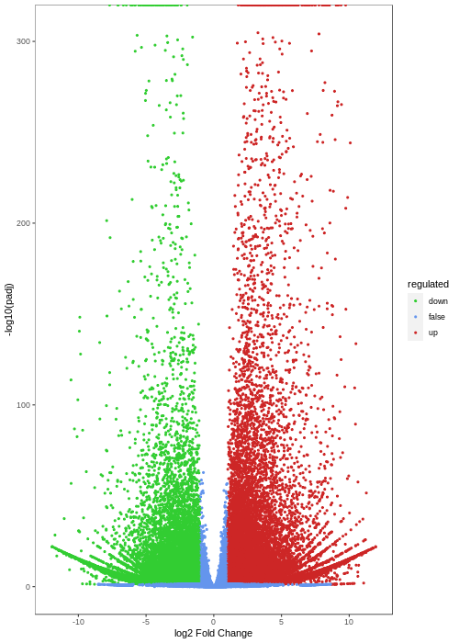
A
B
C
Fig. S5. Volcano plot of DEGs between CK-d0 and Cd-d0 (A), Ck-d0 and Cd-d10 (B), and Cd-d0 and Cd-d10 (C).

Slide 6
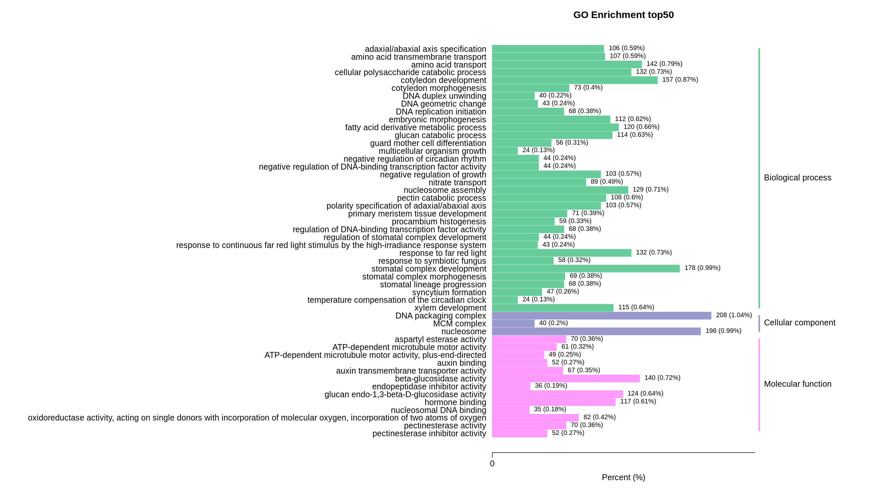
Fig. S6. GO term enrichment results of the DEGs between CK-d0 and Cd-d0

Slide 7
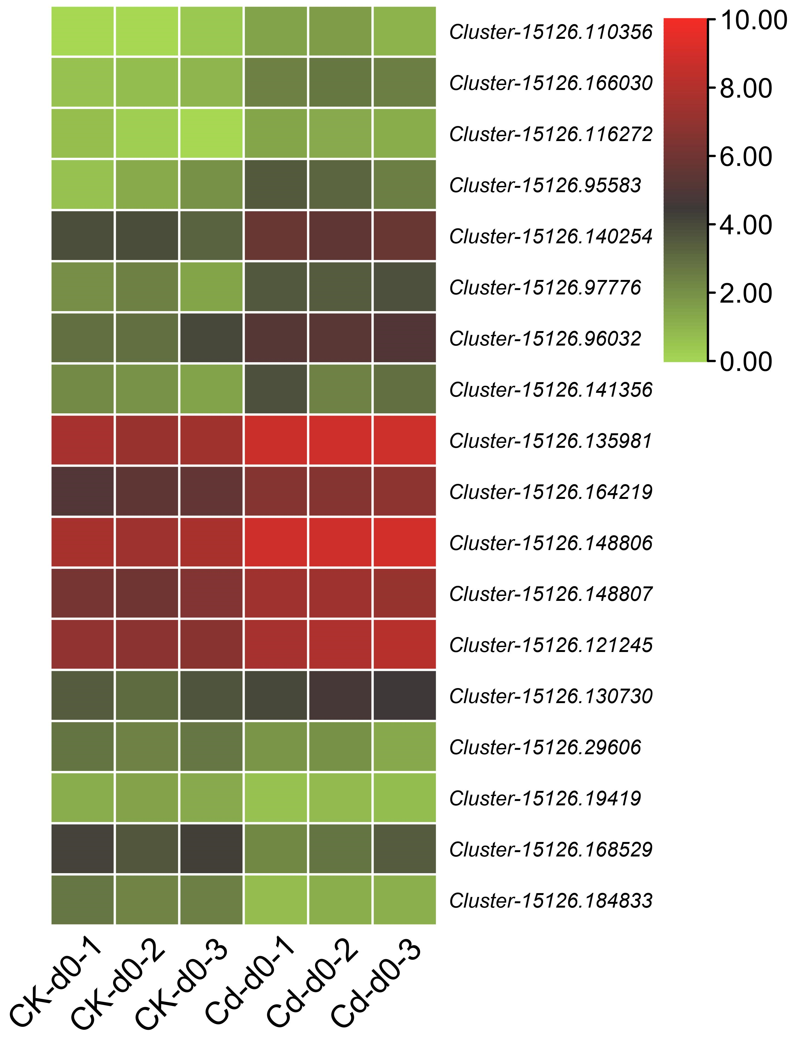
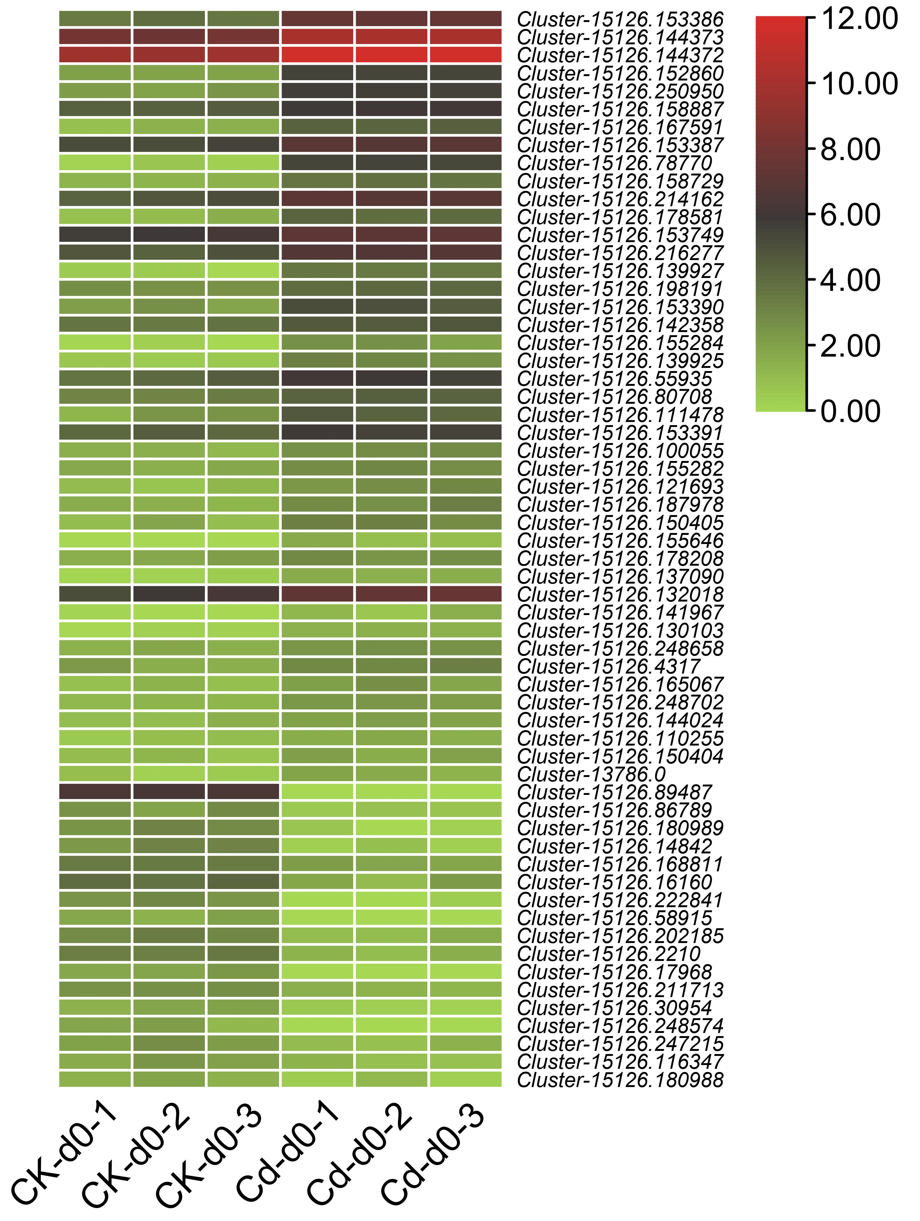
A
B
Fig. S7. Heatmap of log2FC values of the DEGs enriched in heat shock proteins (A) and late embryogenesis abundant (LEA) proteins (B).

Slide 8
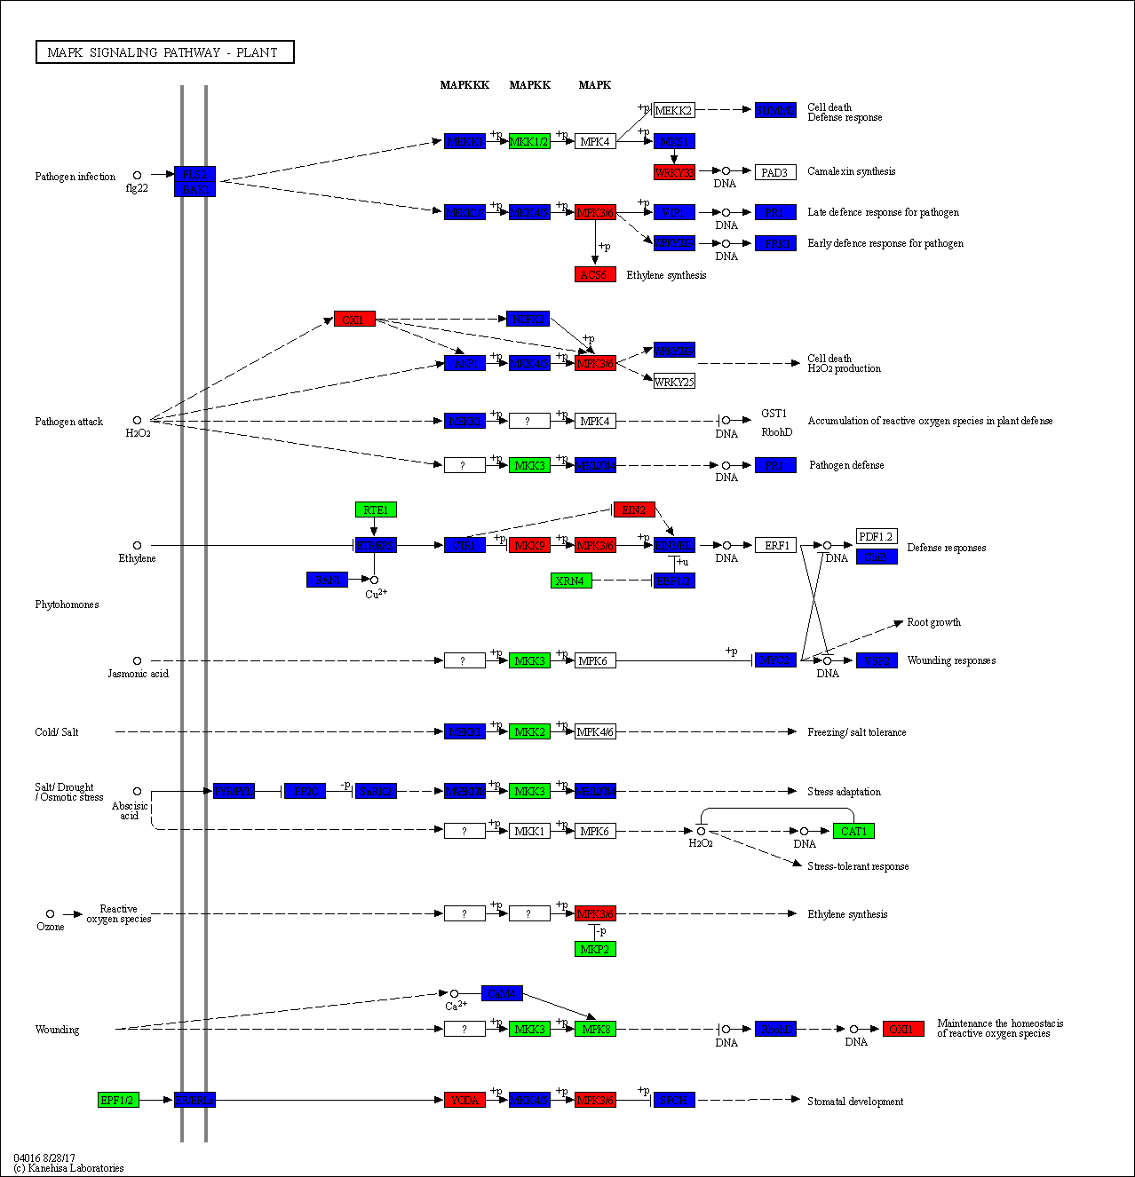
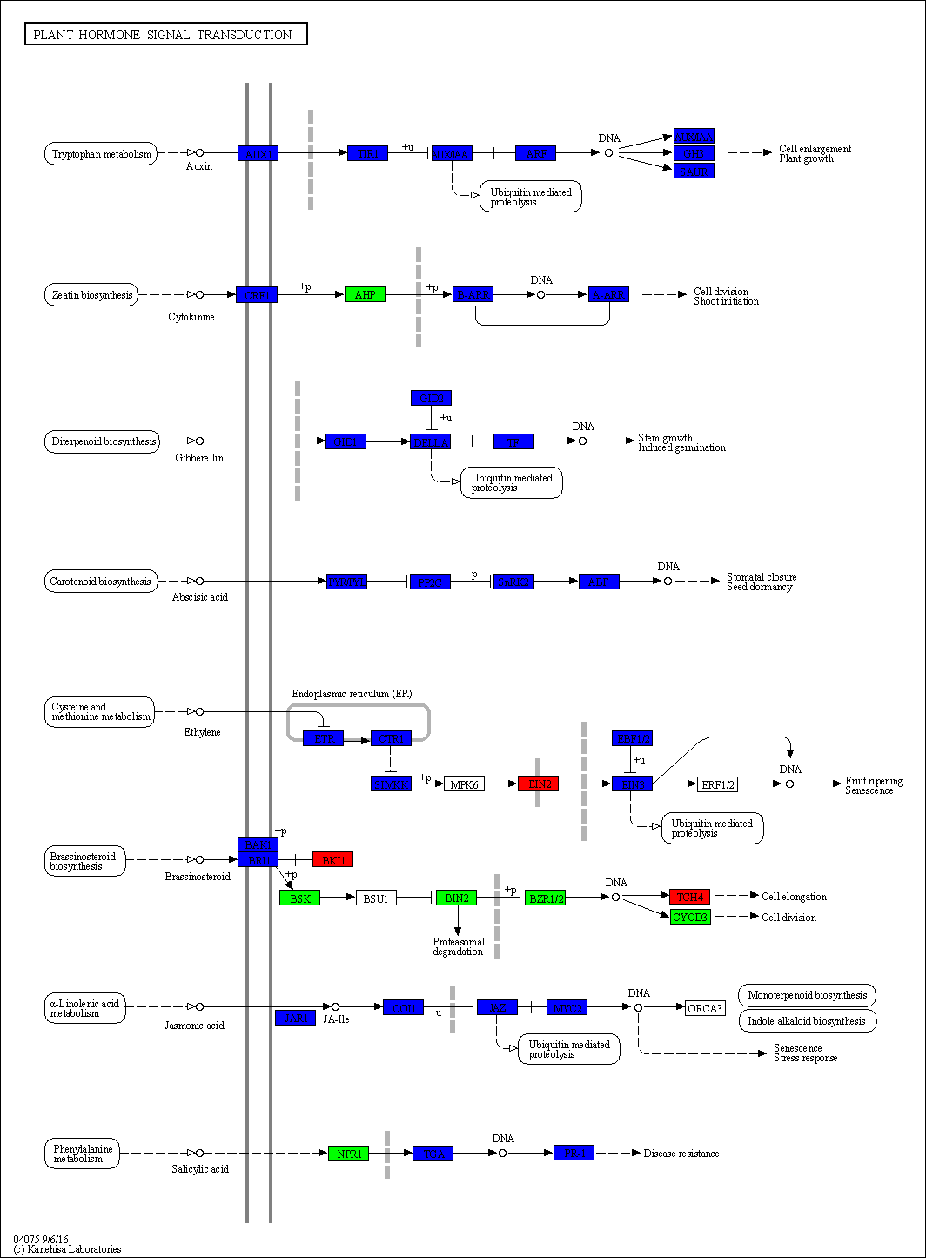
Fig. S8. KEGG enrichment maps of the DEGs between CK-d0 and Cd-d0 involved in MAKP signaling pathway (A) and plant hormone signal transduction (B).

Slide 9
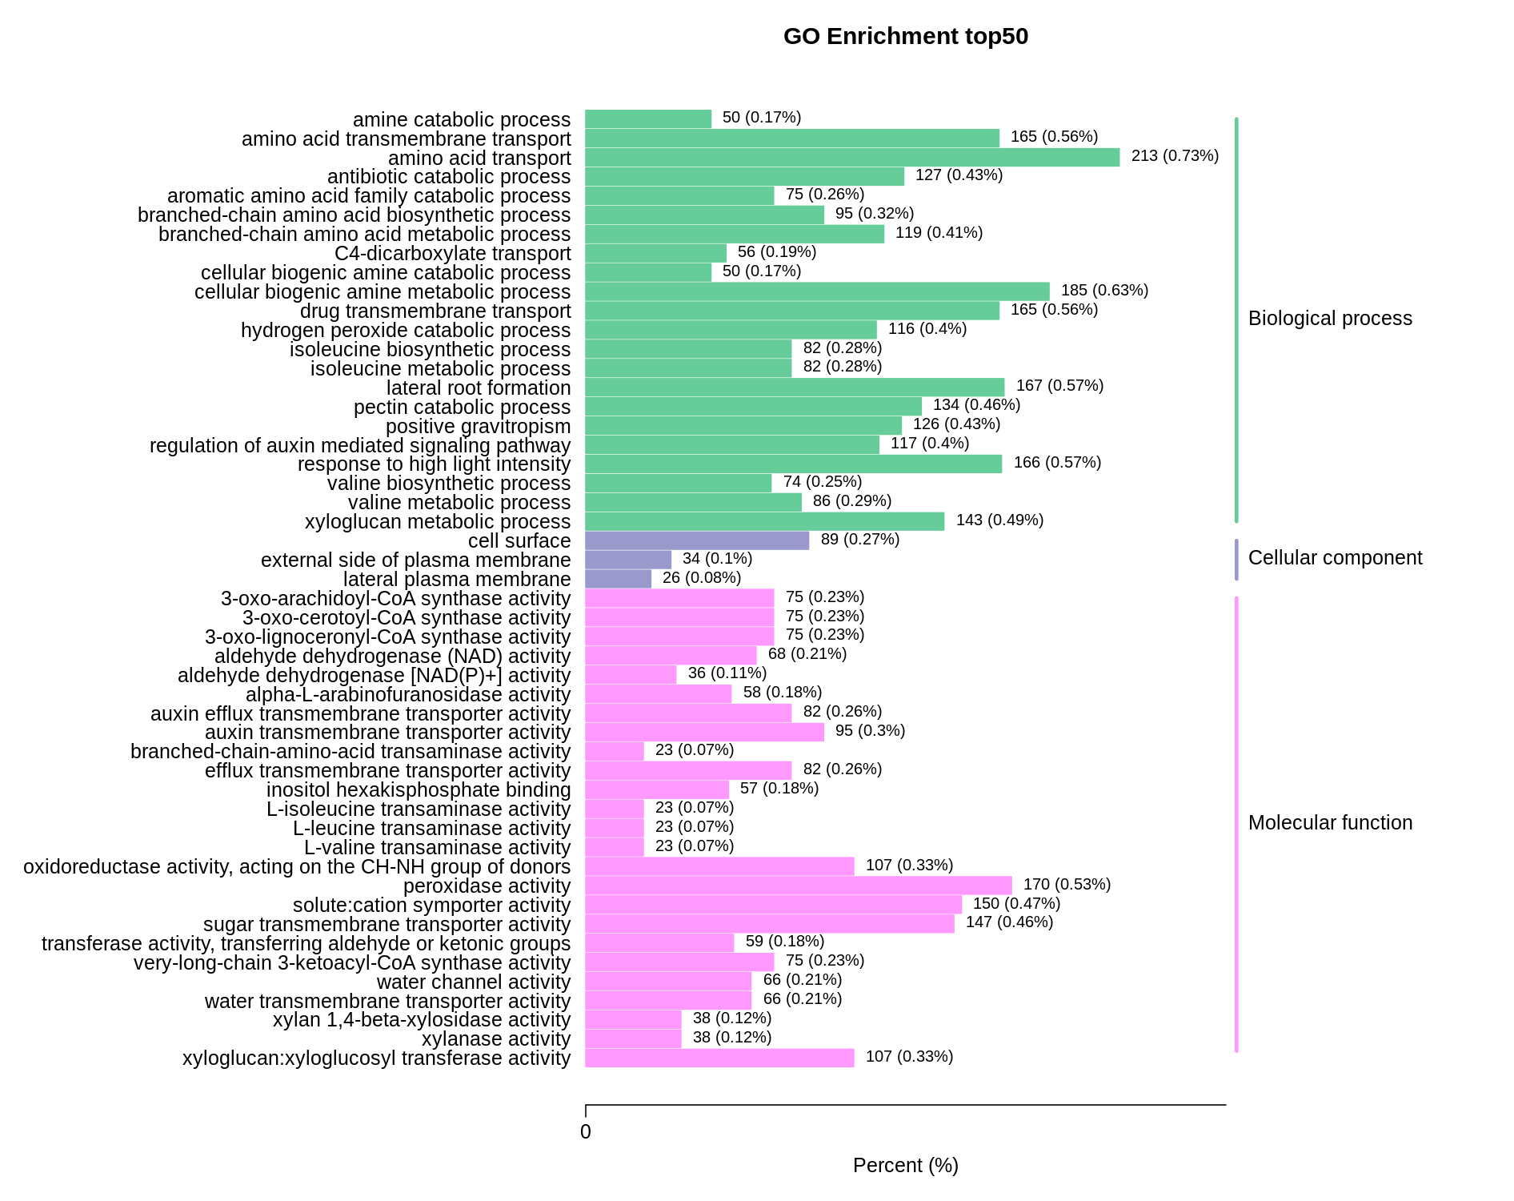
Fig. S9. GO term enrichment results of the DEGs between Cd-d0 and Cd-d10

Slide 10
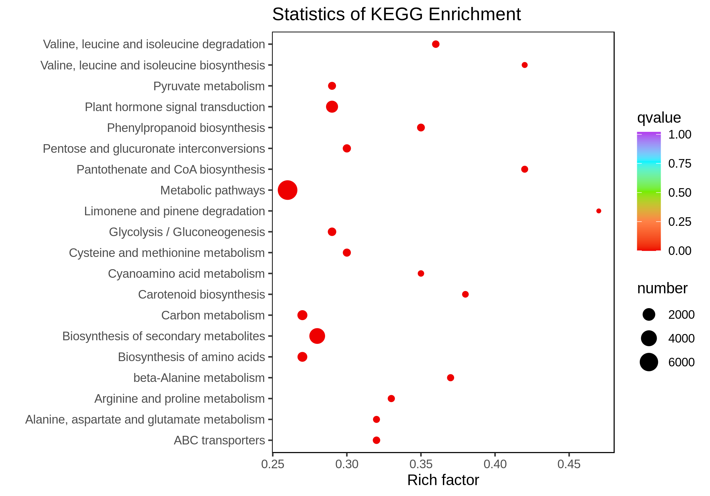
Fig. S10. KEGG annotation and enrichment results of the DEGs between Cd-d0 and Cd-d10

