Slide 1
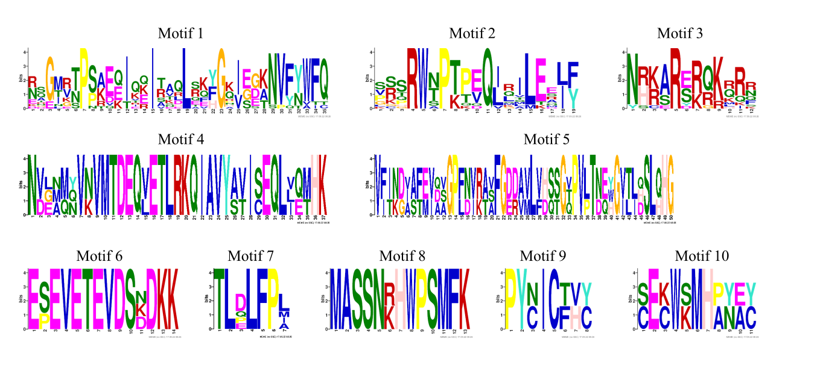
A
C
B
Figure S1. Phylogenetic relationships and conserved motifs of MsWOXs.
A-B: Identification of conserved motifs of MsWOX TFs. Rectangles with different colors represented different conserved motifs. The same conserved motifs are indicated by the same color (A). Amino acid sequences of each conserved motif are listed below (B). C: homeobox domains of MsWOXs were indicated using different color rectangles.

Slide 2
Figure S2. Chromosome location of MsWOX genes in alfafa.
Distributions of MsWOX genes in alfalfa cv. Zhongmu No.1.

Slide 3
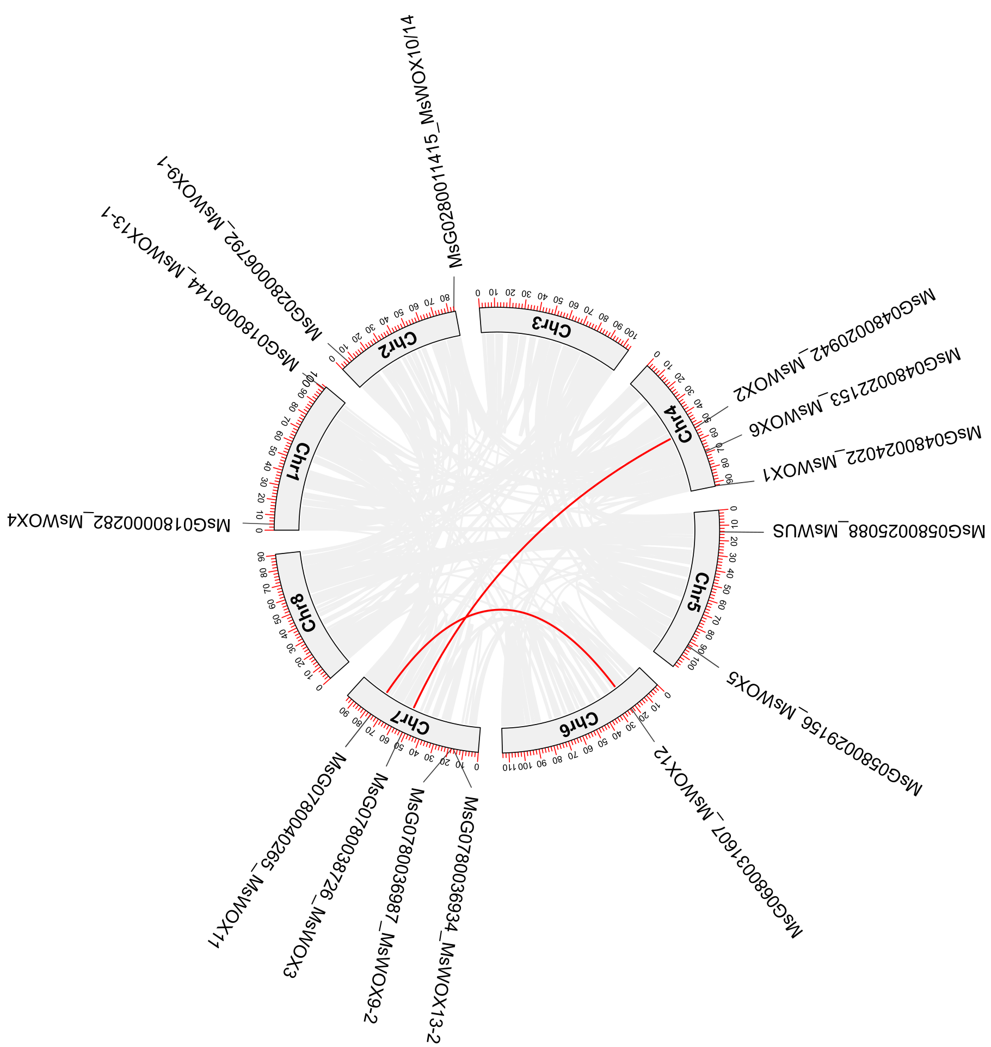
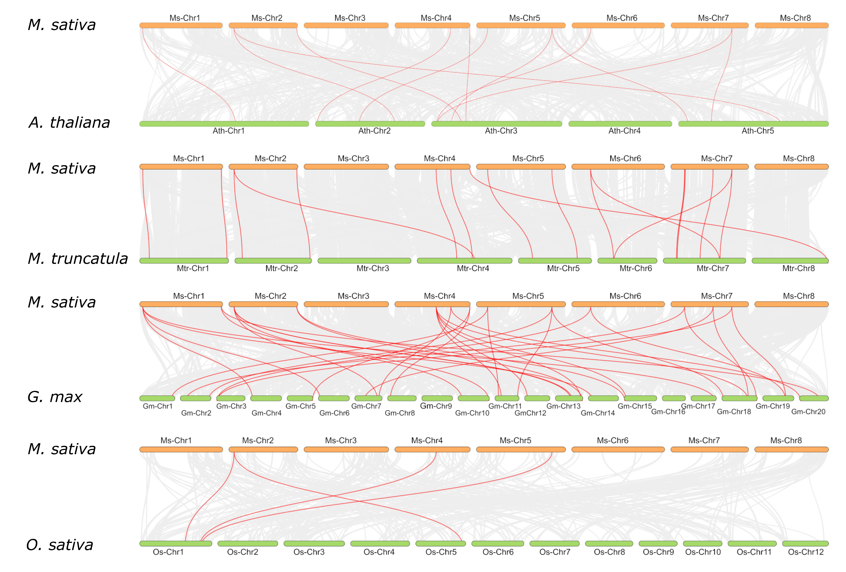
A
B
Figure S3. Synteny analyses of WOX genes.
A: Intraspecific Synteny analysis of MsWOX genes in M. sativa cv. Zhongmu No.1. B: Interspecific synteny analyses of M. sativa compared to A. thaliana, M. truncatula, G.max, and O. sativa. The serial number is expressed on each chromosome.

