Slide 1
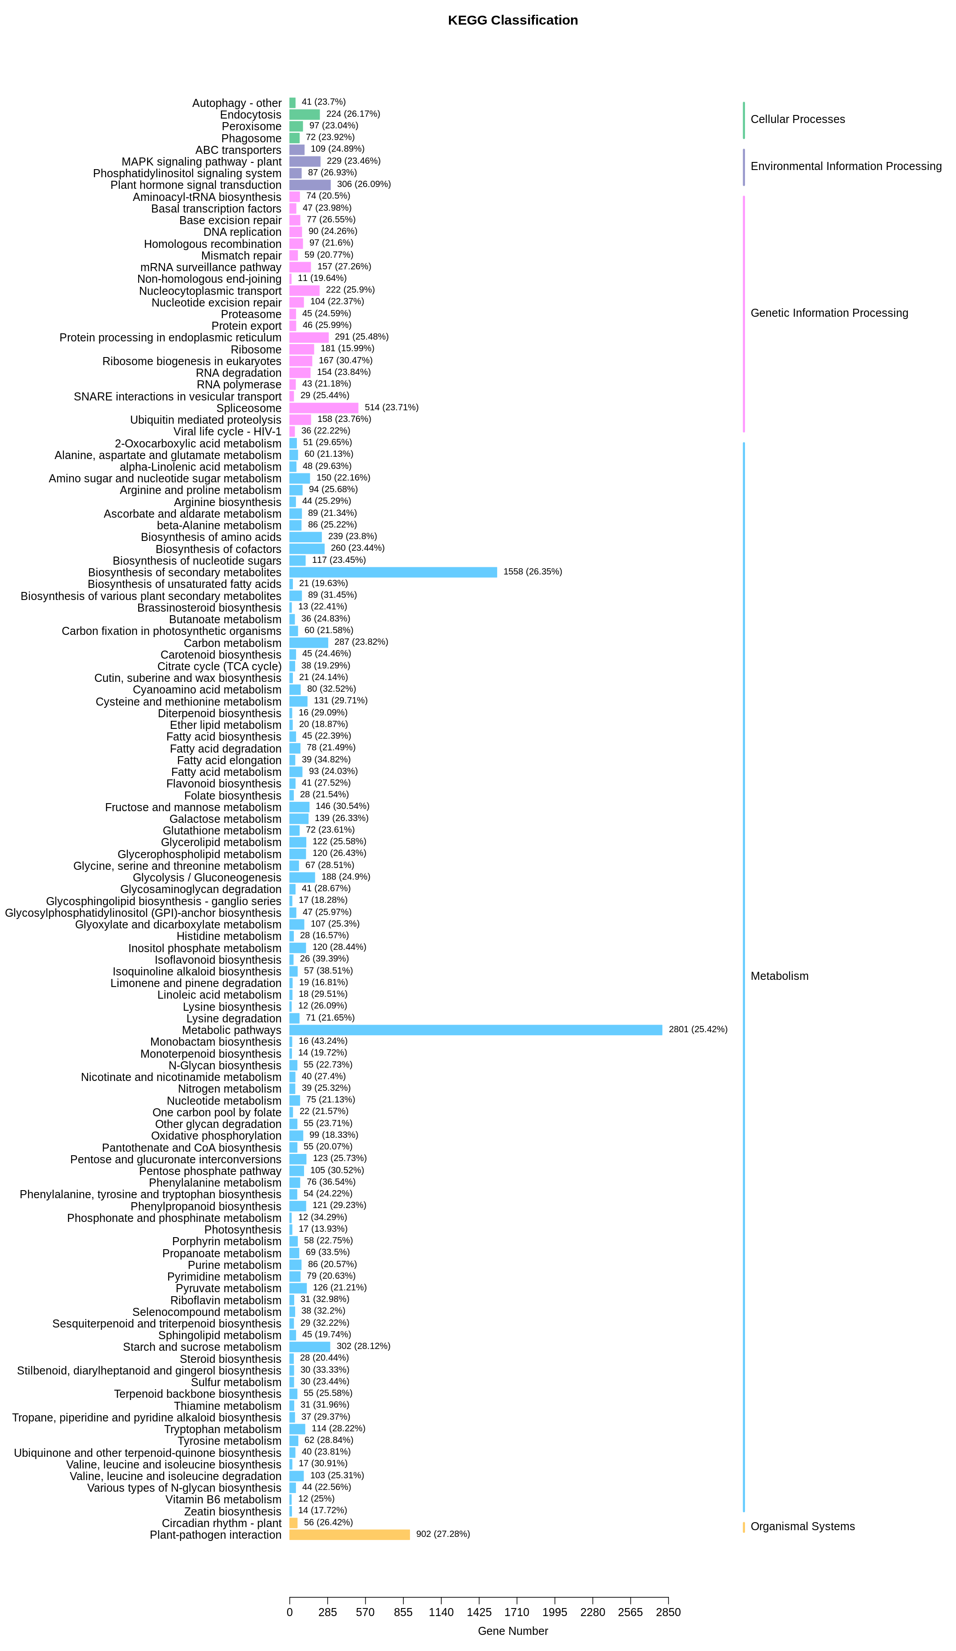
a
Supplementary Figure 2. Classification and enrichment of the differentially expressed genes in a) KEGG and b) GO databases.

Slide 2
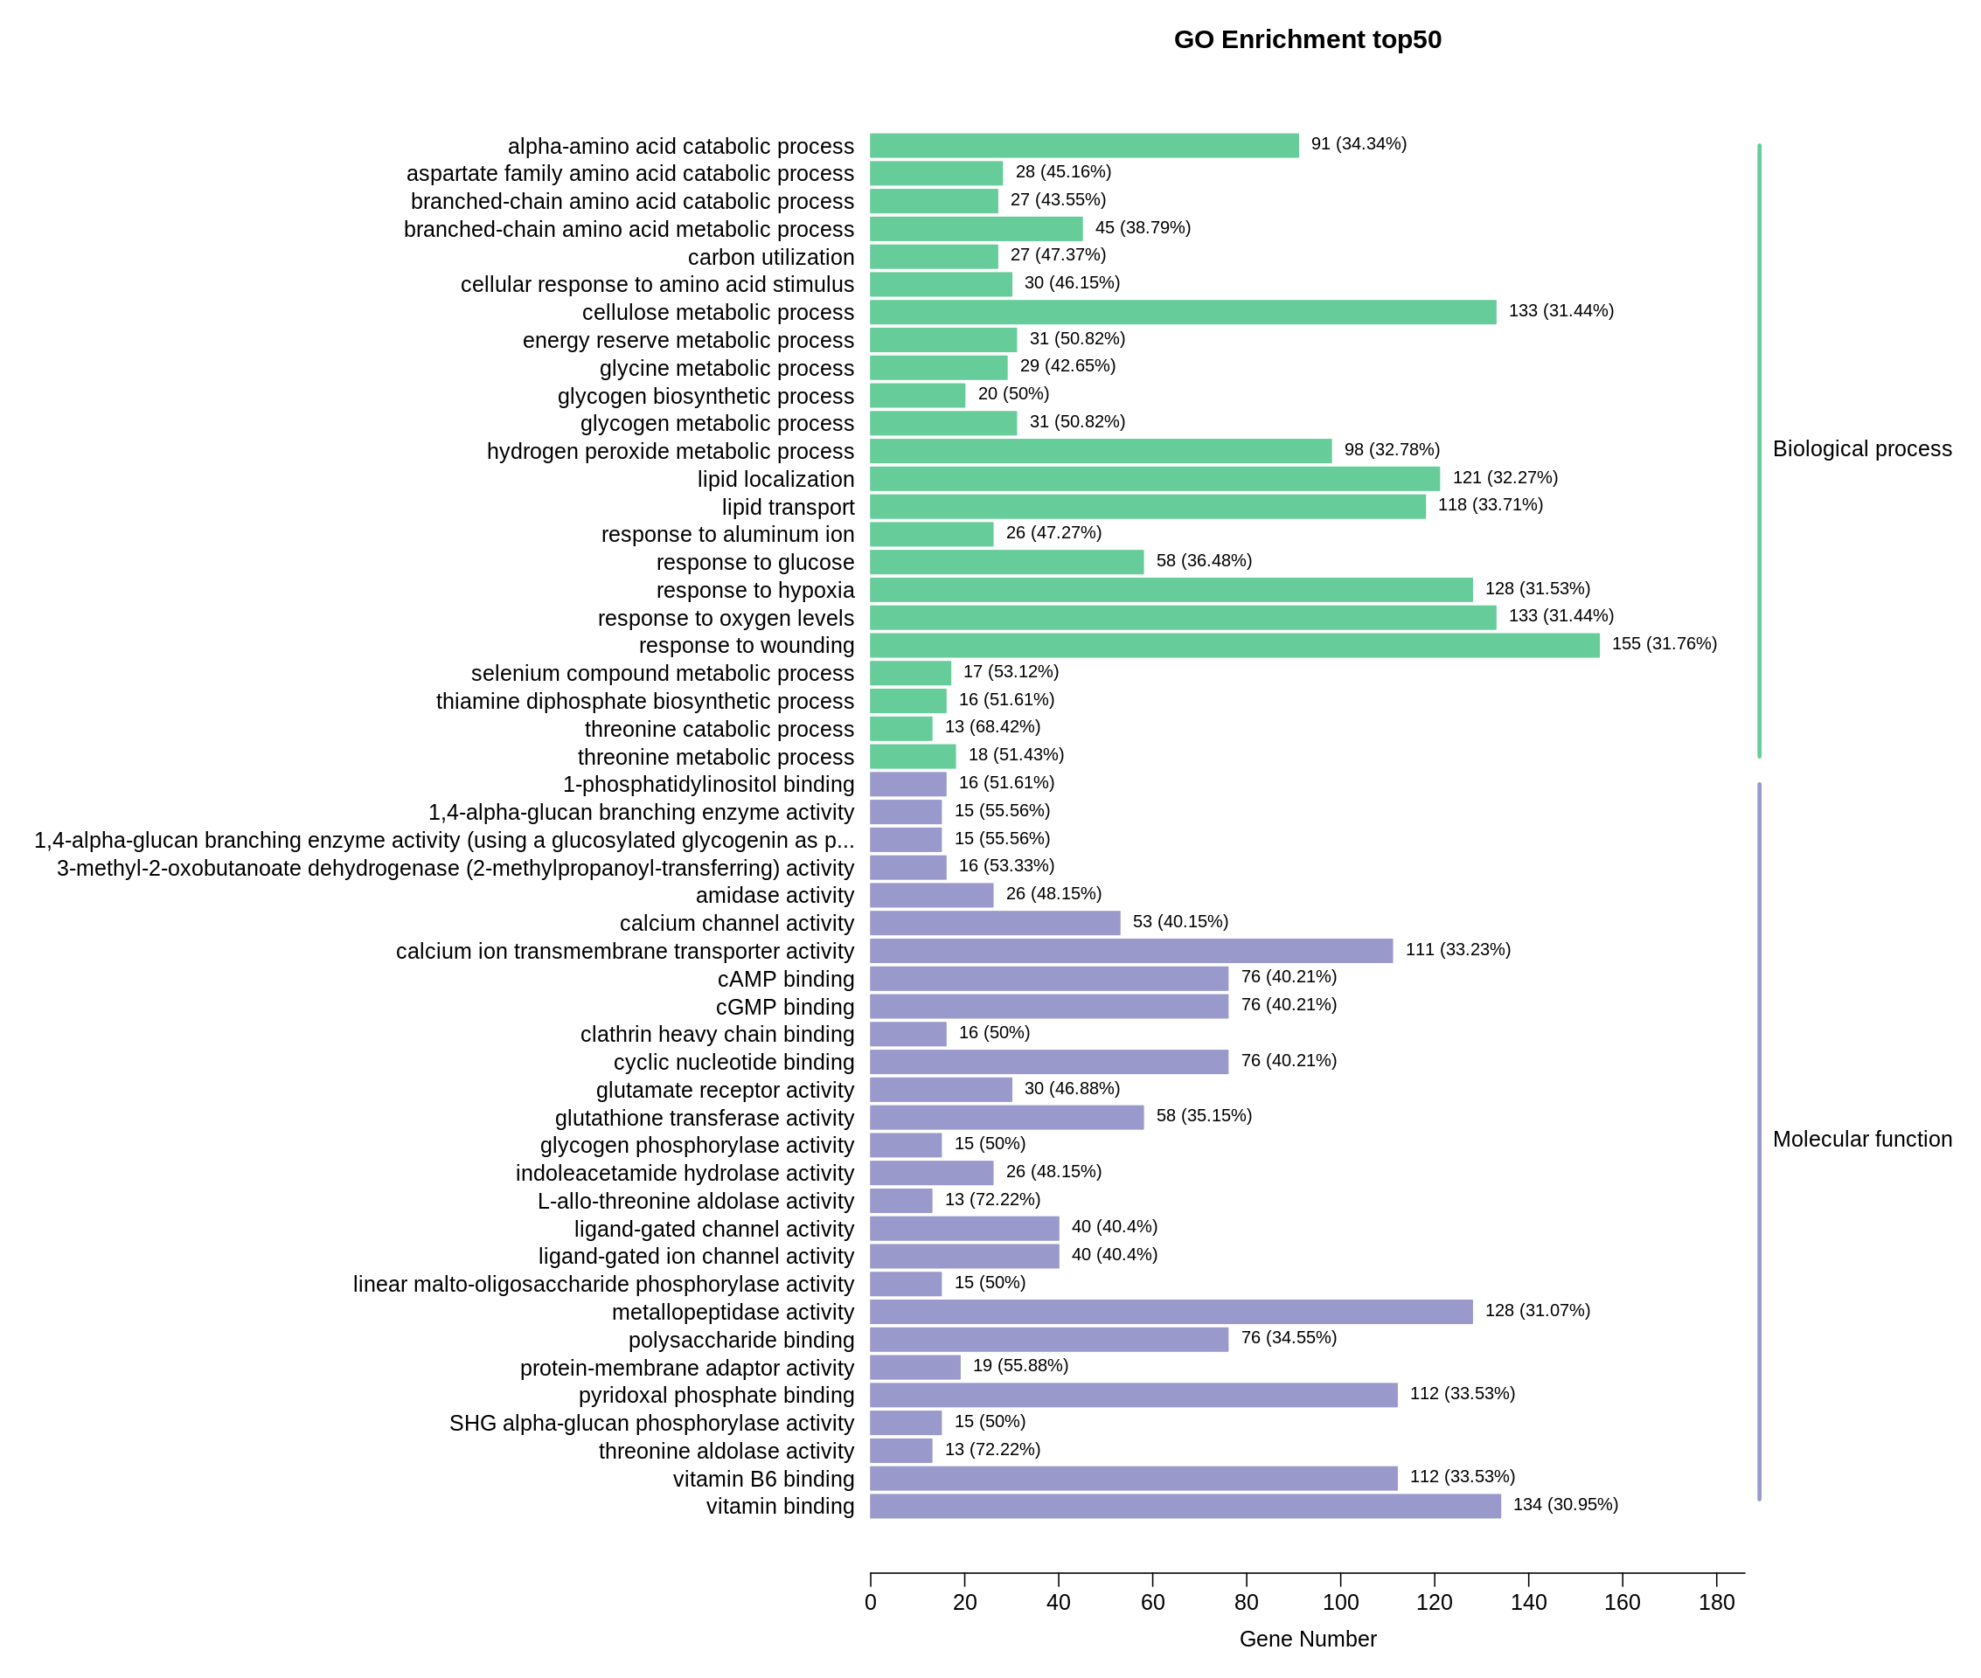
b

