Slide 1
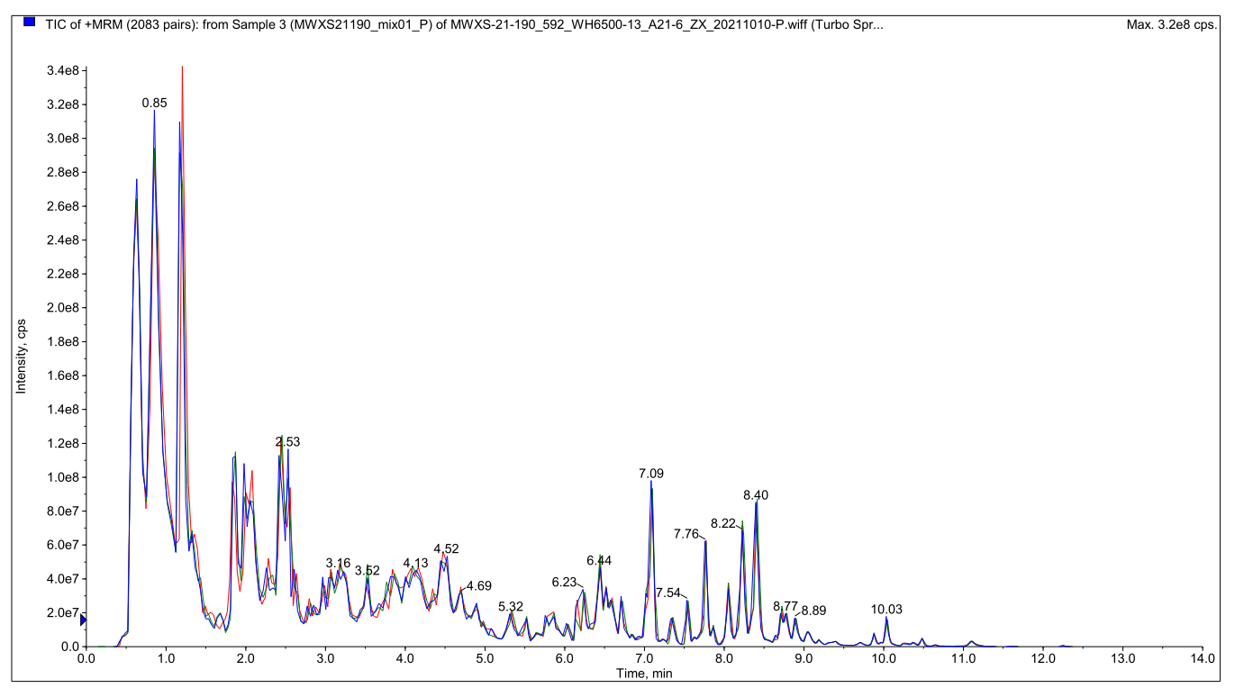
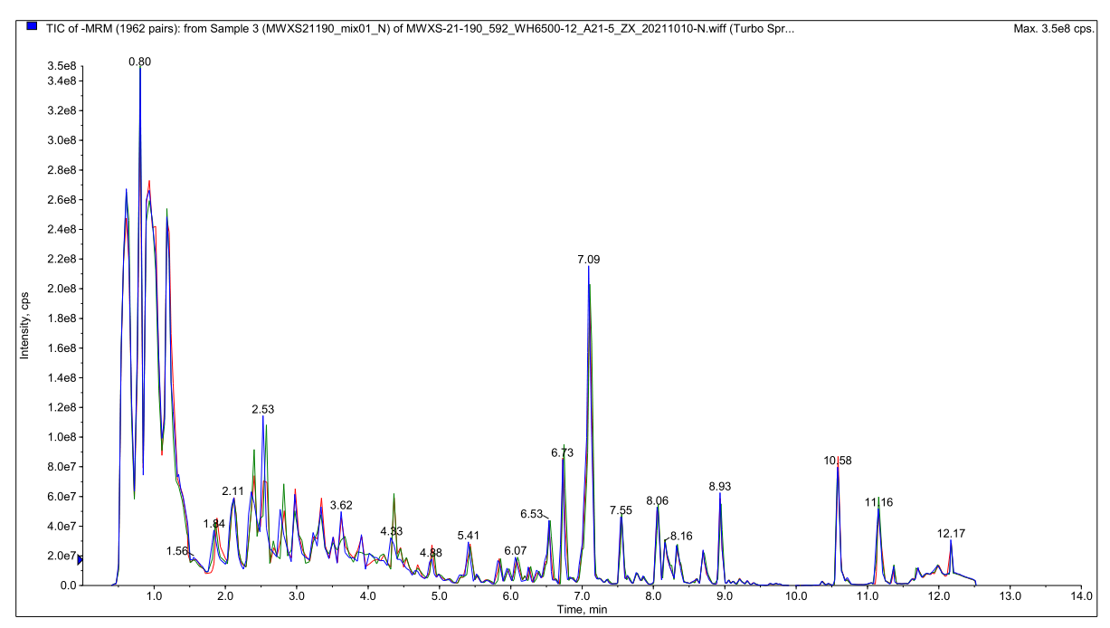
Fig. S1. Total Ion Chromatography (TIC) of the same QC sample analysed by mass spectrometric detection at different times is cited from Han et al. (2023).

Slide 2
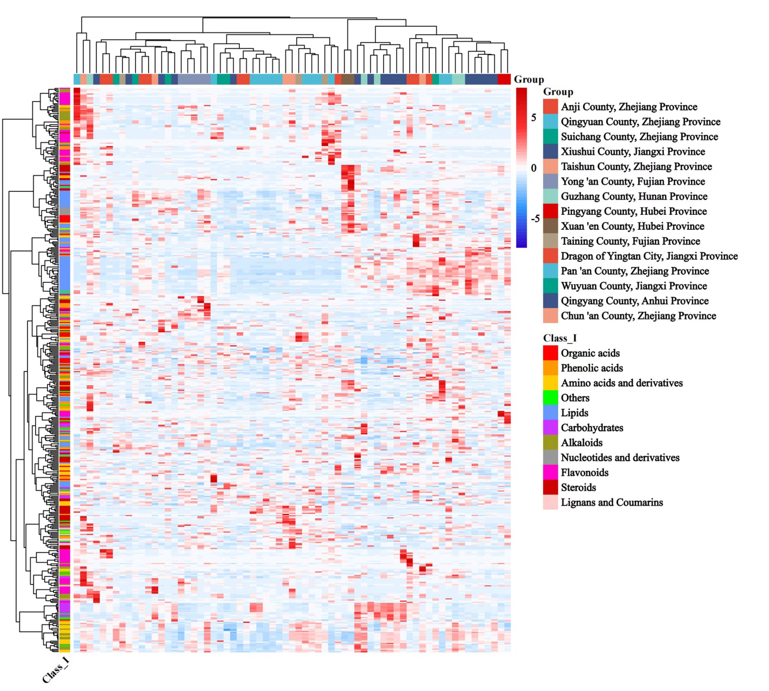
Fig. S2. Heatmap of cluster of 482 metabolites in P. cyrtonema of 67 genotypes from 15 regions.

Slide 3
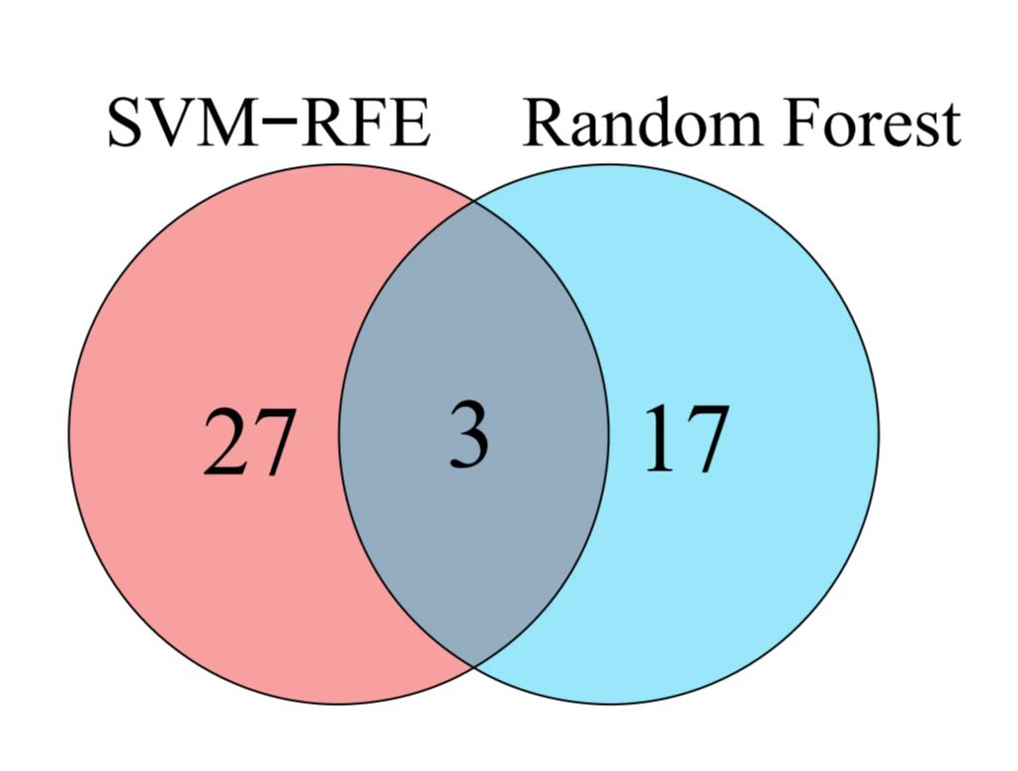
Fig. S3. Venn diagram showing overlapping feature secondary metabolites by SVM-RFE and random forest.

Slide 4
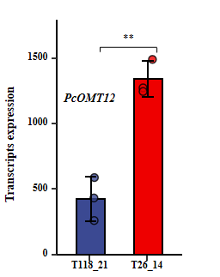
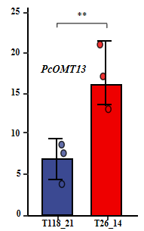

Transcripts expression
****
****
0.6
0.6
Transcripts expression
PcOMT12
PcOMT13
0.4
0.4
0.2
0.2
0.0
T118_21
T26_14
0.0
T118_21
T26_14
Fig. S4. Different transcript expression analysis of differentially expressed genes of PcOMT11, PcOMT10, PcOMT12 and PcOMT10 among genotypes T118_21 and T26_14.

Slide 5
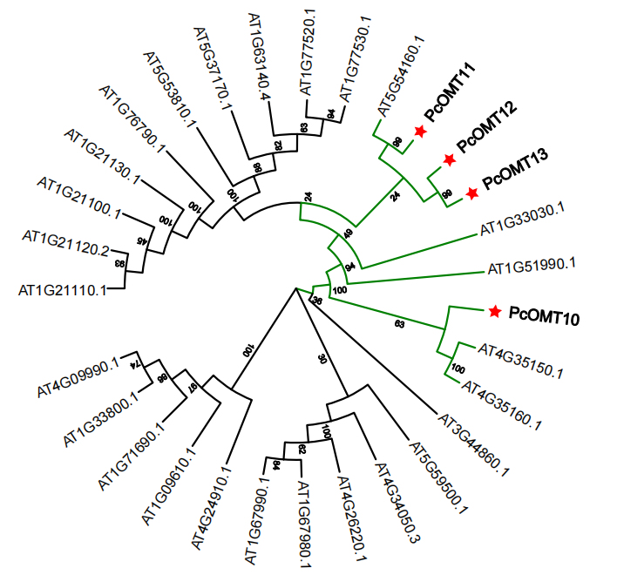
Fig. S5. Phylogenetic analysis of PcOMTs. PcOMT10/11/12/13 sequences in P. cyrtonema and the amino acid sequence of the known O-methyltransferase in Arabidopsis thaliana were aligned using CLUSTALO and the Neighbor-joining tree was constructed using MEGA7 software.

Slide 6
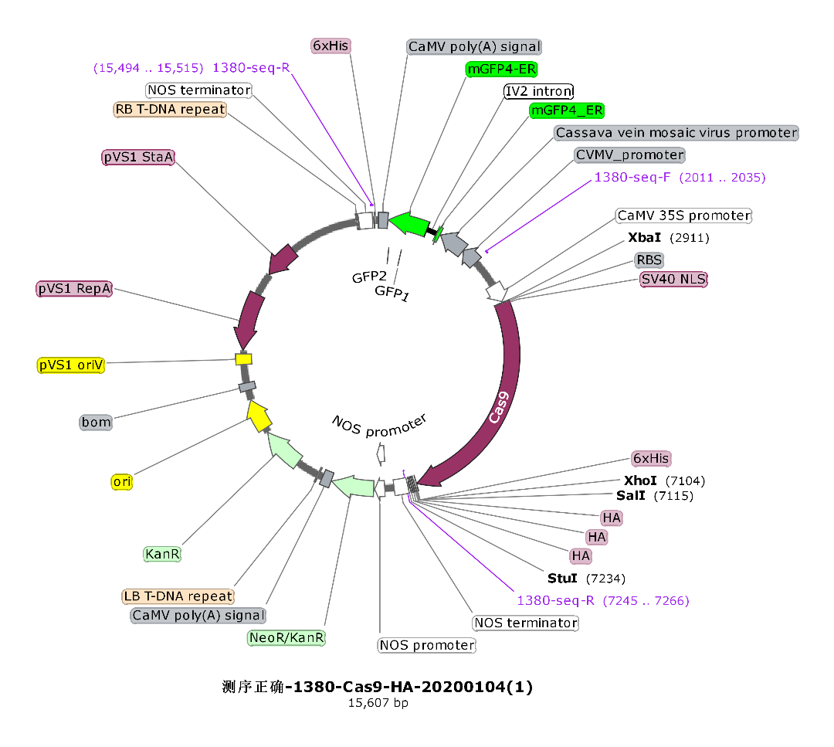
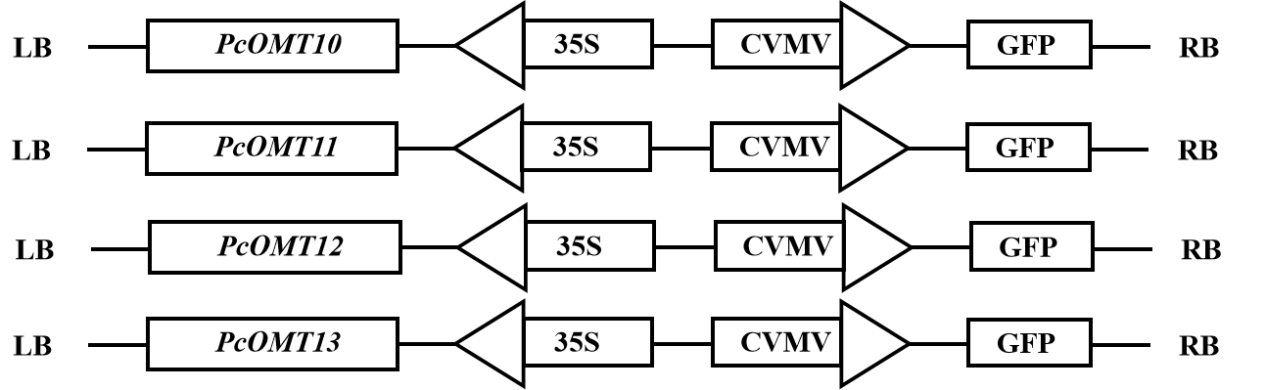
A
B
Fig. S6. (A) The overexpressed vector of gene cloning used for transient expression in tobacco leaves is cited from Han et al. (2023). (B) Constructs of PcOMT10/11/12/13 carrier used in transient assays in the leaves of N. benthaniana.

Slide 7
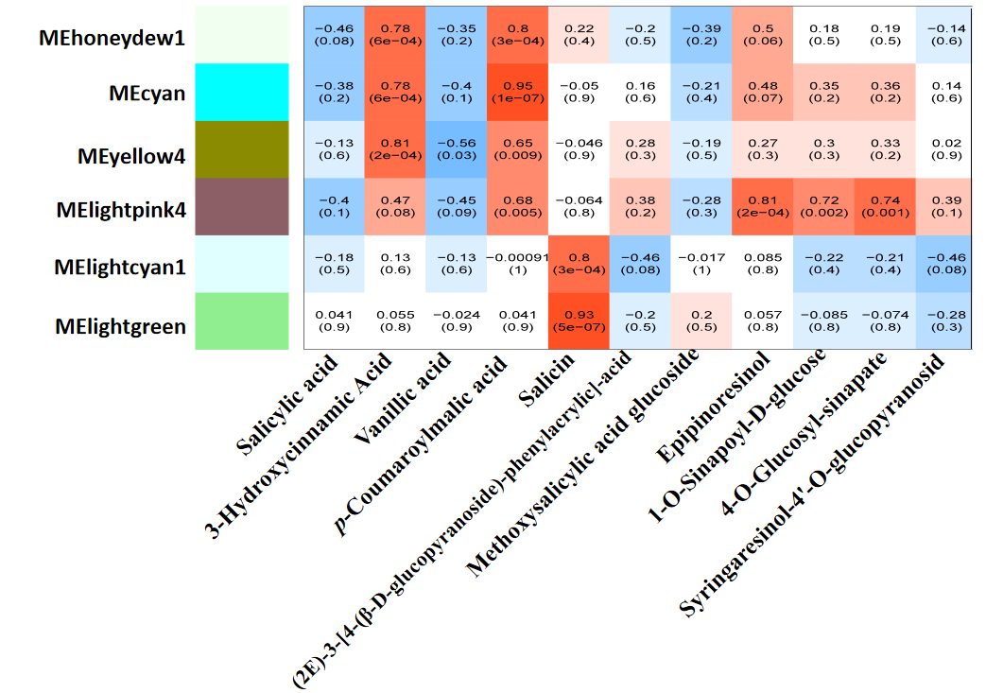
Fig. S7. Module-phenolic acids and lignans weighted correlation analysis.

