Slide 1
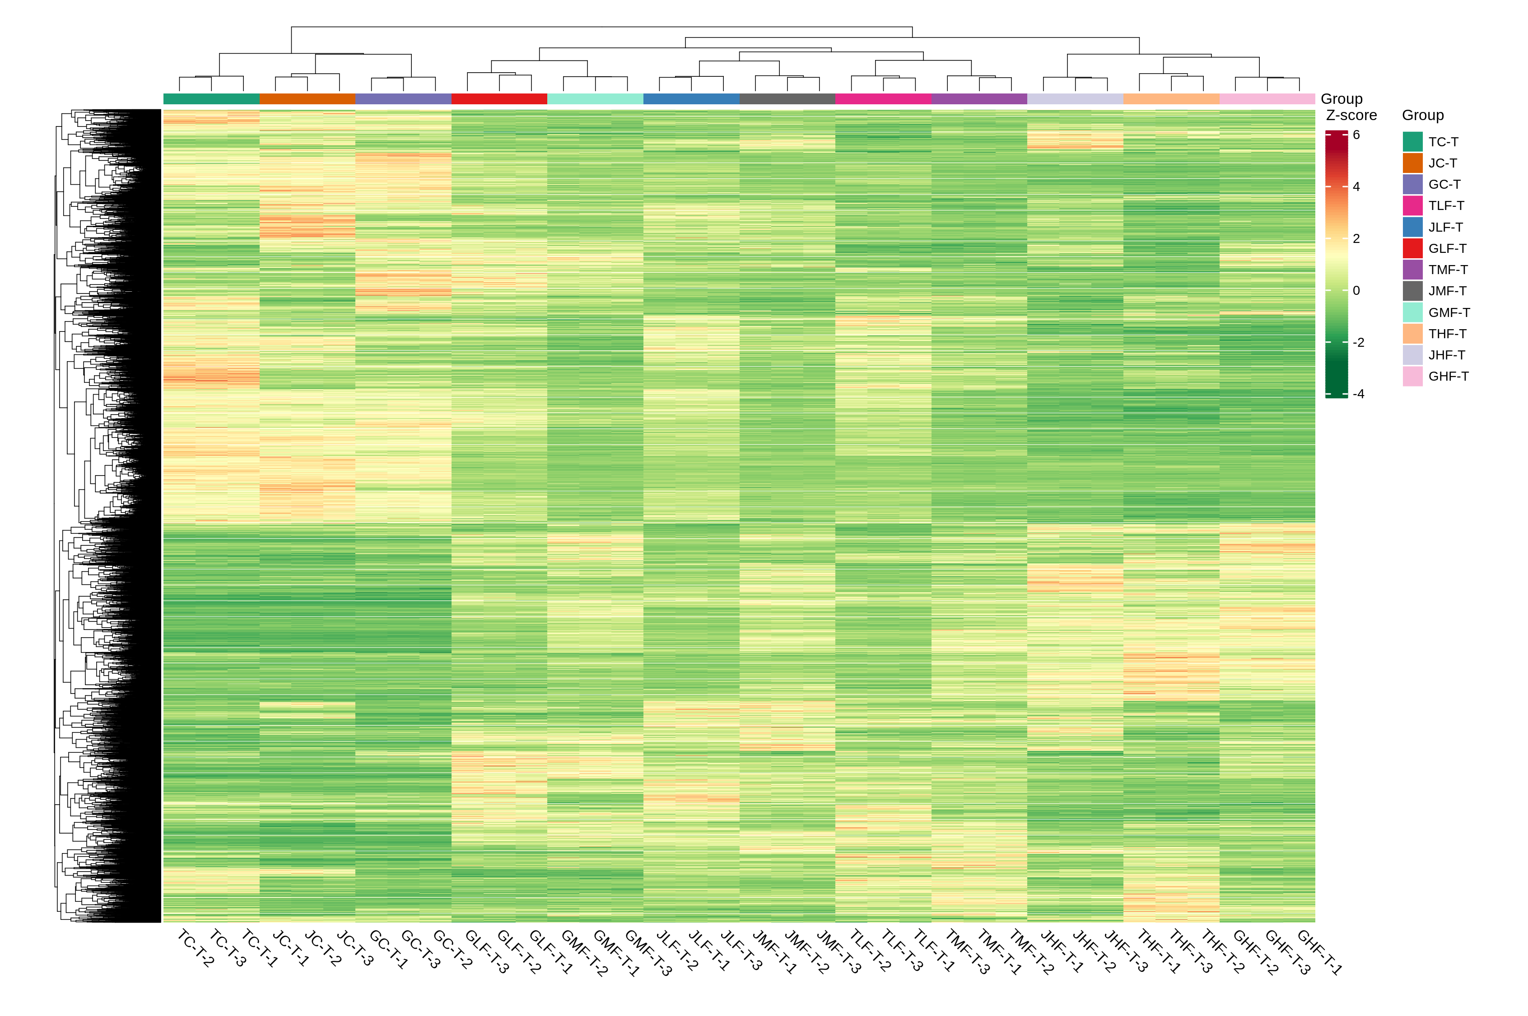
Figure S2. Heatmap of FPKM values of differentially expressed genes in the leaves of three mango varieties after 24 (LF), 48 (MF), and 72 (HF) hours of cold treatment.

