Slide 1
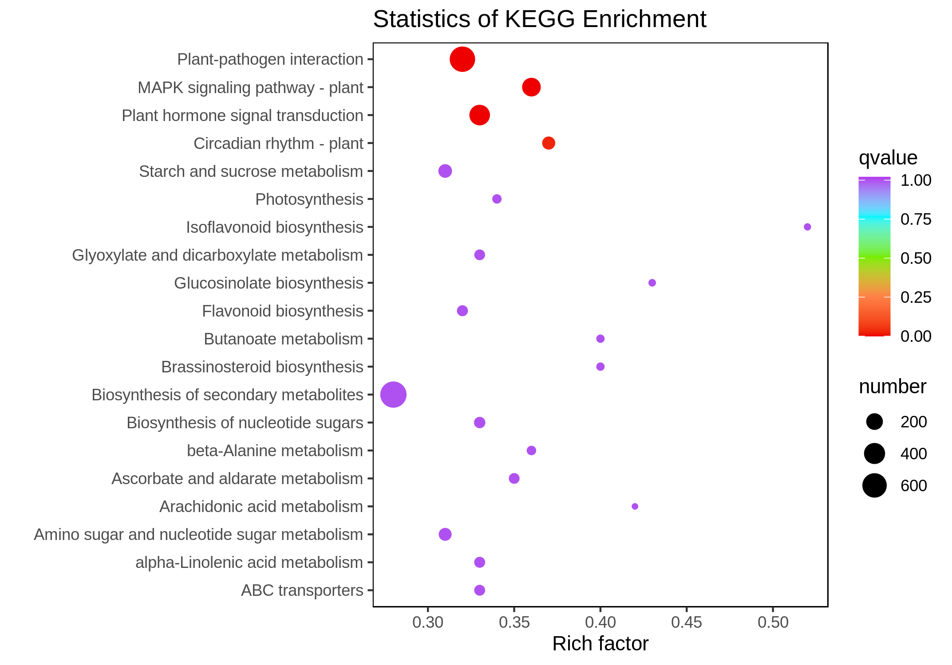
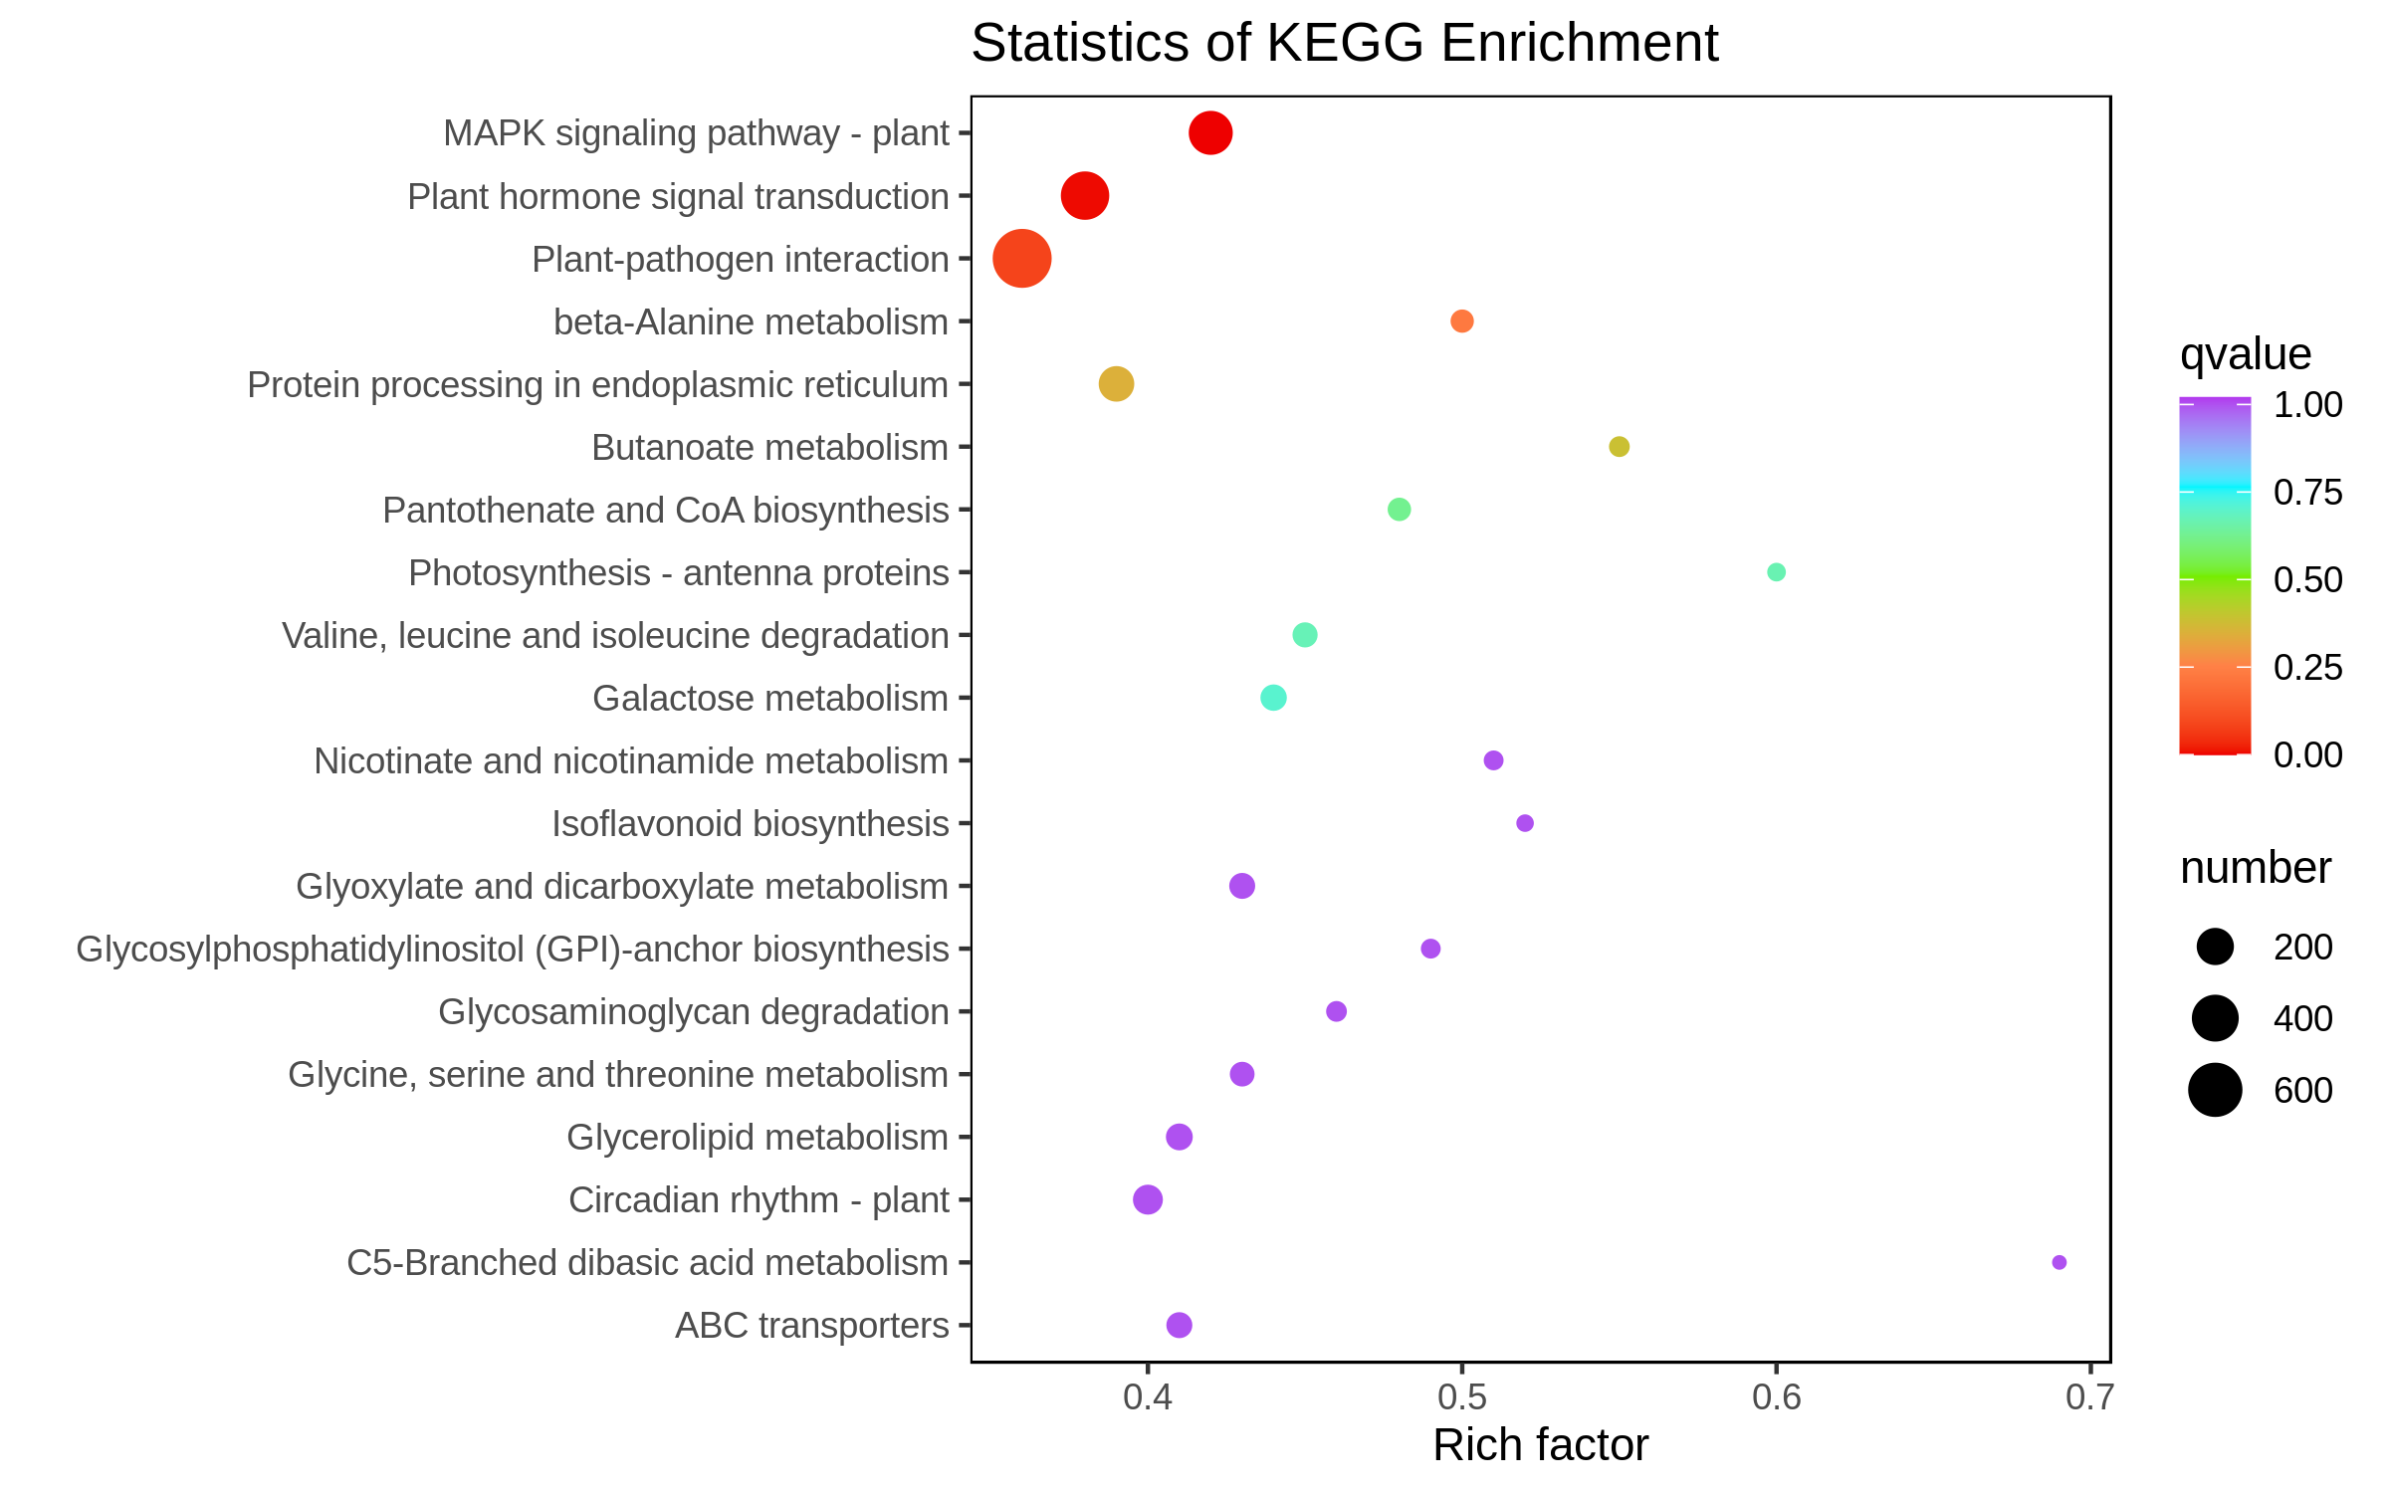
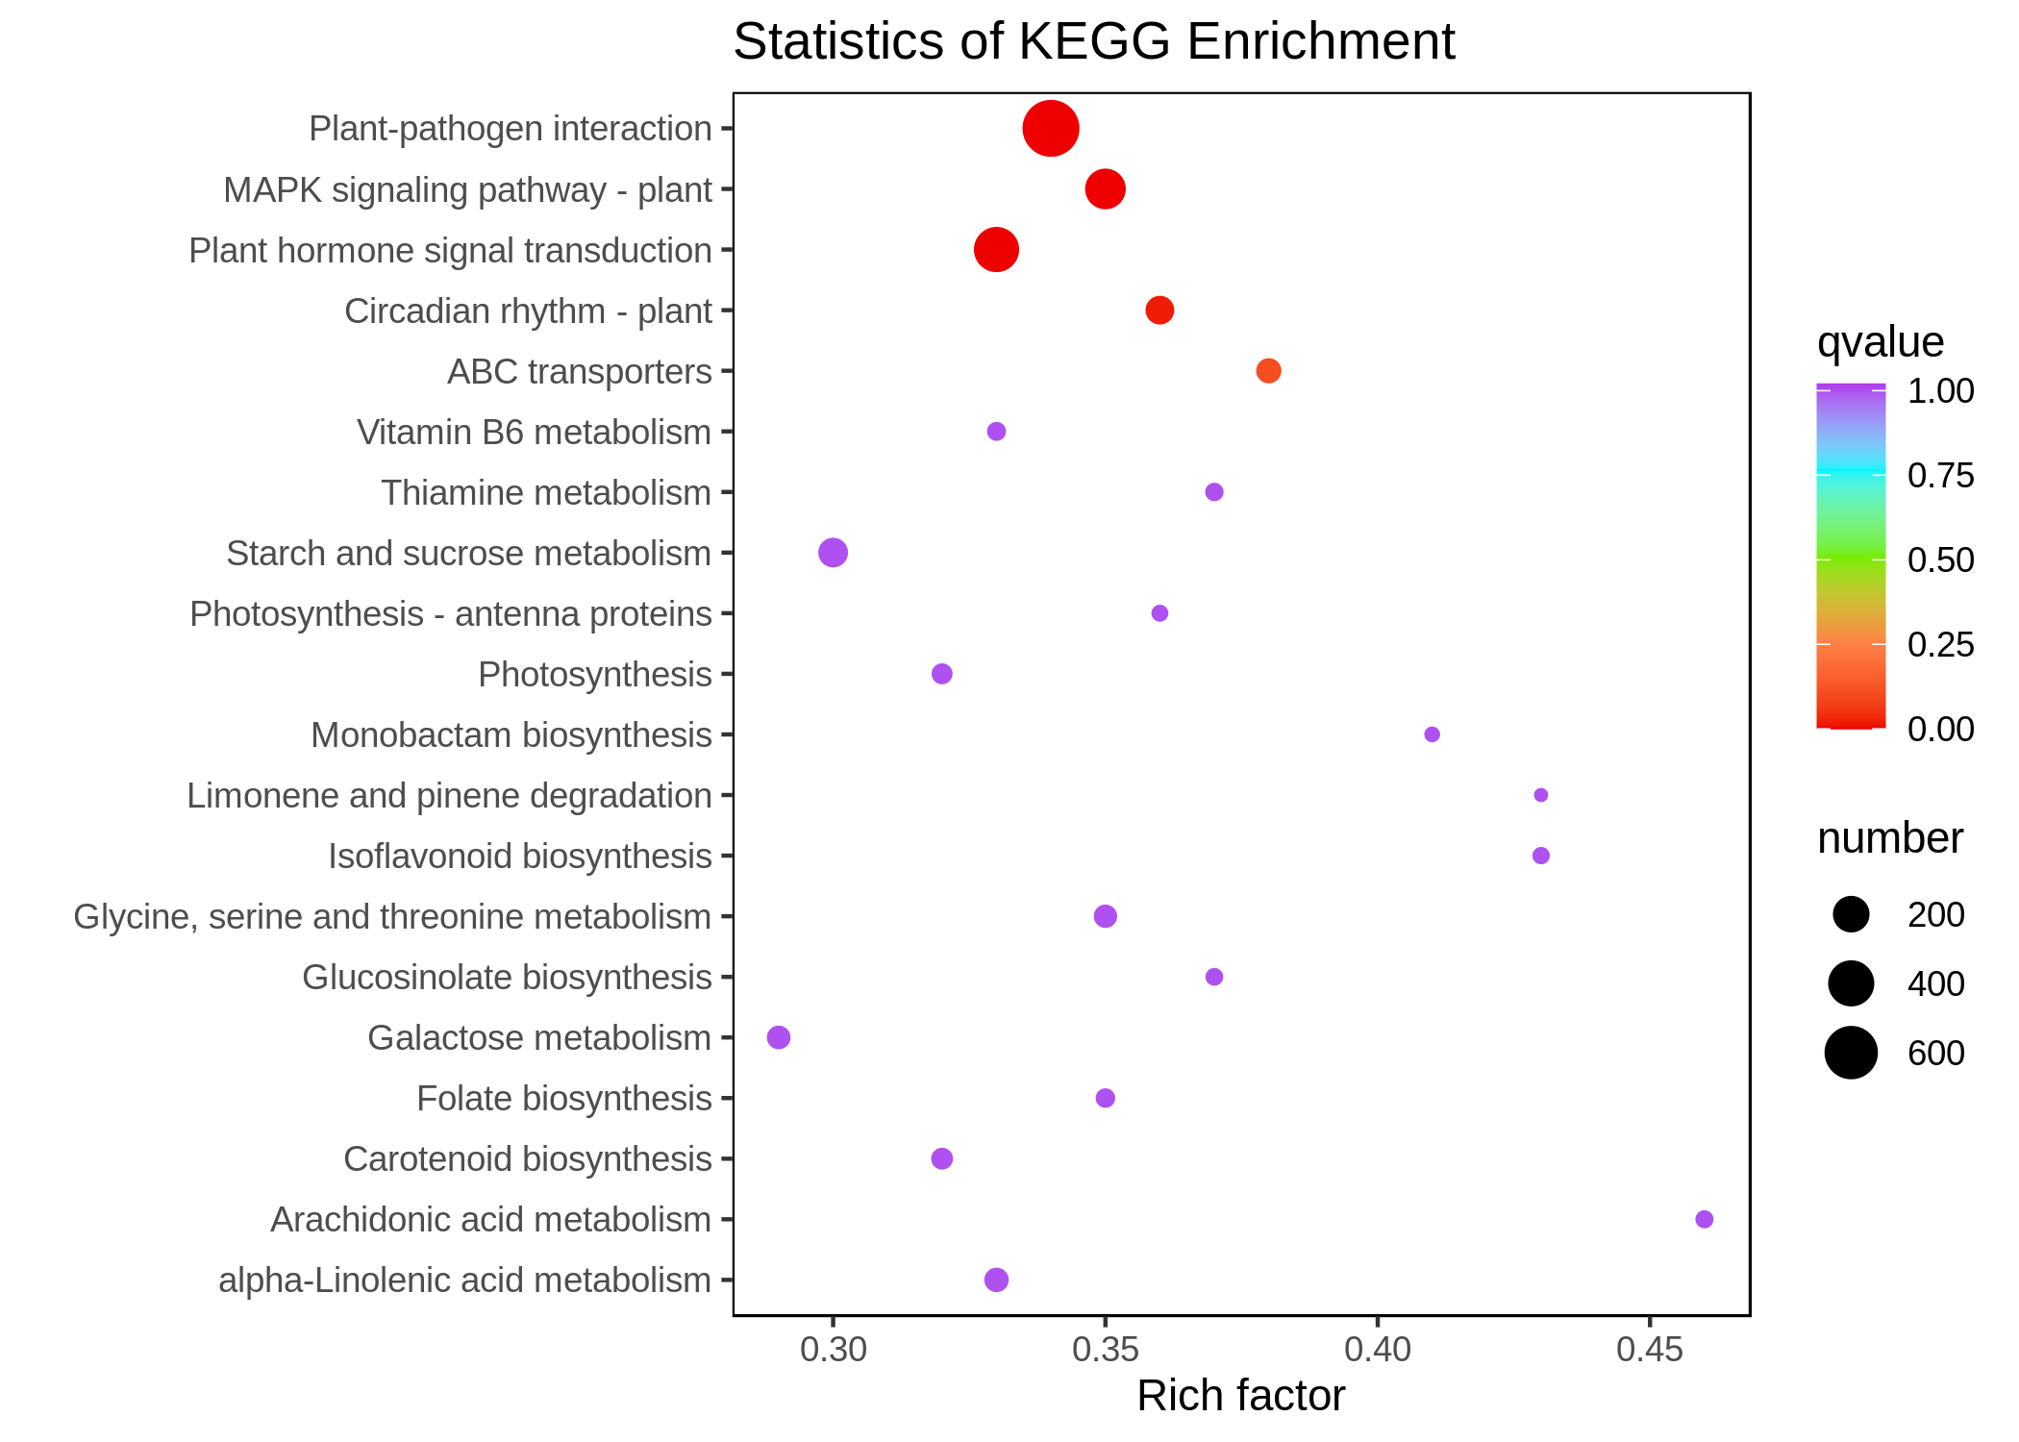
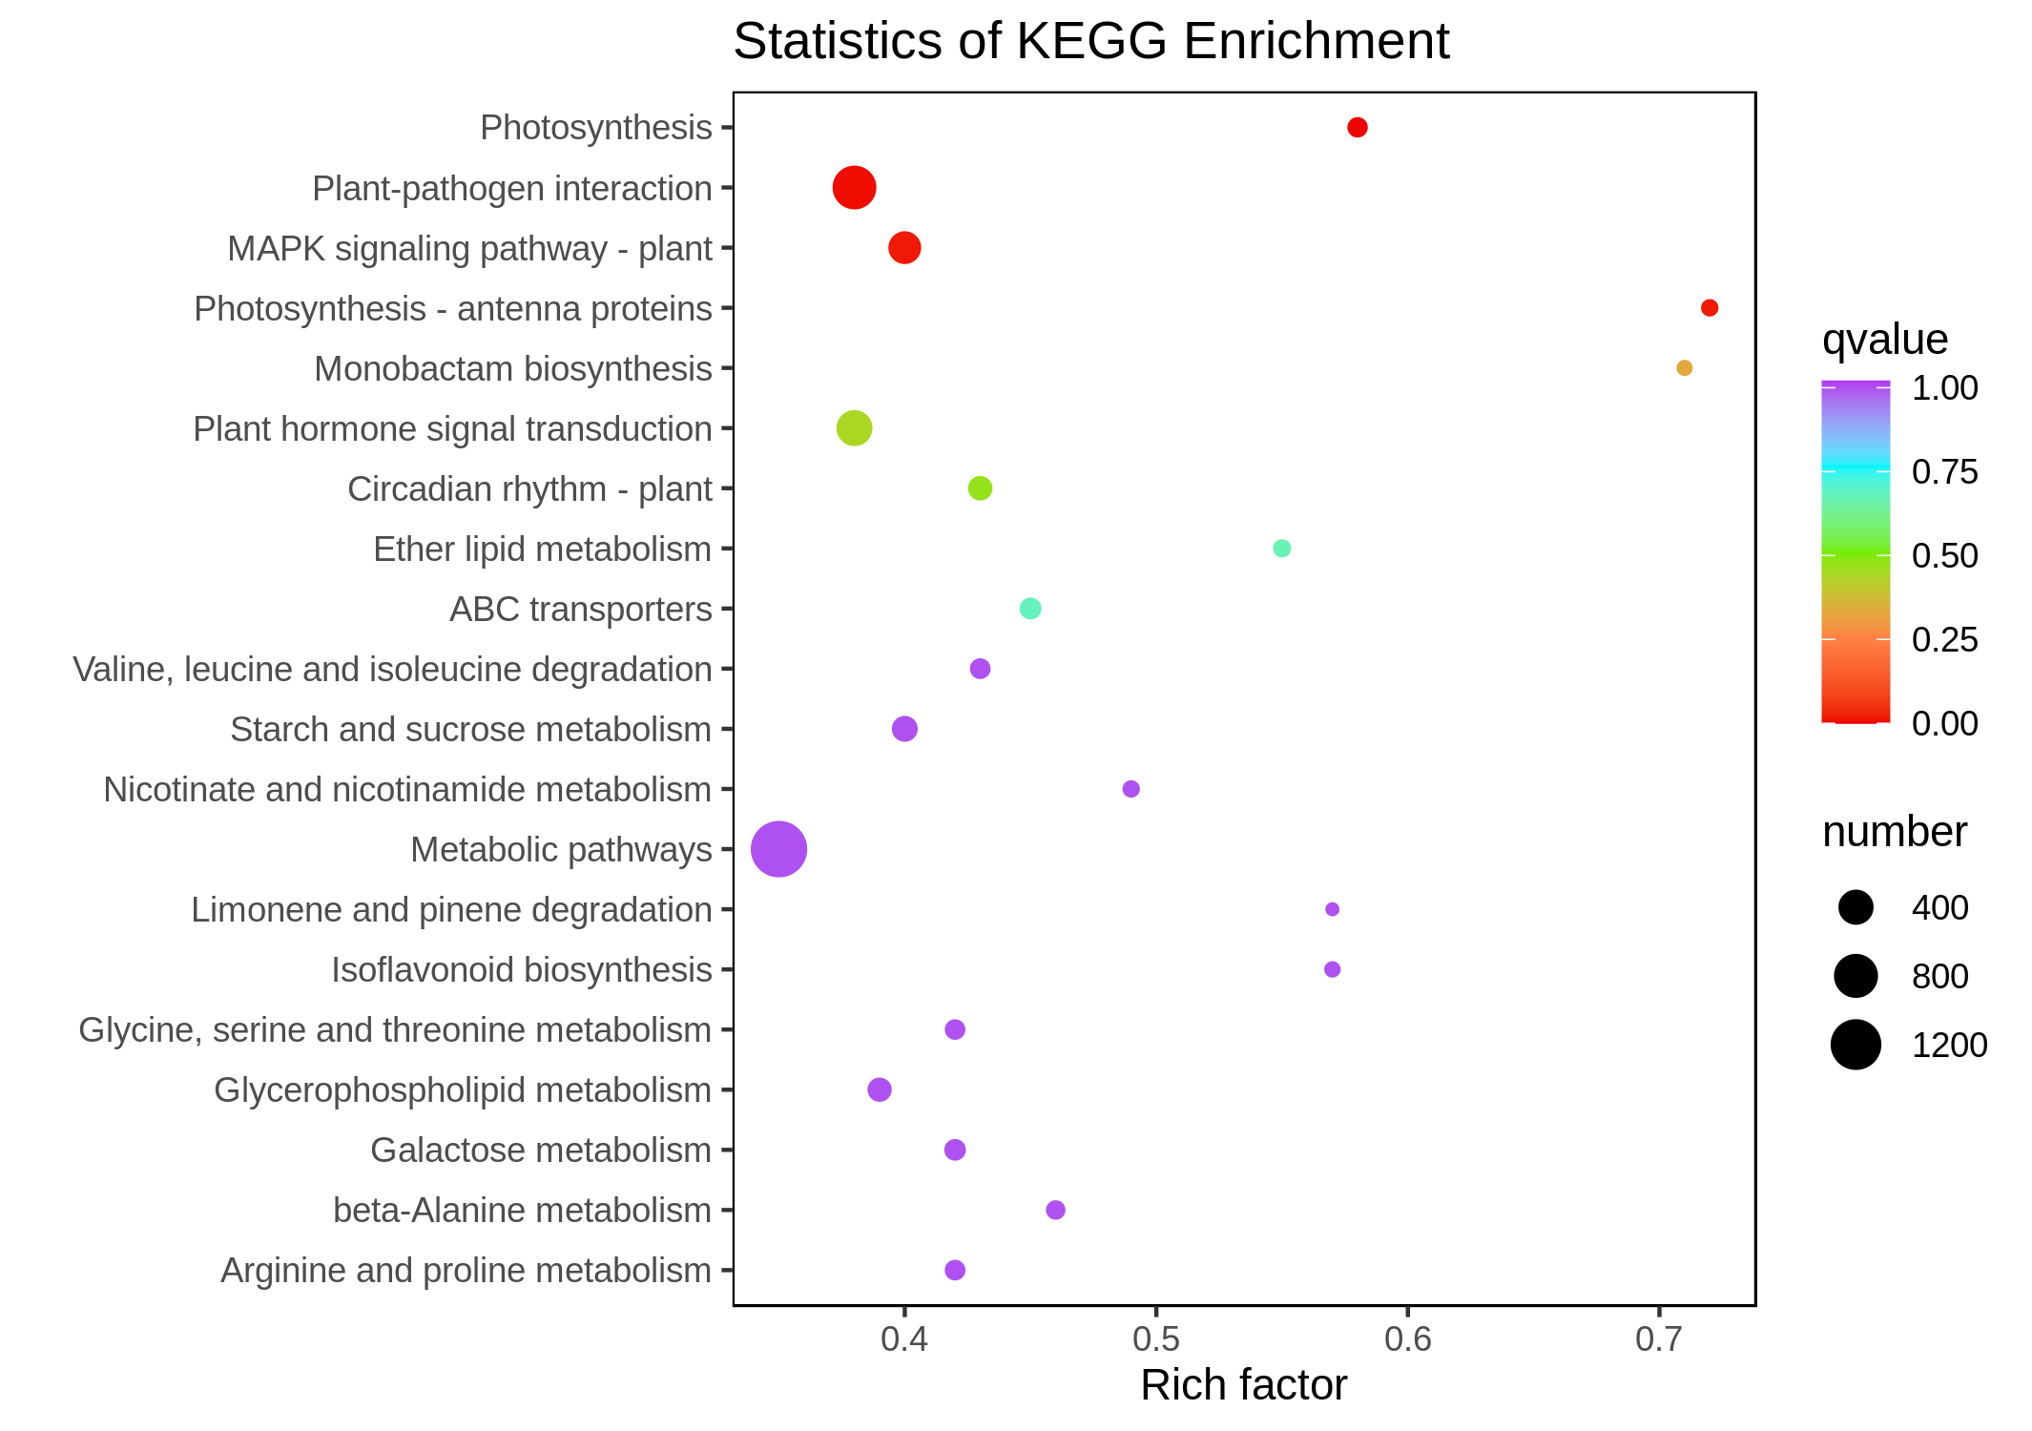
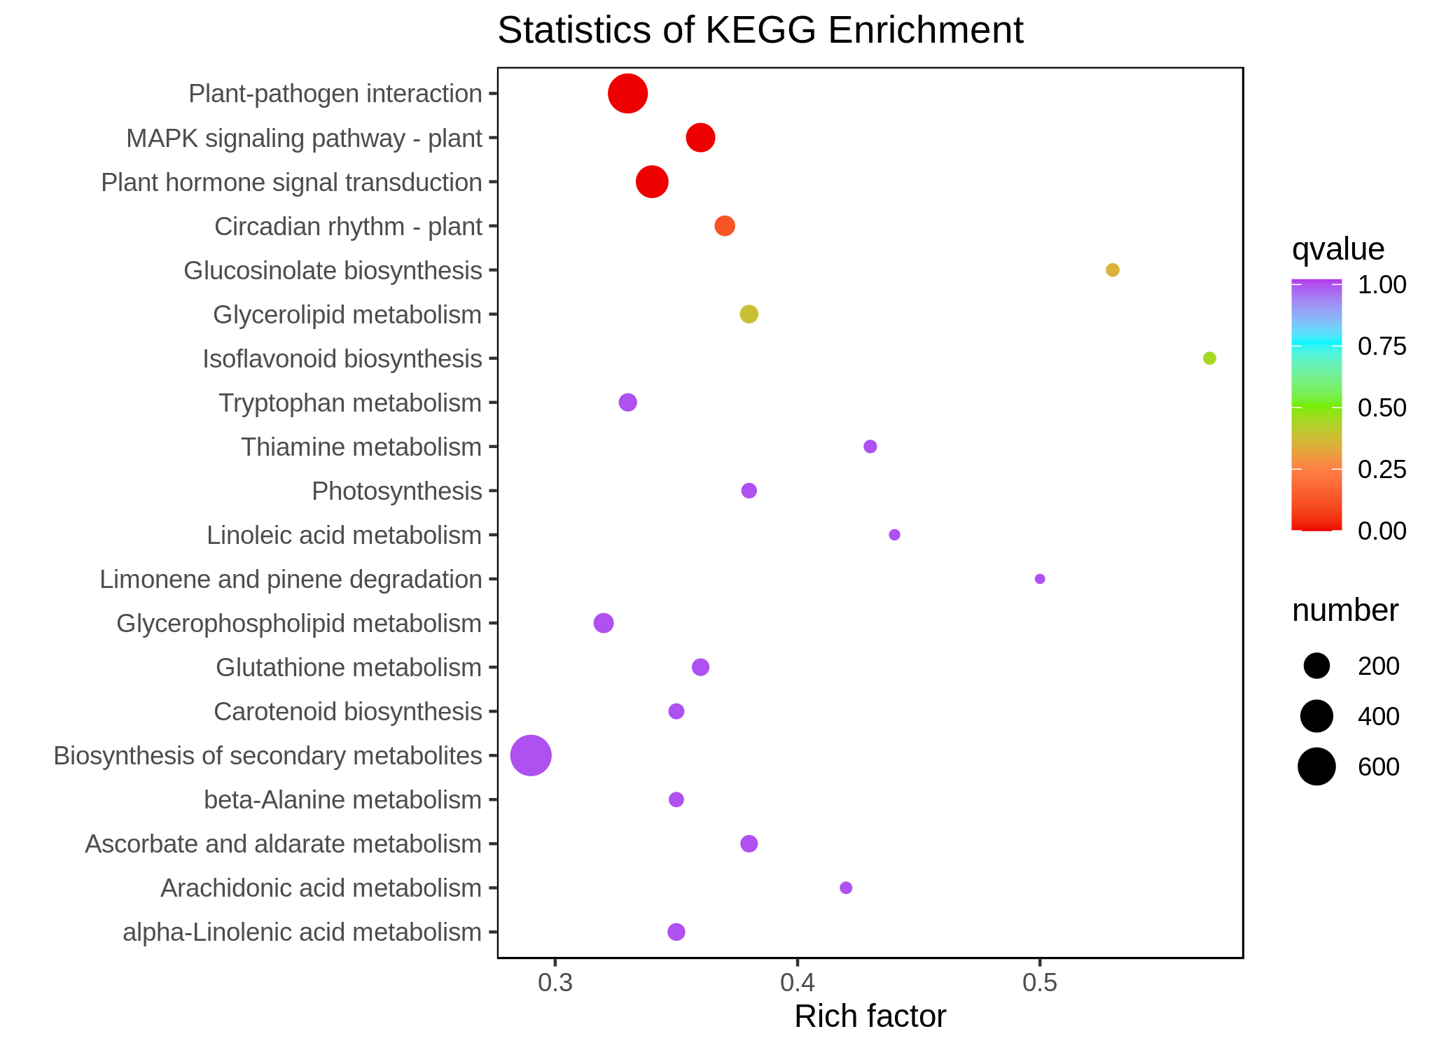
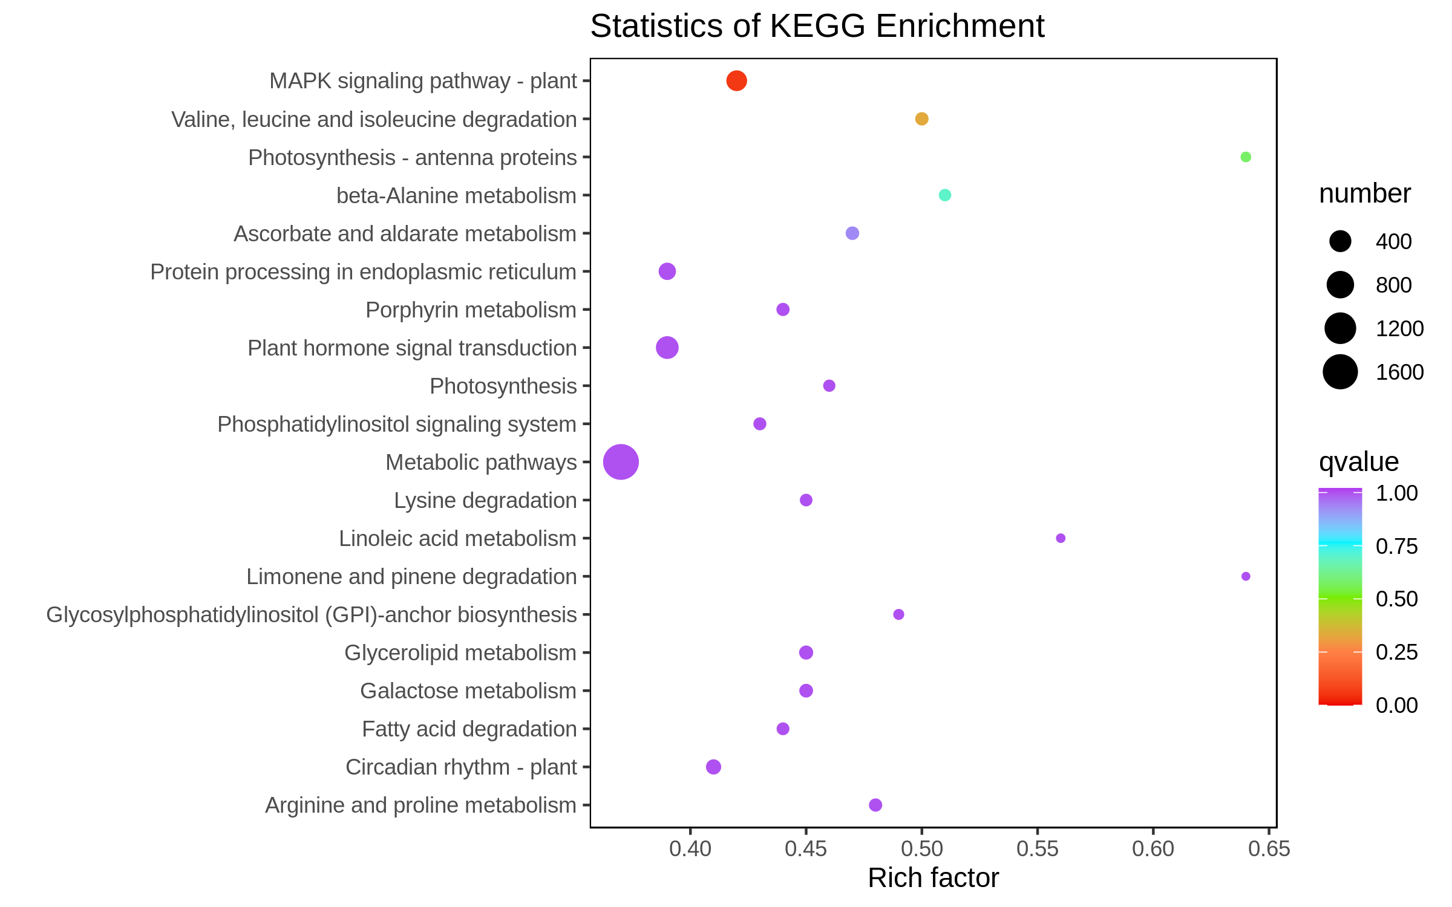
JCvsJMF
JCvsJHF
GCvsGMF
GCvsGHF
TCvsTMF
TCvsTHF
Figure S3. Scatter plots of KEGG pathways to which differentially expressed genes were enriched after 48 (MF) and 72 (HF) hours of cold treatment in the leaves of three mango varieties.

