Slide 1
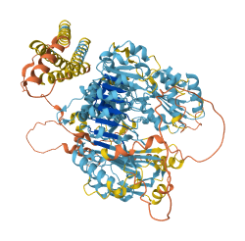
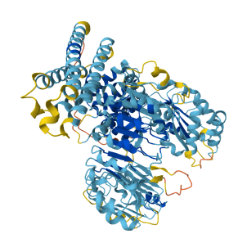
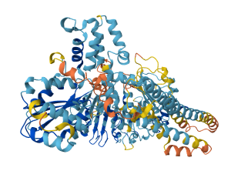
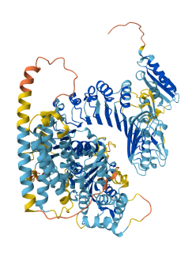
Zm00001eb115030
Zm00001eb197290
Zm00001eb226710
Zm00001eb115030
Zm00001eb197290
Model Confidance:
Very high (pLDDT > 90)
High (pLDDT > 70)
Low (pLDDT > 50)
Very low (pLDDT < 50)
AlphaFold produces a per-residue model confidence score (pLDDT) between 0 and 100. Some regios below pLDDT may be unstructured in isolation
Figure S3 AlphaFold structure of NBS-LRR proteins of Zea mays.

