Slide 1
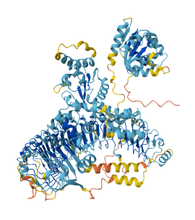
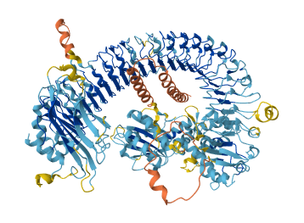
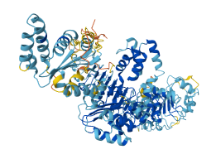
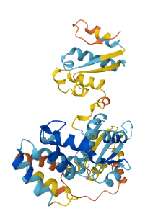
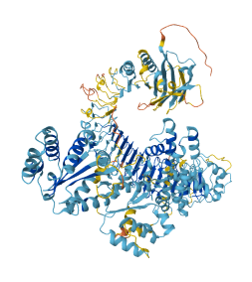
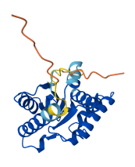
Solyc05g006620
Solyc07g052770
Solyc07g052770
Solyc07g052800
Solyc12g097000
Solyc12g097010
Model Confidance:
Very high (pLDDT > 90)
High (pLDDT > 70)
Low (pLDDT > 50)
Very low (pLDDT < 50)
AlphaFold produces a per-residue model confidence score (pLDDT) between 0 and 100. Some regios below pLDDT may be unstructured in isolation
Figure S5 AlphaFold structure of NBS-LRR proteins of Solanum lycopersicum.

