Slide 1
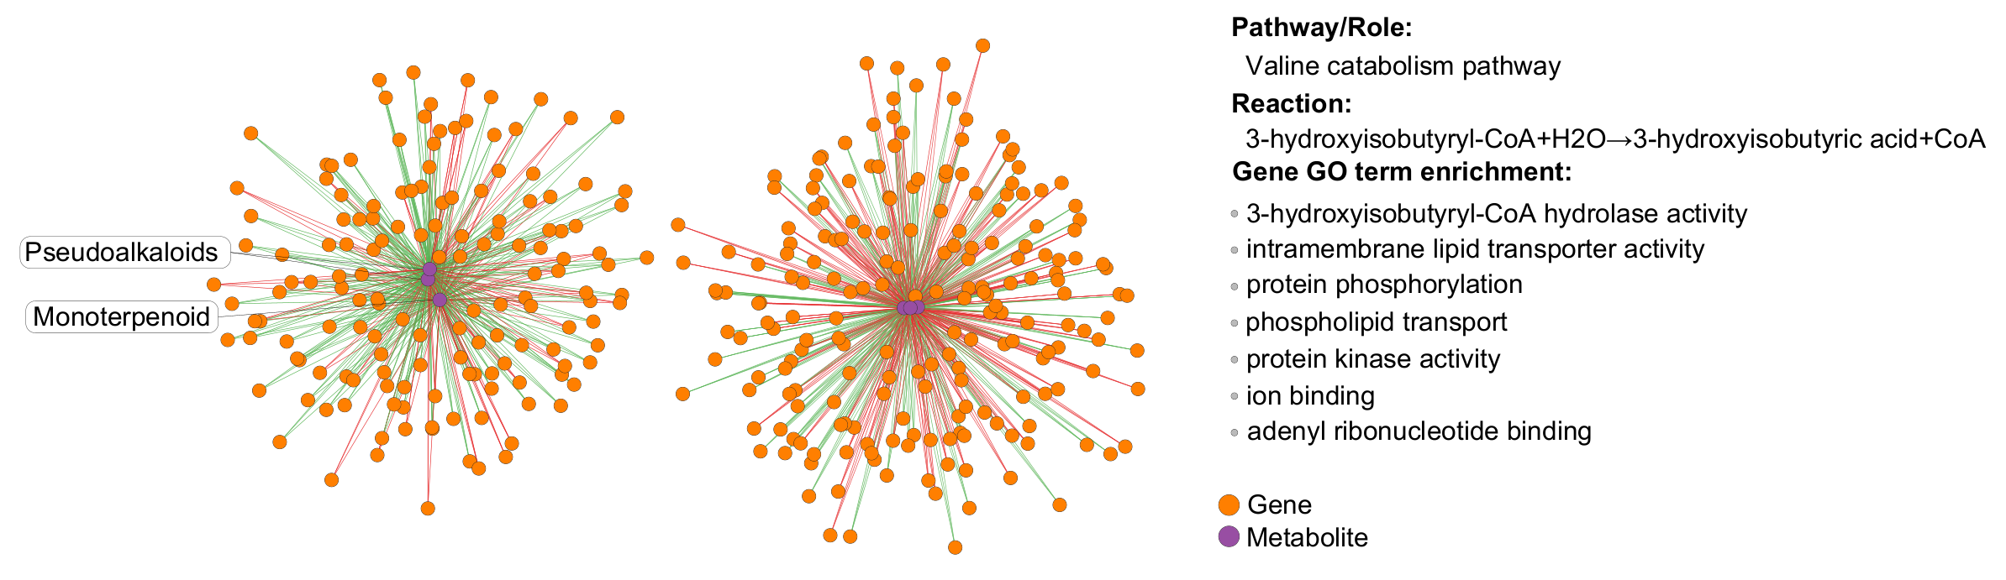
Supplementary: Genes-metabolites integration network from the ‘Unique Aphid’ group. Integration was performed with the sPLS tool of the mixOmics R package. A cutoff of Corr>0.7 was used. Green-positive, red- negative correlation. Enrichment was perfomed on the correlated genes in gProfiler with a 0.05 cutoff.

