Slide 1
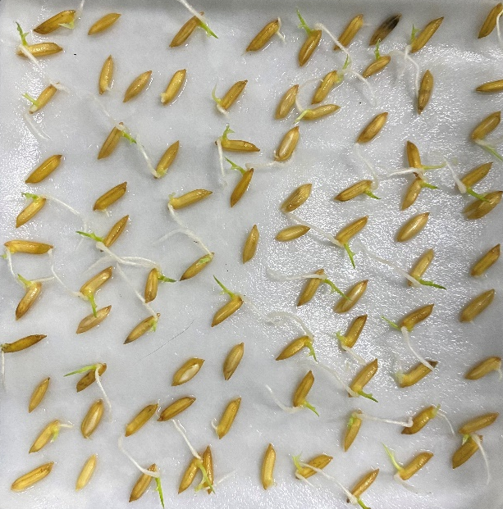
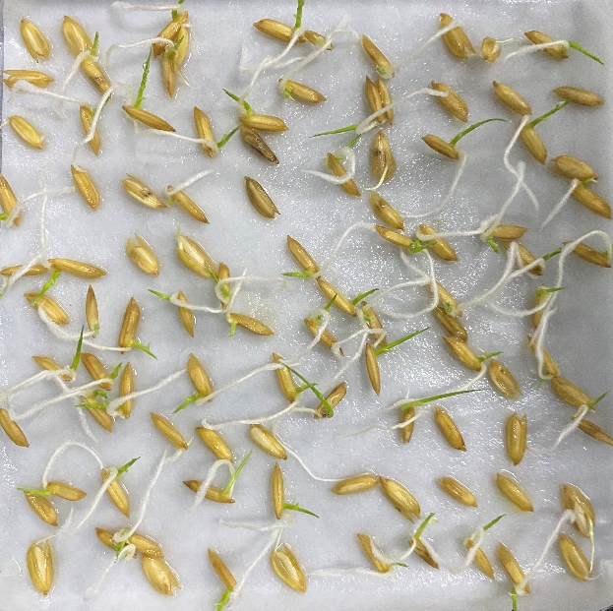
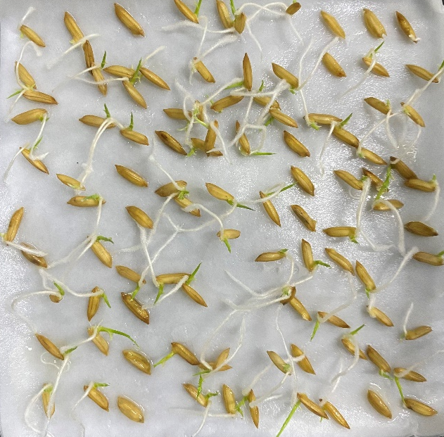
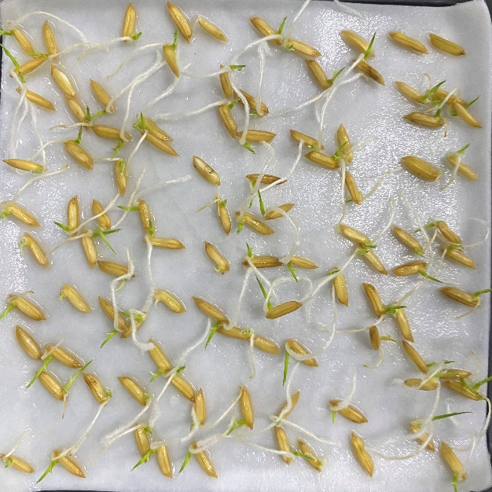
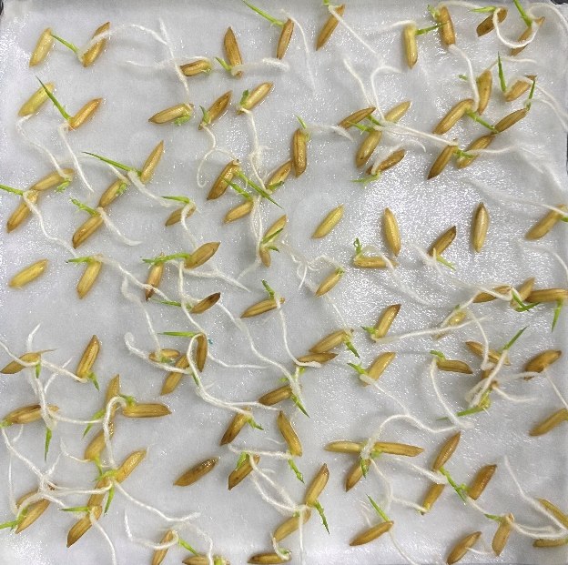
2014
2016
2 cm
2017
2018
2021
Supplementary Figure 1. Germination of aging seeds (Day 3). The numbers in the figure represent the year of harvest of rice seeds, respectively. Sow 100 seeds in each germination box (12 cm × 12 cm).

