Slide 1
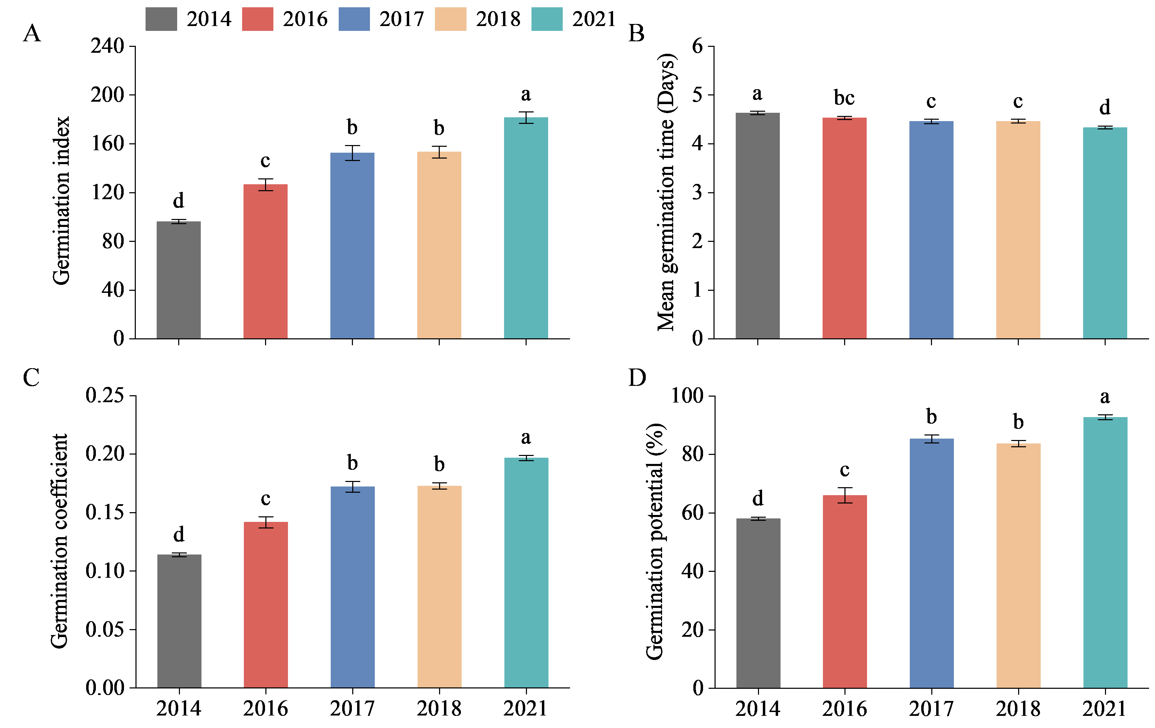
Supplementary Figure 5. Germination traits of aging rice seeds. (A) Germination index. (B) Mean germination time. (C) Germination coefficient. (D) Germination potential. Each vertical bar with error bar represents mean ± standard deviation (n = 4). Different letters indicate significant differences between groups. (Duncan's test for multiple comparisons p<0.05).

