Slide 1
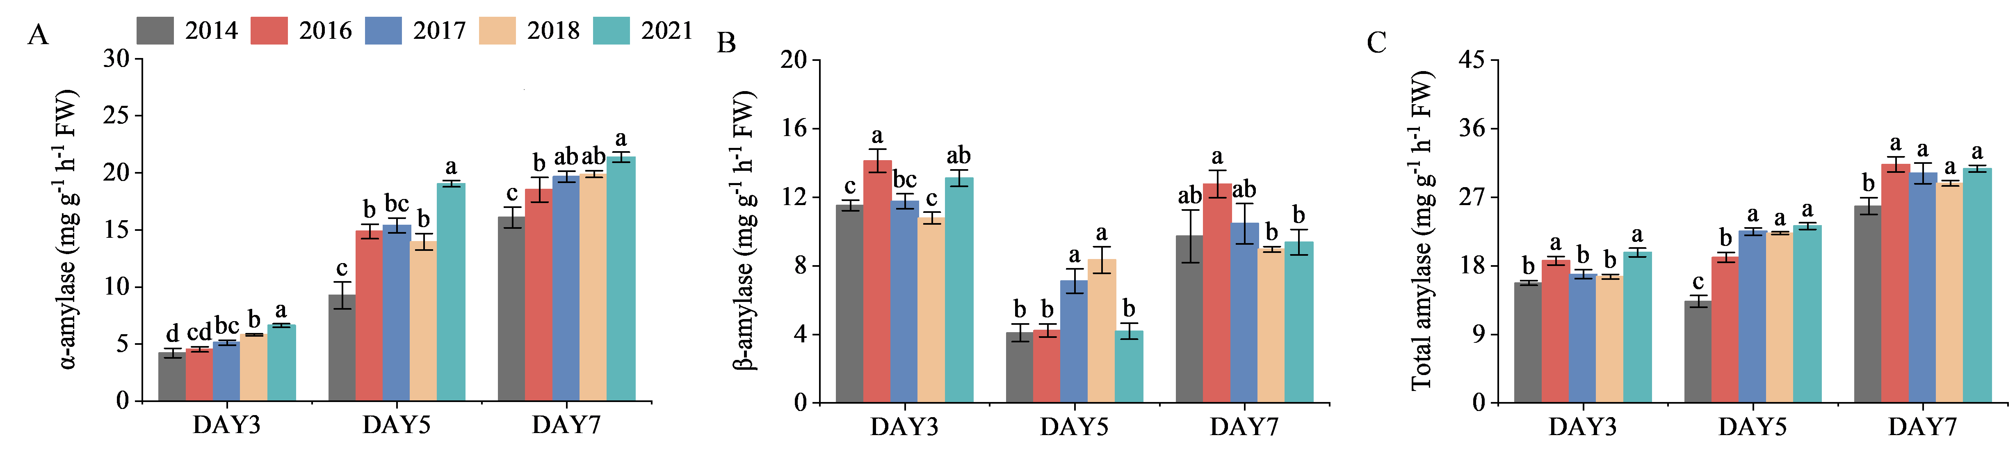
Supplementary Figure 6. Amylase activity in aging rice seeds during germination. (A) α-amylase activity. (B) β-amylase activity. (C) Total-amylase activity. Each vertical bar with error bar represents mean ± standard deviation (n = 4). Different letters indicate significant differences between groups over the same time period. (Duncan's test for multiple comparisons p<0.05).

