Slide 1
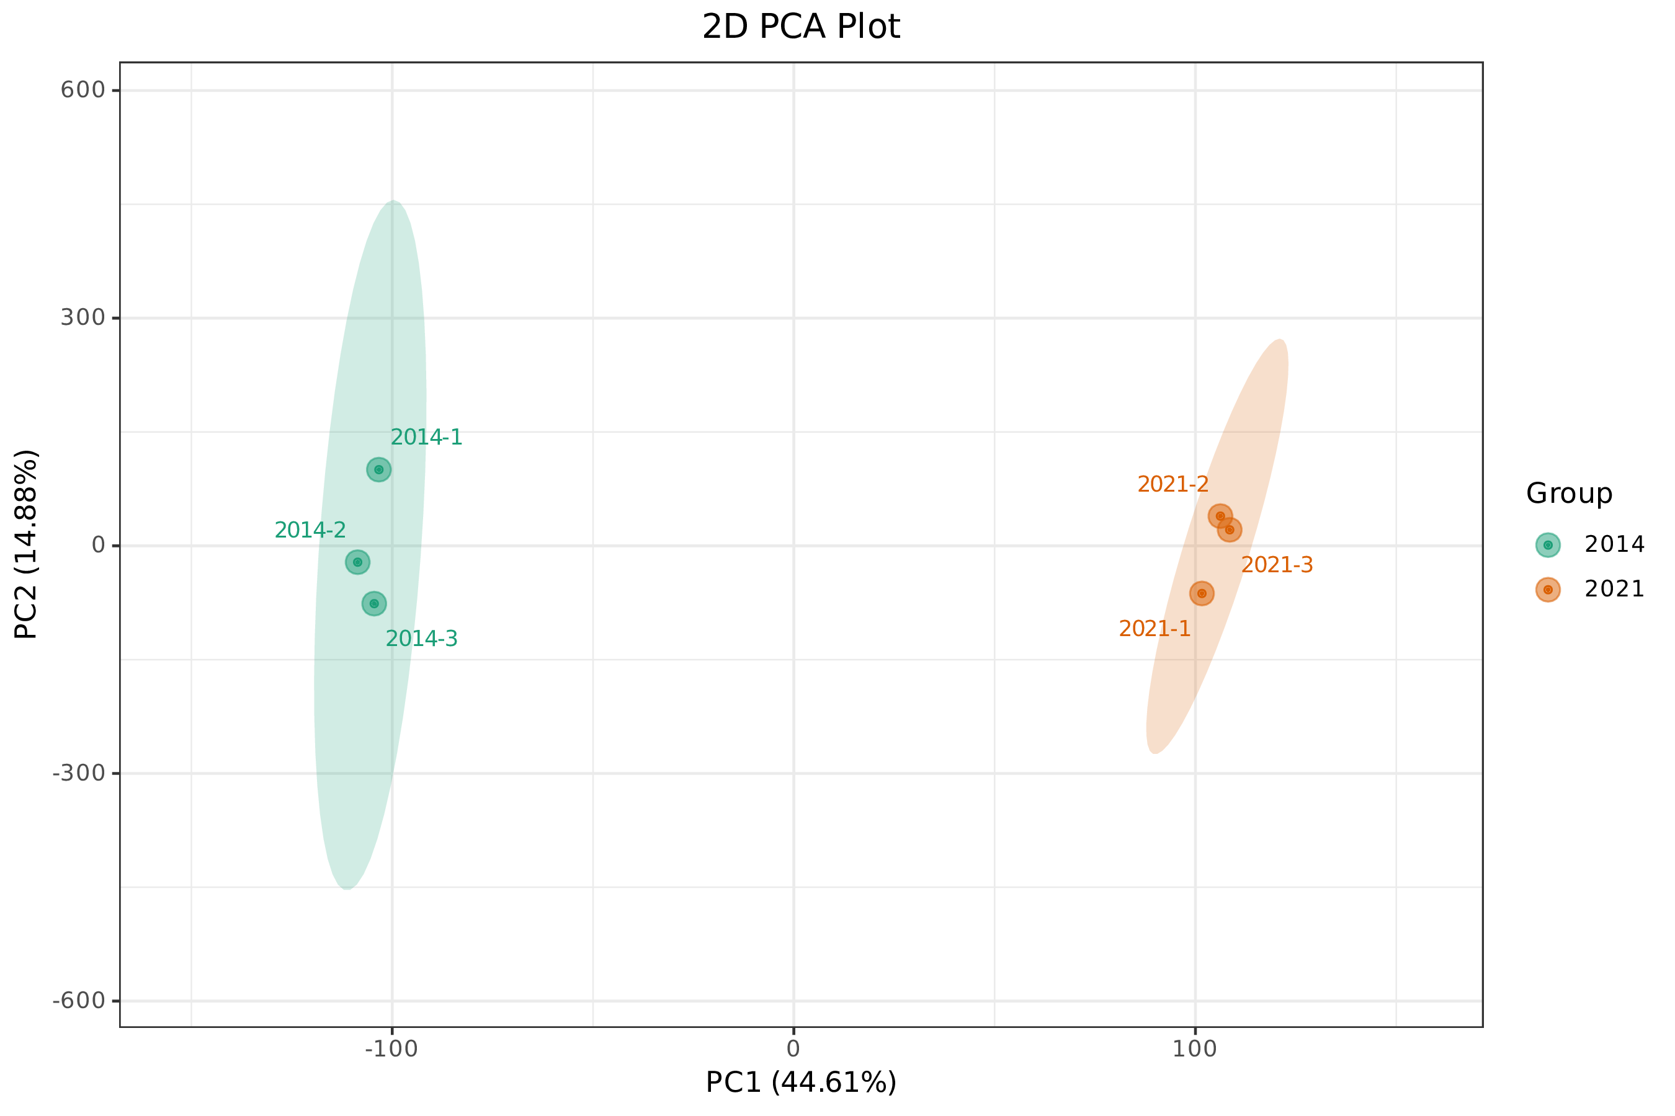
Supplementary Figure 9. Principal Component Analysis (PCA) of transcriptomics .

