Slide 1
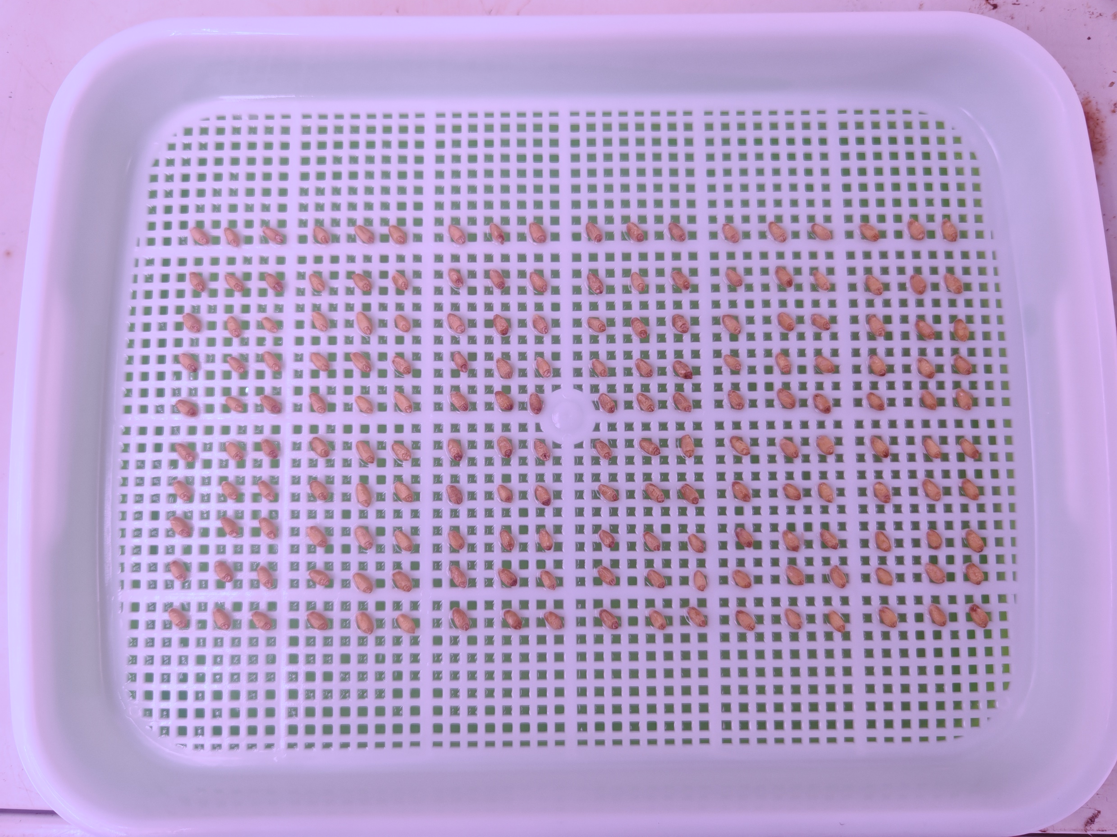
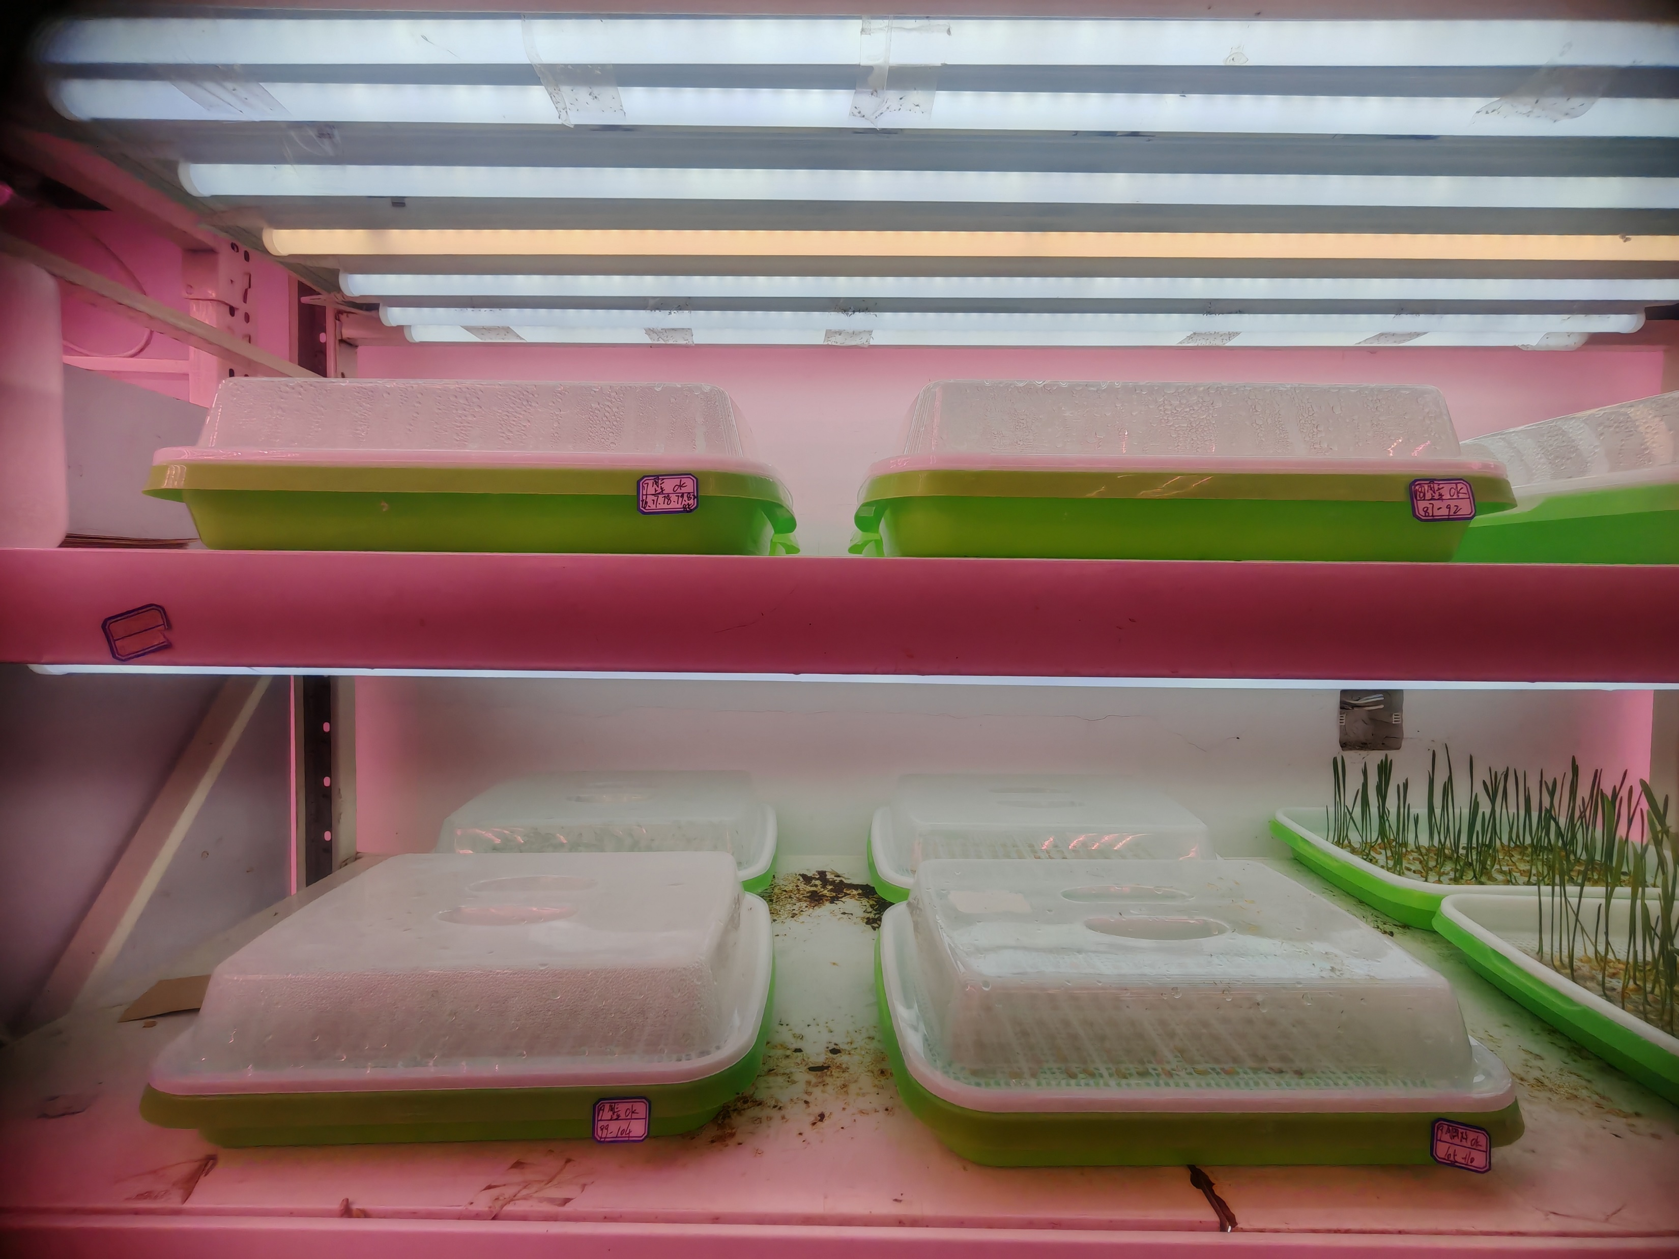
Supplementary figure 1 Seed layout diagram.

Slide 2
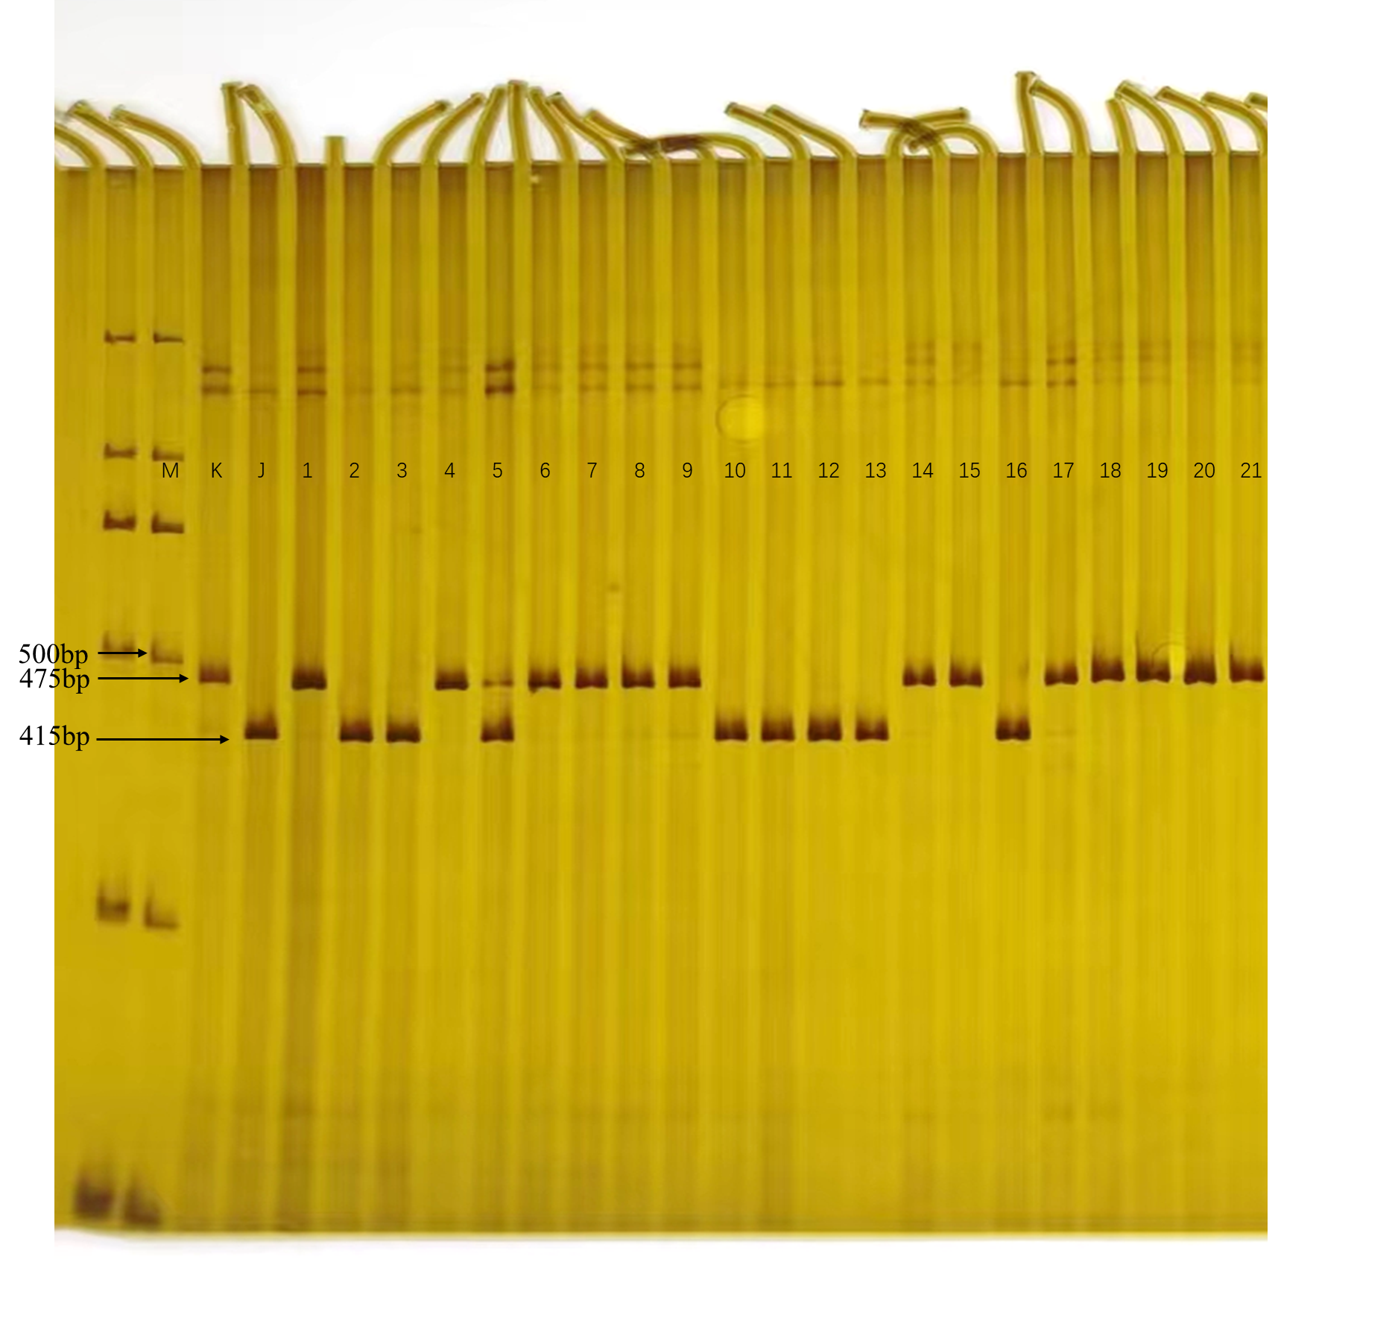
Supplementary figure 2 Identification of PCR (InDel) markers in KJ-RILs M:D2000 DNA ladder, K:KN9204, J:J411

Slide 3
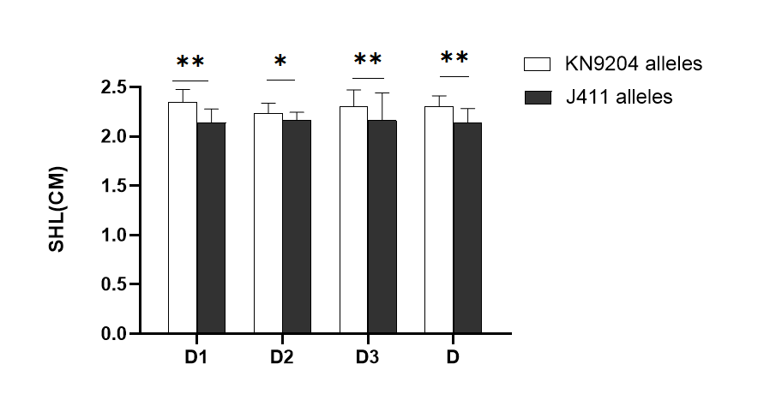
Supplementary figure 3 KNchr3B-195 marker was used to analyze the significance of SHL differences among different genotypes in 188 KJ-RILs
D1:he first experiment under drought stress, D2: the second experiment under drought stress, D3: the third experiment under drought stress, D: mean of triplicate experiments

