Slide 1
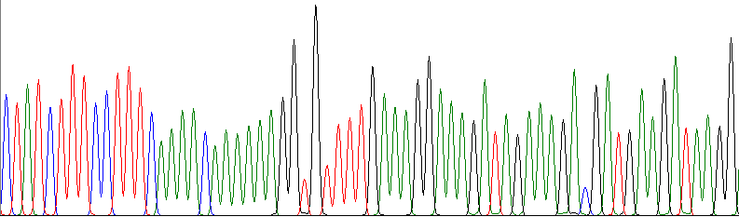
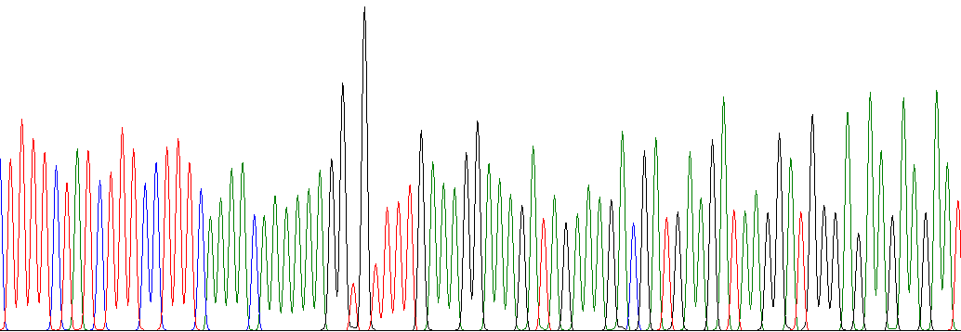
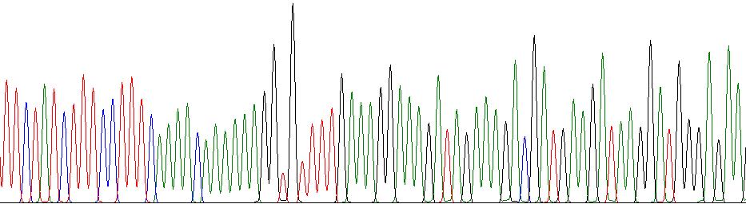
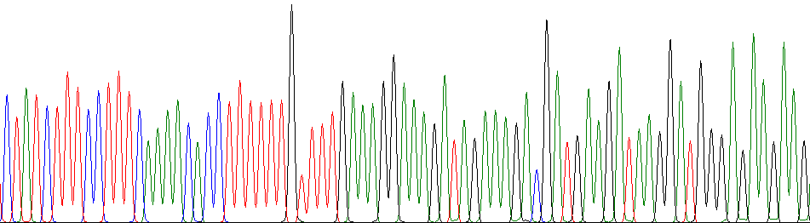
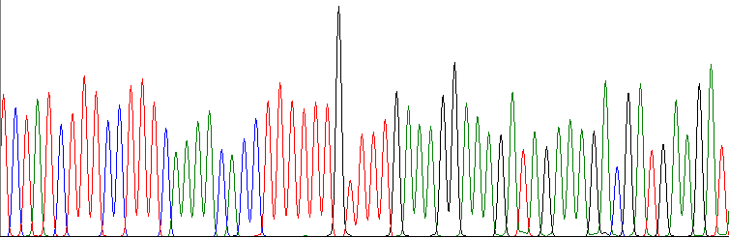
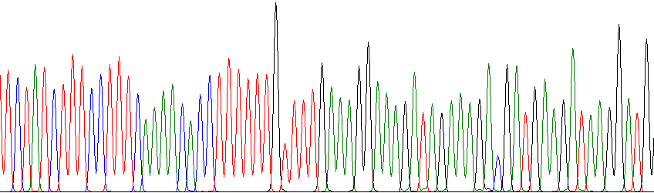
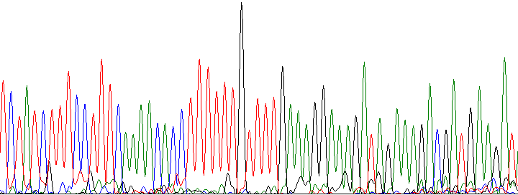
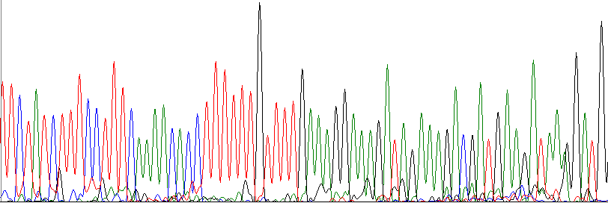
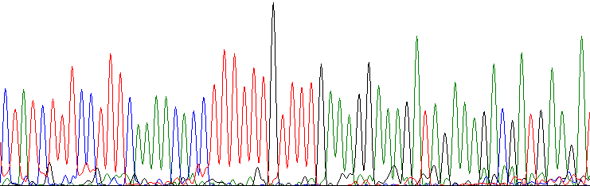
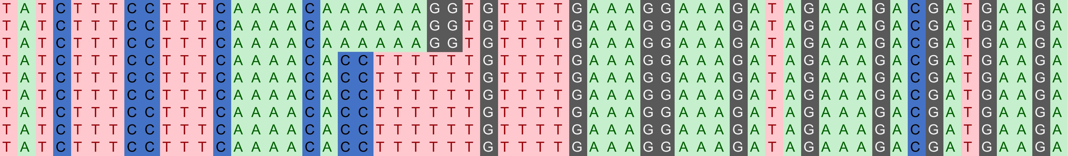
D. 'Black Gold' 1
D. 'Black Gold' 2
D. 'Black Gold' 3
D. officinale 1
D. officinale 2
D. officinale 3
D. nobile 1
D. nobile 2
D. nobile 3
D. 'Black Gold' 1
D. 'Black Gold' 2
D. 'Black Gold' 3
D. officinale 1
D. officinale 2
D. officinale 3
D. nobile 1
D. nobile 2
D. nobile 3
Figure Supplementary 3.1 Sequencing chromatograms of the accD-psaI barcode in three Dendrobium species.

Slide 2
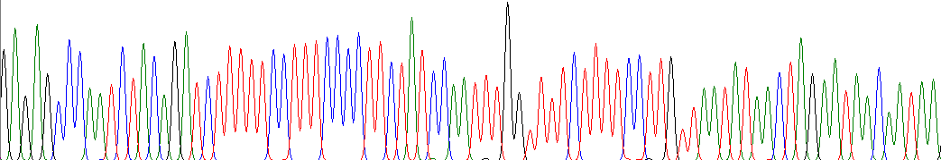
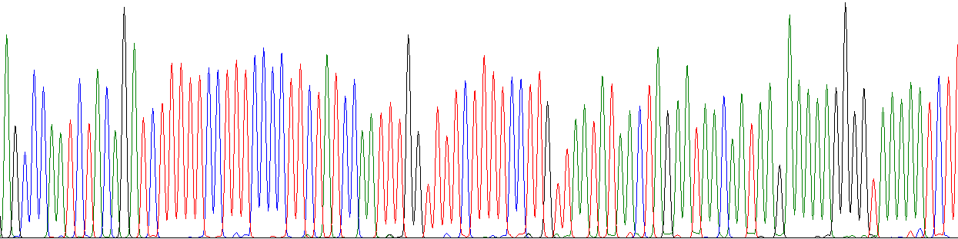
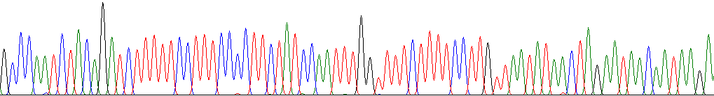
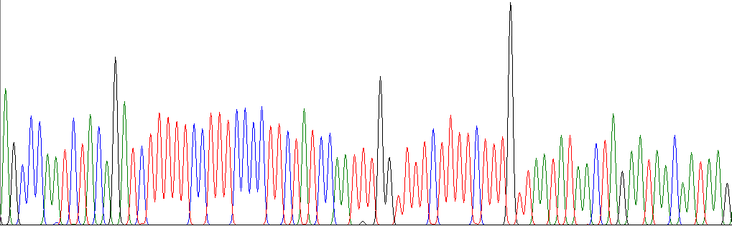
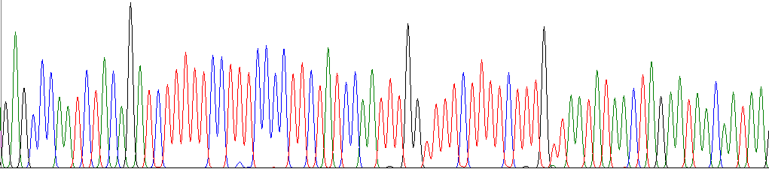
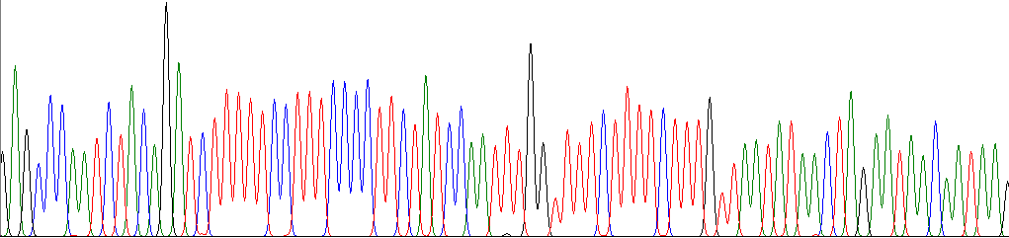
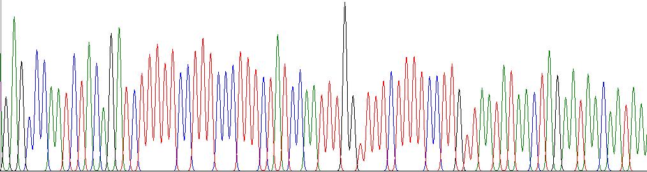
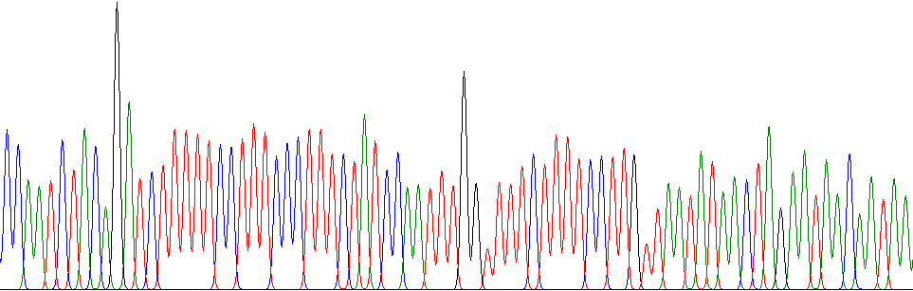
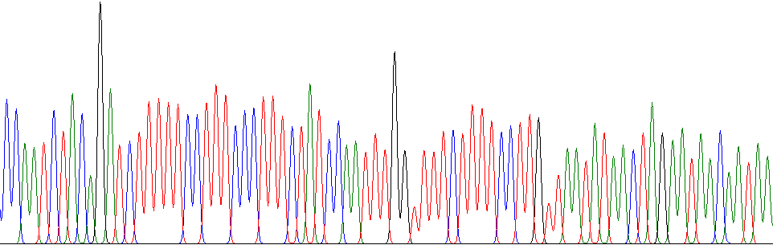
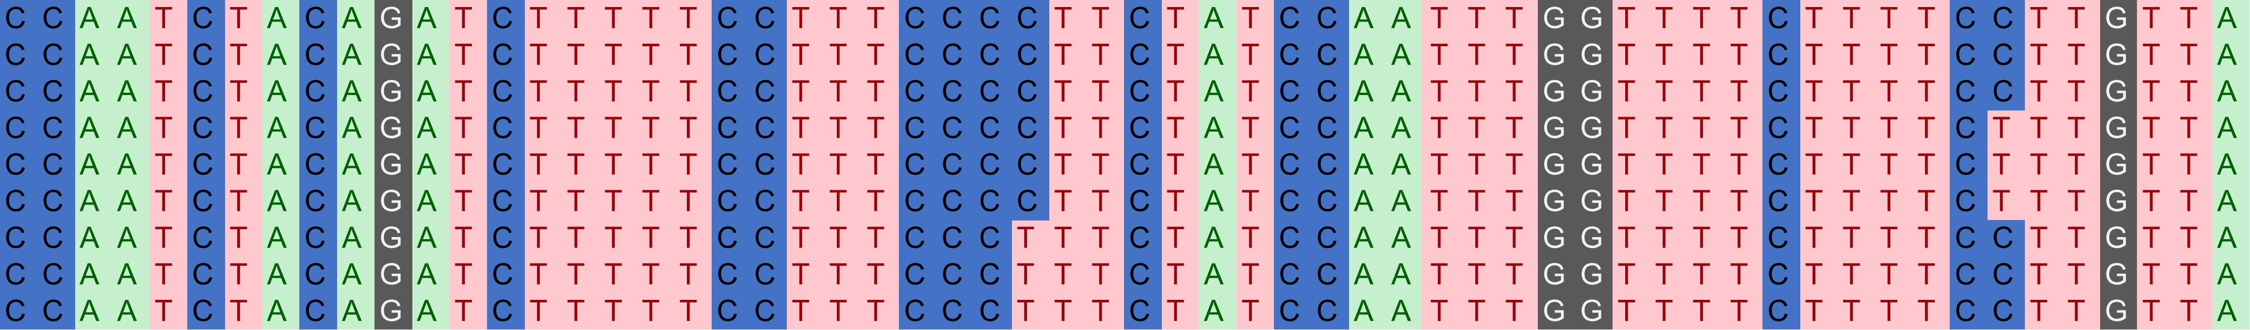
D. 'Black Gold' 1
D. 'Black Gold' 2
D. 'Black Gold' 3
D. officinale 1
D. officinale 2
D. officinale 3
D. nobile 1
D. nobile 2
D. nobile 3
D. 'Black Gold' 1
D. 'Black Gold' 2
D. 'Black Gold' 3
D. officinale 1
D. officinale 2
D. officinale 3
D. nobile 1
D. nobile 2
D. nobile 3
Figure Supplementary 3.2 Sequencing chromatograms of the matK-rps16 barcode in three Dendrobium species.

