Slide 1
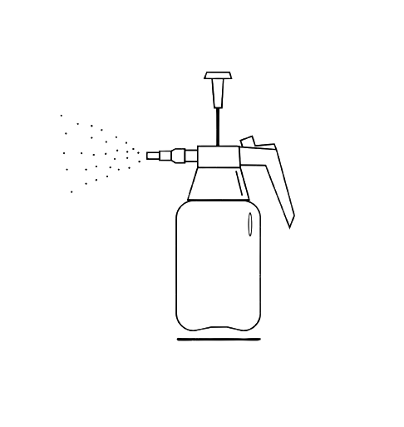
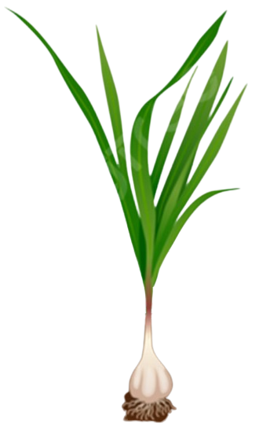
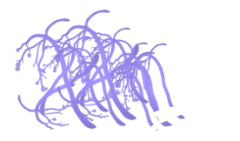
Nano-chitosan
100 ppm
Enhance Nutritional Status
Enhancing Growth Performance
Increase Photosynthetic Pigments
Increasing Crop Yield
Accumulate Organic Osmolytes
Improving Crop Quality
Activate Antioxidant Systems
Facilitating Sustainable Agriculture
Trichoderma Fungi
Synergistic effect of Trichoderma Inoculation and Nano-chitosan Spraying on Garlic Plants

