Slide 1
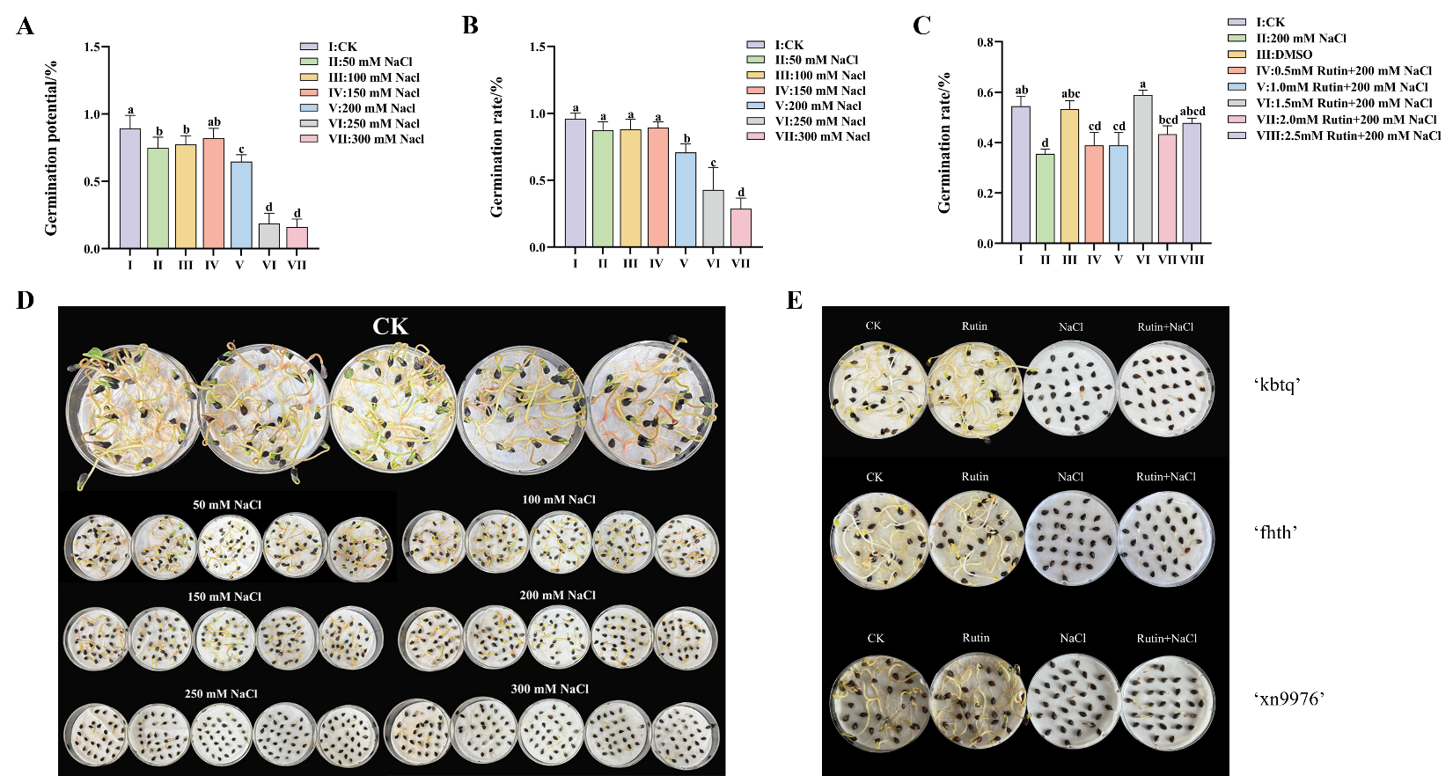
Figure S1. Preliminary experiments to determine optimal concentrations for NaCl stress and rutin treatment. (A, B) germination rate and germination potential of ‘fhth’ seeds under a gradient of NaCl concentrations to establish a moderate stress level, (C) germination potential of ‘fhth’ seeds under a gradient of rutin concentrations to identify the optimal protective dose, (D) visual phenotypes of ‘fhth’ germination corresponding to the NaCl gradient, and (E) representative images of the three sweet buckwheat varieties (‘kbtq’, ‘fhth’, and ‘xn9976’) under the final selected experimental conditions. Based on these results, 200 mM NaCl and 1.5 mM rutin were chosen for all subsequent experiments. For panels A-C, values are presented as the mean ± standard deviation (n=3), and different lowercase letters indicate significant differences among concentrations (P<0.05).

