Slide 1
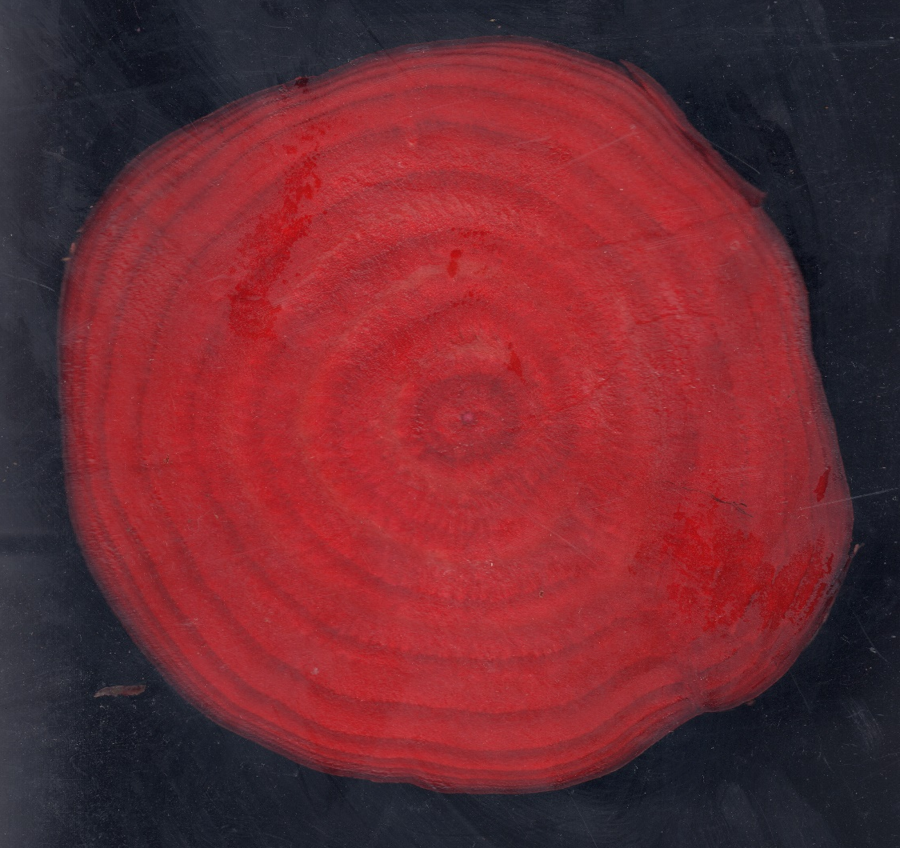
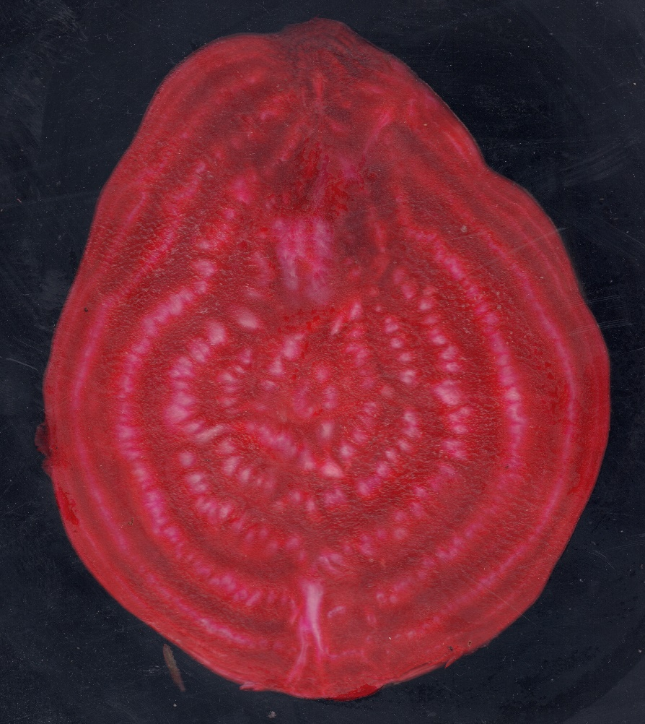
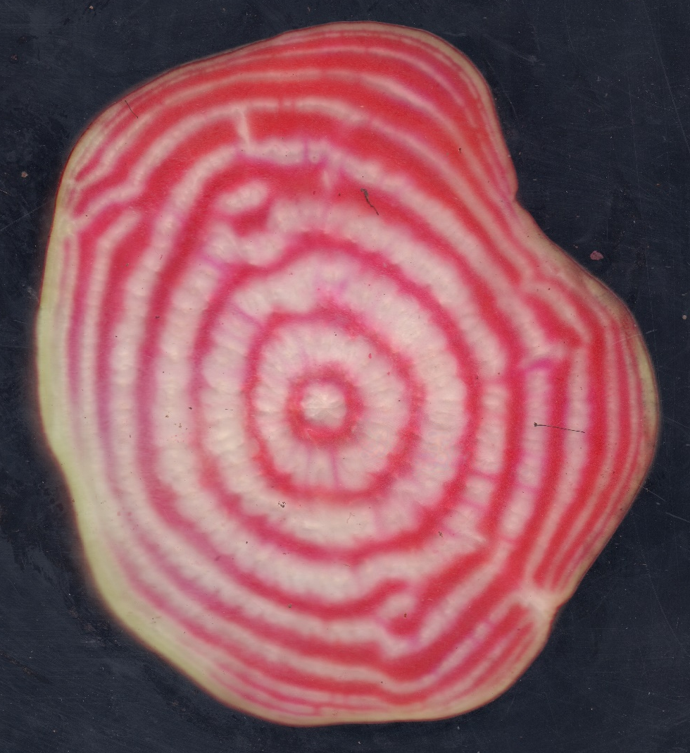
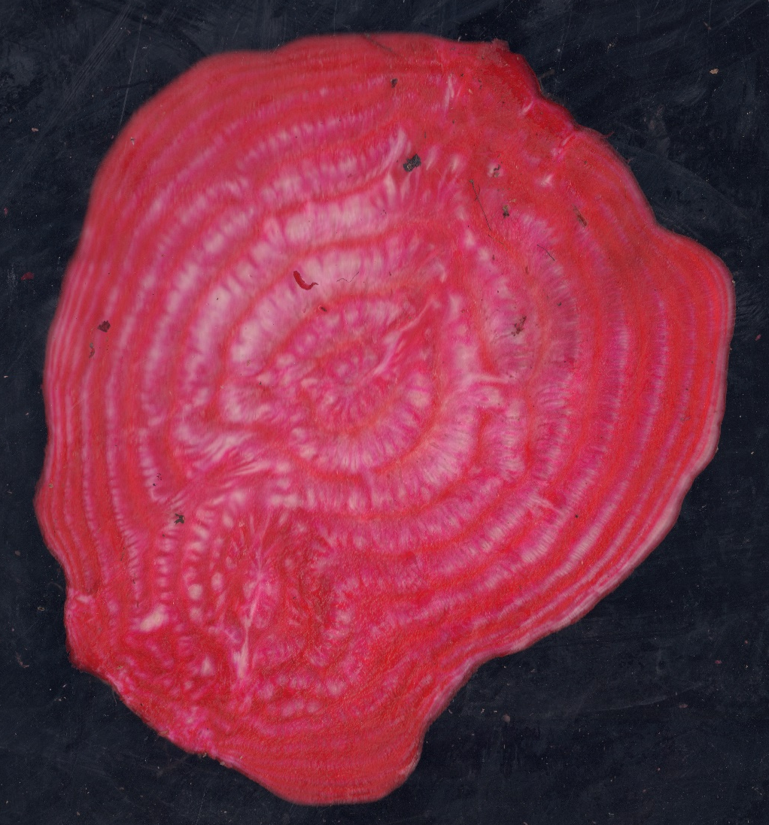
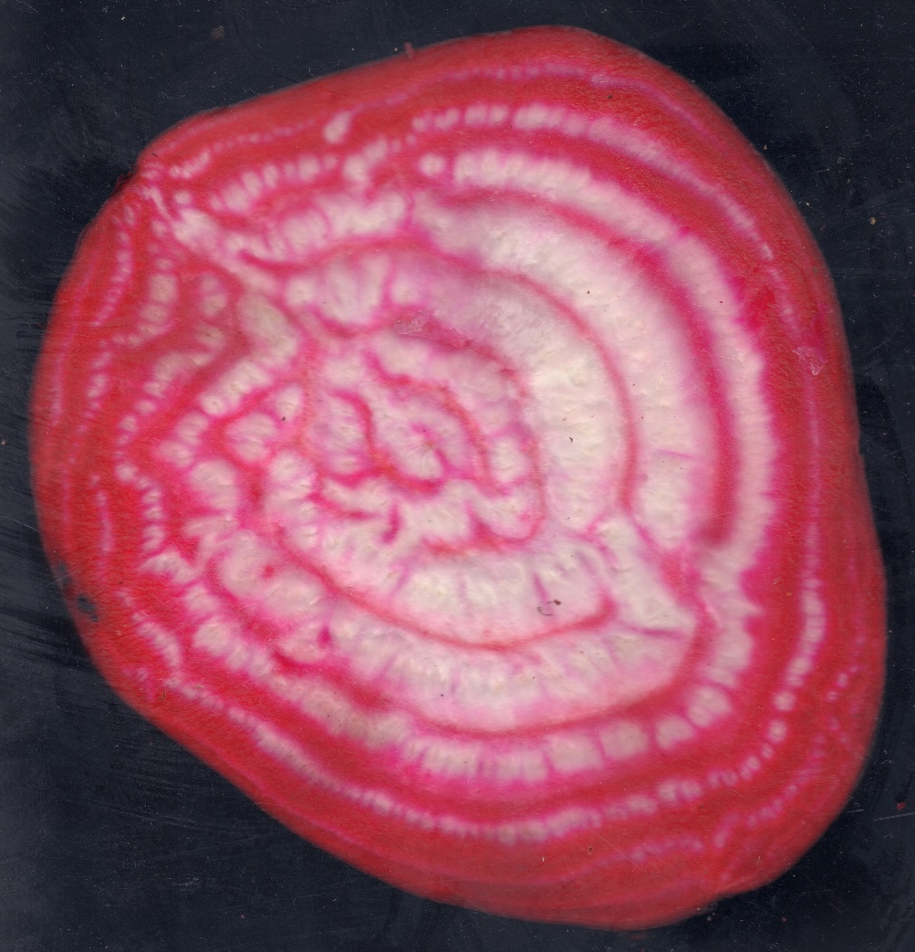
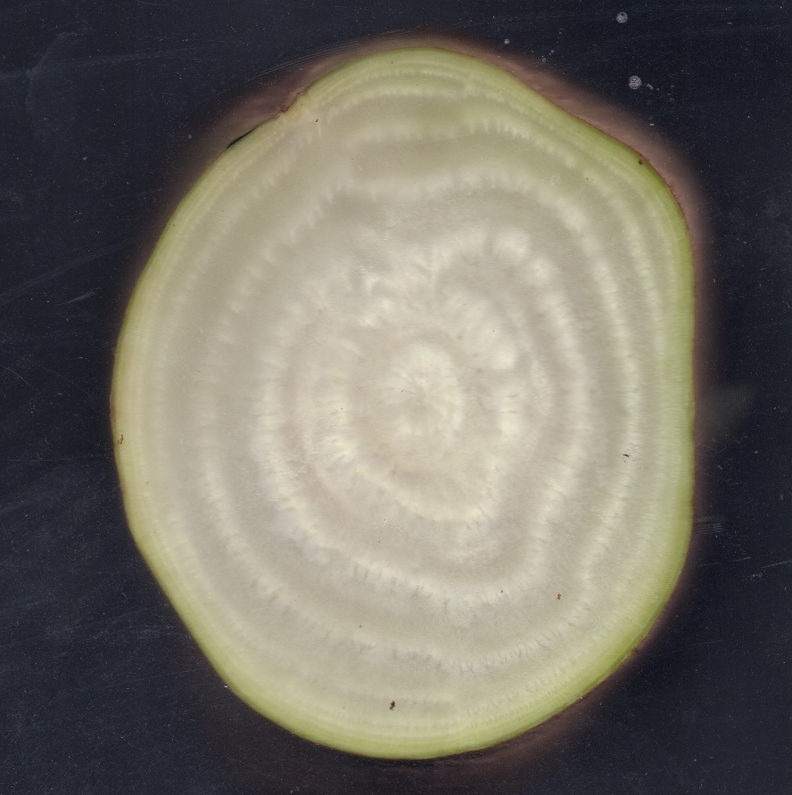
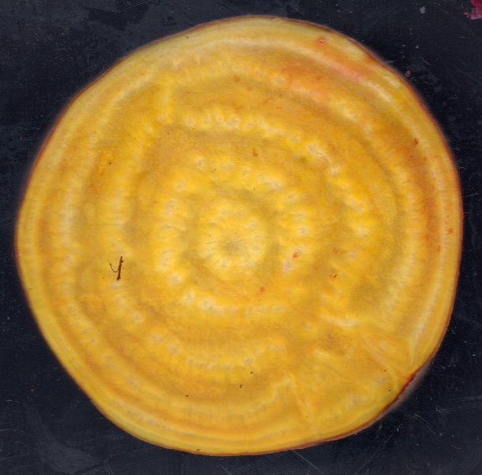
Parenchymatous
Vascular
BETA 355
Red
Red
BETA 1032
Red
Rose
BETA 2129
Red
White
BETA 1306
Rose
Rose
BETA 1159
Rose
White
BETA 1058
White
White
BETA 1795
Yellow
White
S6 Fig.

