Slide 1
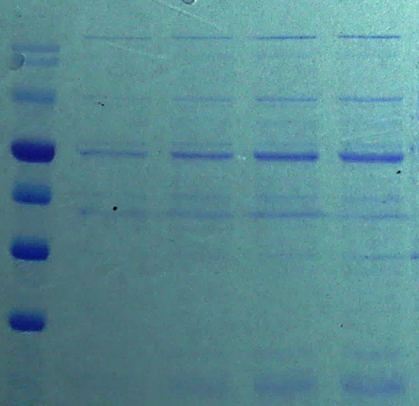
Marker
0.3 mM- IPTG
0.1 mM- IPTG
0.4 mM- IPTG
0.2 mM- IPTG
KDa
180
140
100
72
60
45
35
Fig. S1. SDS-PAGE profile gel for detection of SgTPS-V proteins in E. coli strain BL21 (DE3) under the induction with various concentration from isopropyl-β-D-thiogalactopyranoside (IPTG) (0.1 mM, 0.2 mM, 0.3 mM and 0.4 mM IPTG). The PM1600 ExcelBand™ All Blue (180-10 KDa) was used as a protein Marker.

