Slide 1
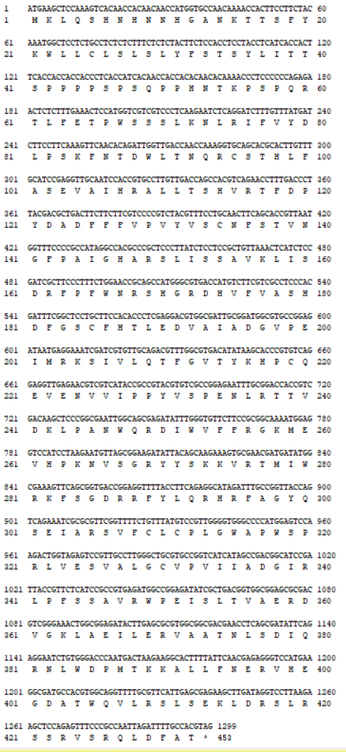
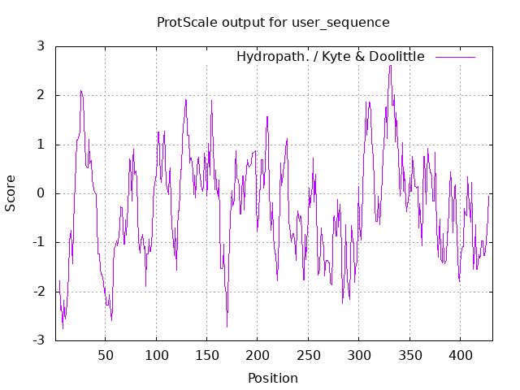
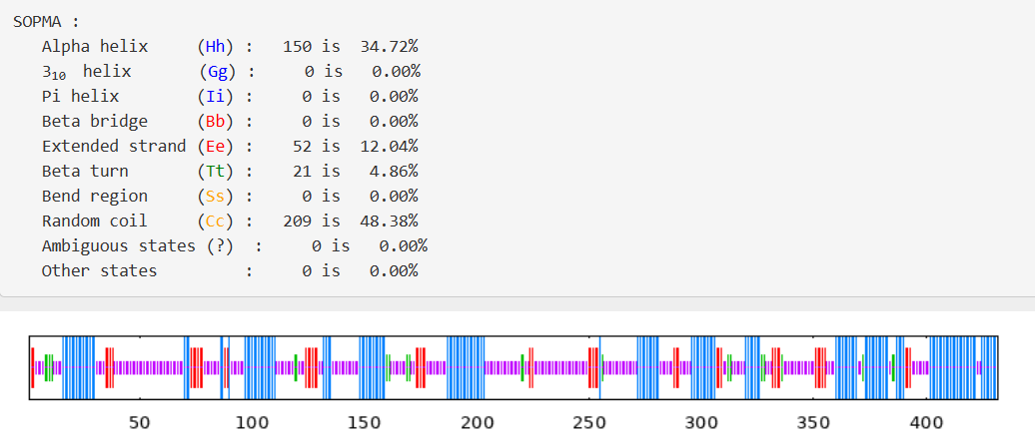
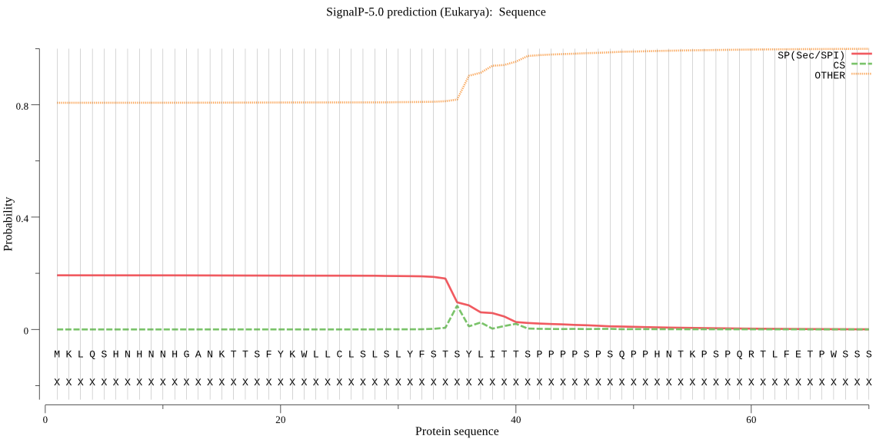
A
M 1 2 3
B
M
15000 bp
2000 bp
1000 bp
7500 bp
C
D
E
Fig. S1 Amplification of AhIRX7 gene from the salt-tolerant mutant S24, and analysis of the chemical and physical properties of AhIRX7 protein. A The full CDS length of the amplified AhIRX7 products and the enzymatic digestion of AhIRX7 recombinant vector were analyzed by agarose gel electrophoresis. Marker: 2000 bp (Left), 15000 bp (Right). 1 indicates the amplification products of the AhIRX7 gene CDS, 2 indicates the AhIRX7 recombinant vector, 3 indicates the enzymatic digestion of AhIRX7 recombinant vector. B The amino acid sequence of AhIRX7 protein. C The hydropathy of AhIRX7 protein was analyzed by constructing hydropathy plots with the Kyte and Doolittle algorithm (https://web.expasy.org/cgi-bin/protscale/protscale.pl). D–E The prediction of AhIRX7 protein secondary structure and signal peptide.

Slide 2
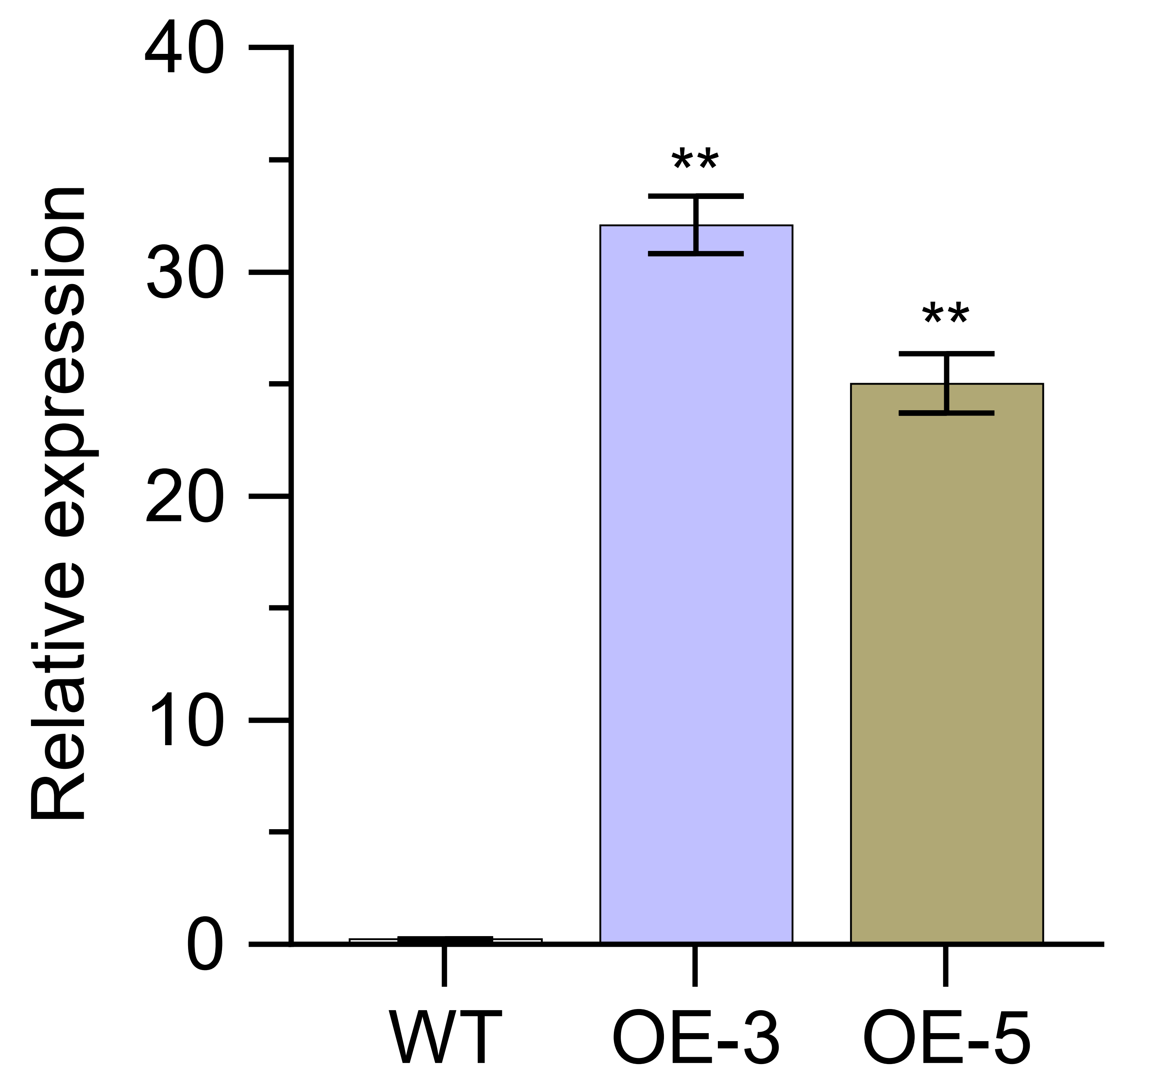
A
B
Fig. S2 AhIRX7 expression was analyzed in wild-type (WT), overexpression peanut lines (A), and overexpression Arabidopsis lines (B). Data are presented as mean ±SE (n = 3). Two-tailed Student’s t-tests were performed (**P < 0.01).

Slide 3
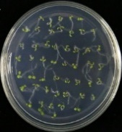
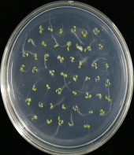
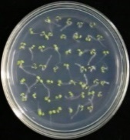
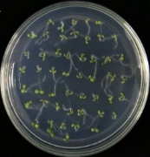
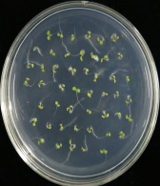

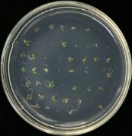
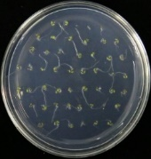
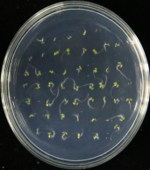
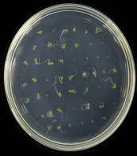
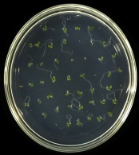
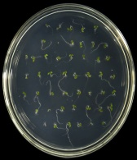
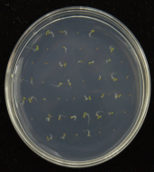
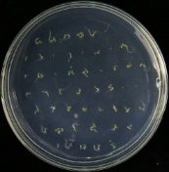
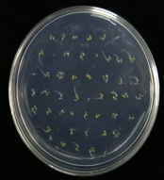
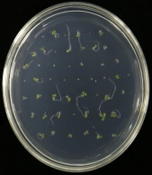
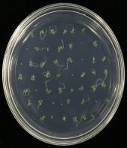
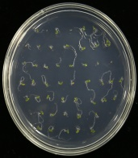
A
WT
OE-3
OE-5
B
WT
OE-3
OE-5
1/2 MS
1/2 MS
100 mM
NaCl
350 mM
Man
125 mM
NaCl
300 mM
Man
C
D
E
F
Fig. S3 The seed germination phenotype of WT and transgenic Arabidopsis under different treatments. A–B The representative phenotype of seed germination in WT and transgenic Arabidopsis under 100/125 mM NaCl (A) and 300/350 mM Mannitol (B). C–F The germination rates (C and E) and cotyledons greening rate (D and F) were calculated between WT and transgenic Arabidopsis under salt and drought treatment, respectively. Data are presented as mean ±SE (n = 3). Two-tailed Student’s t-tests were performed **P < 0.01).

Slide 4
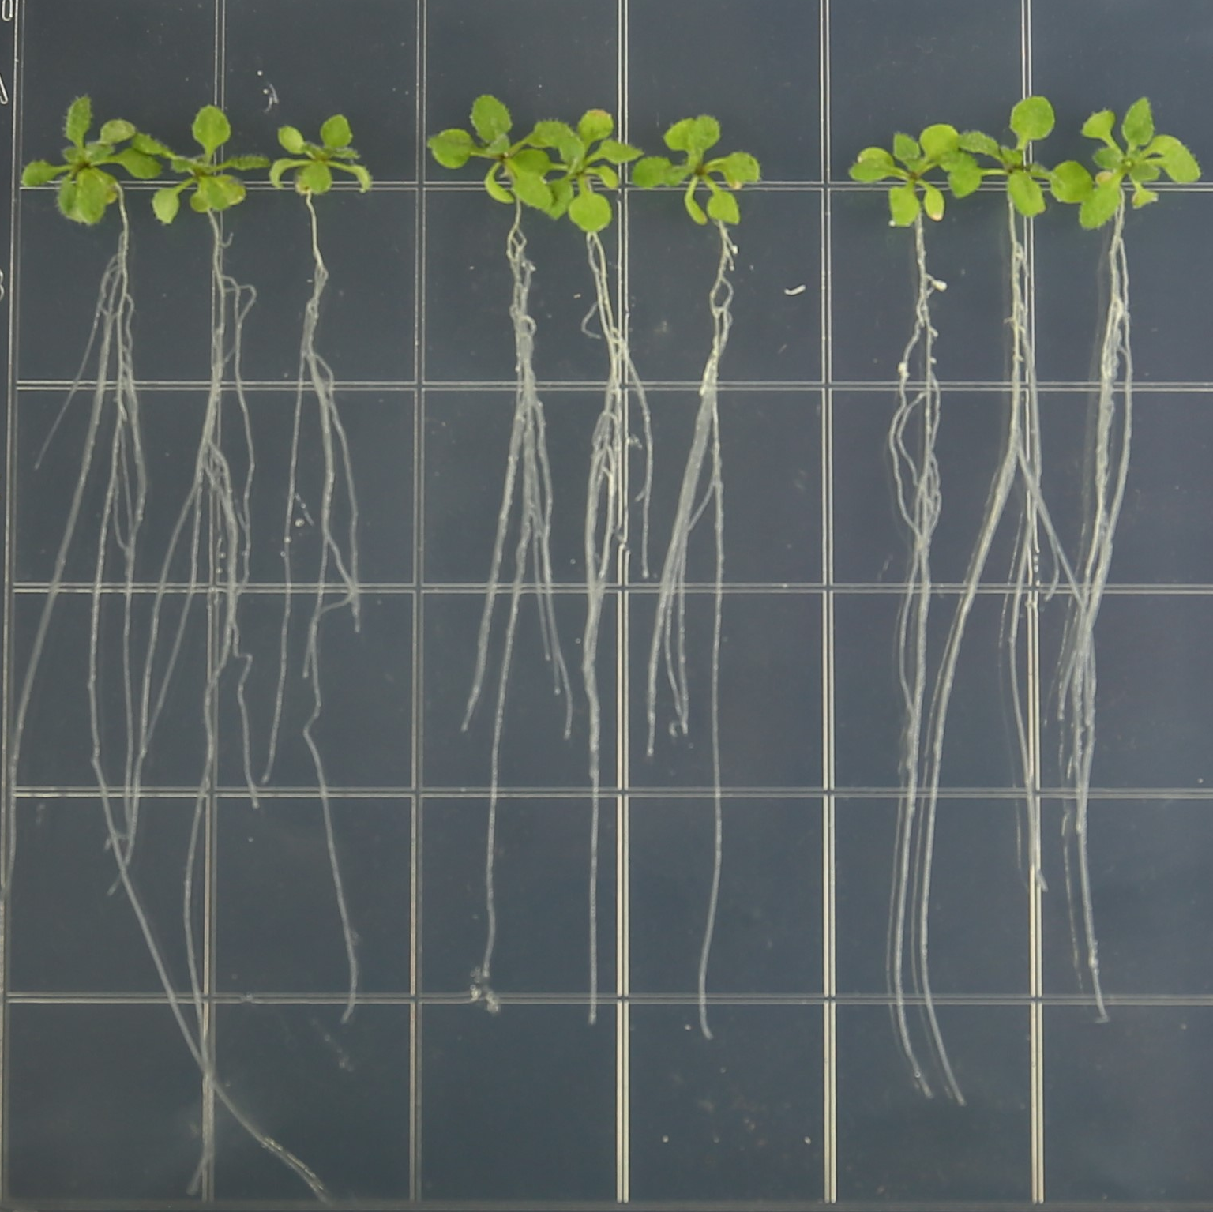
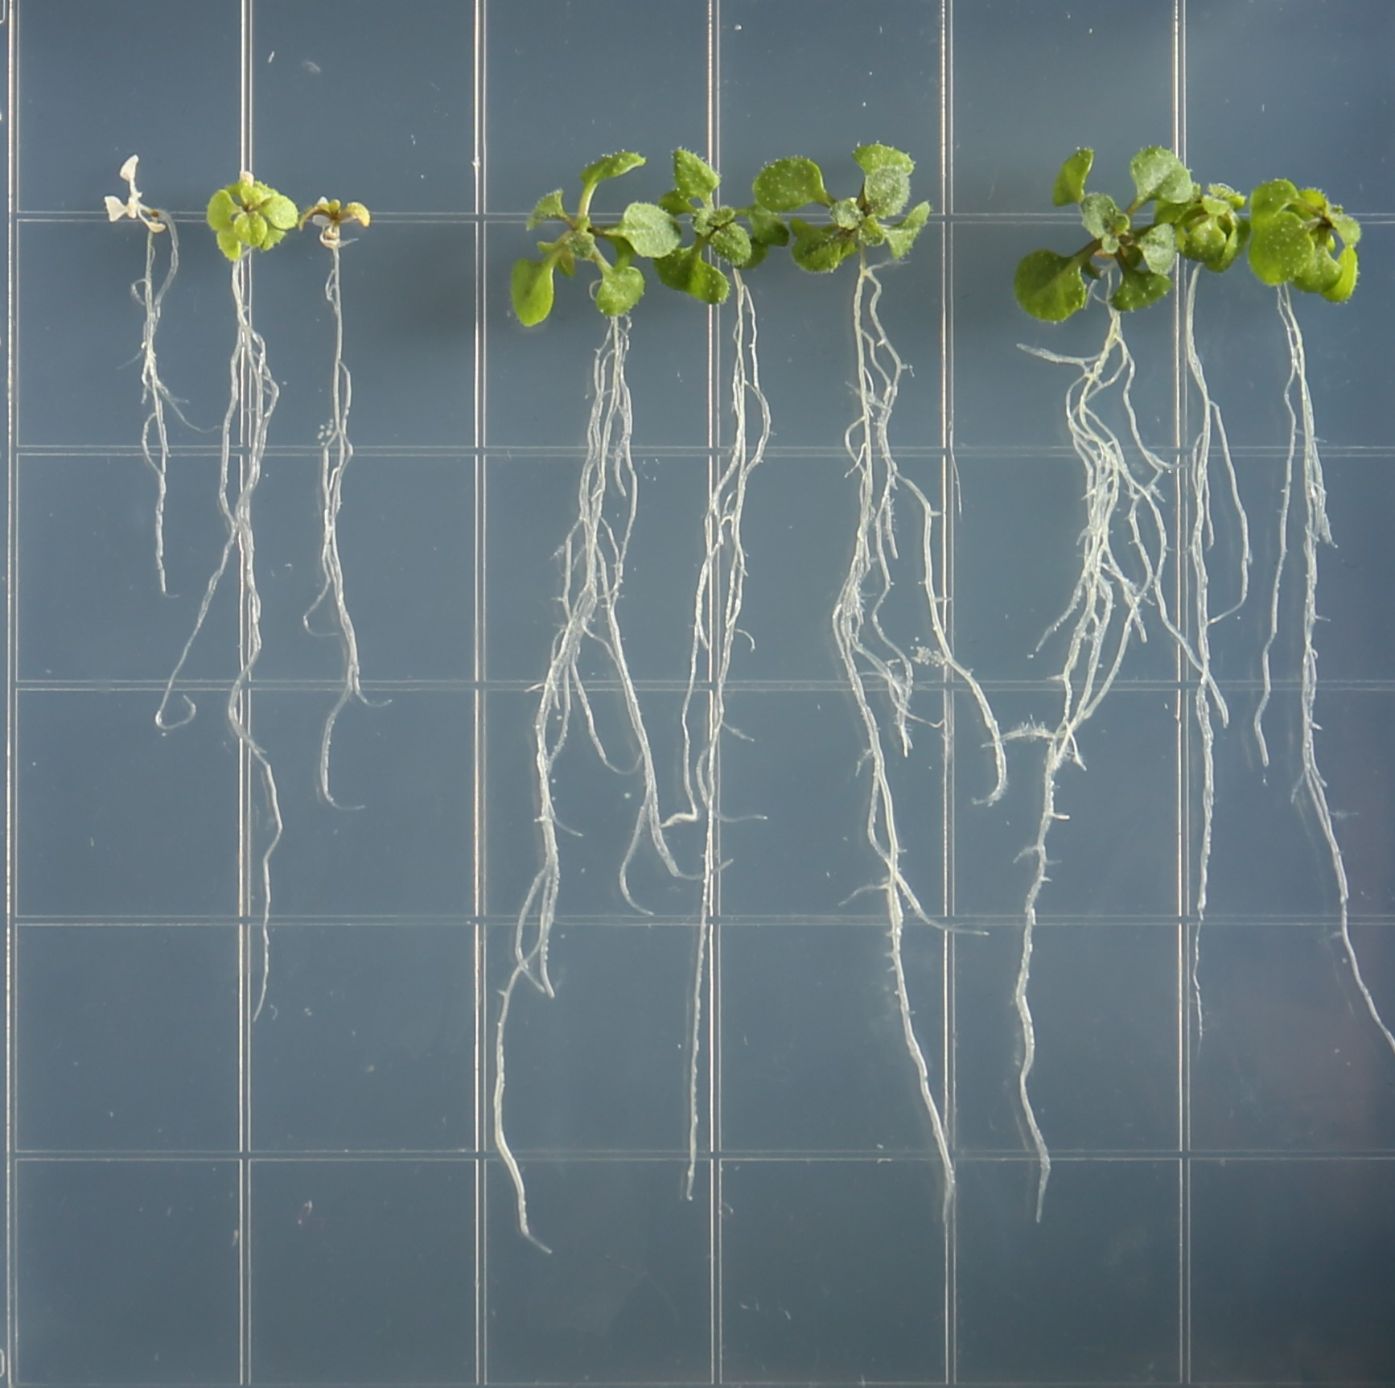
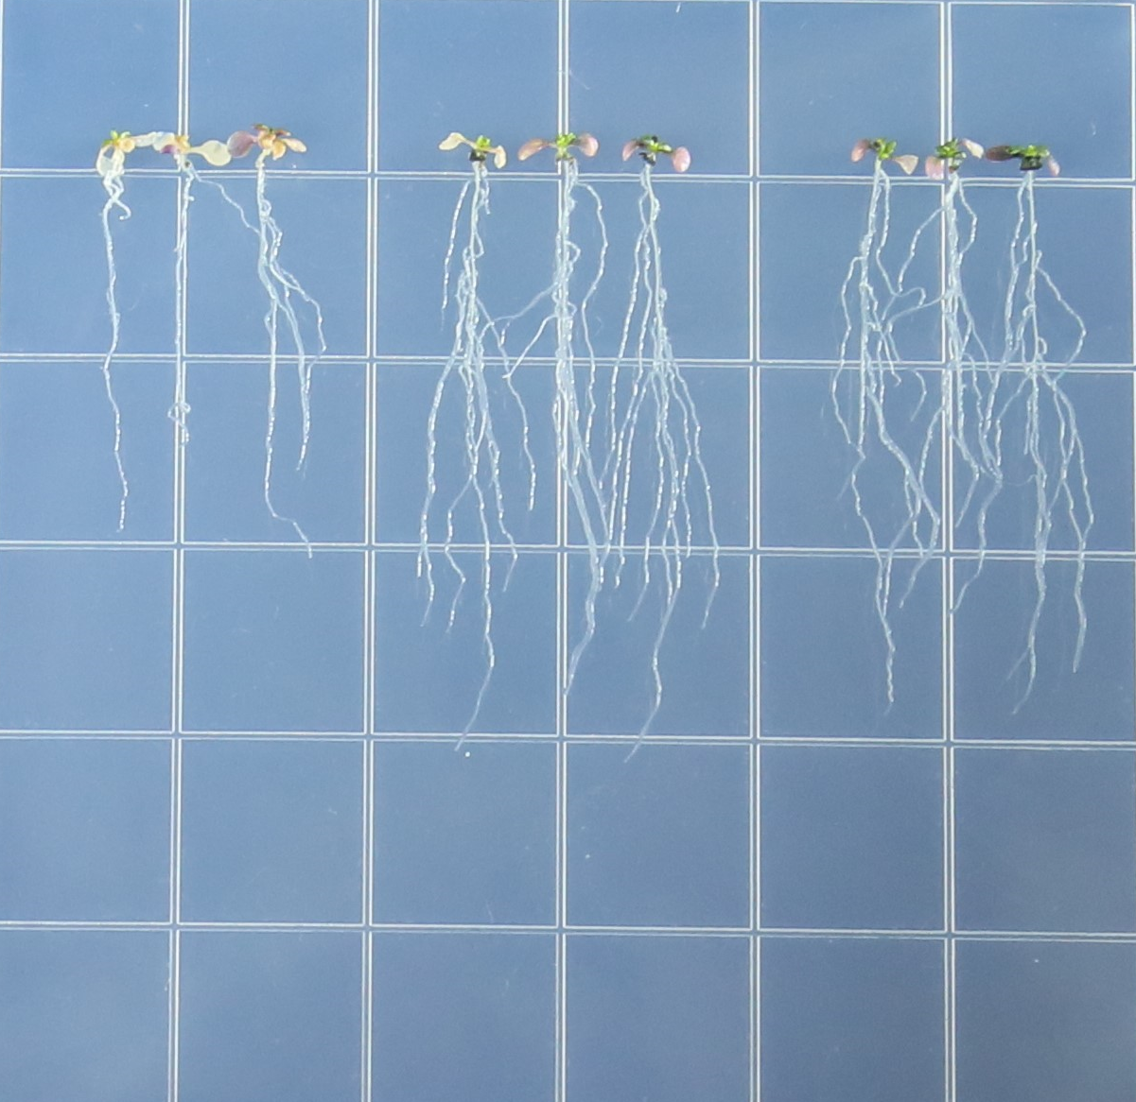
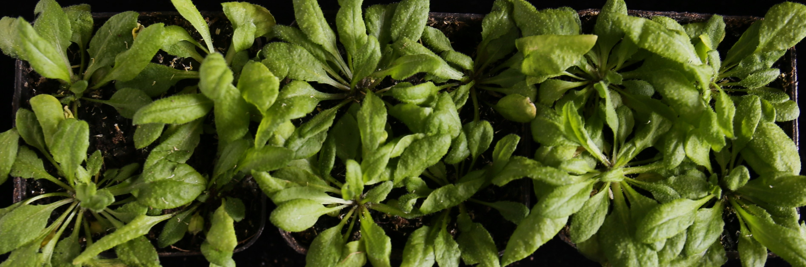
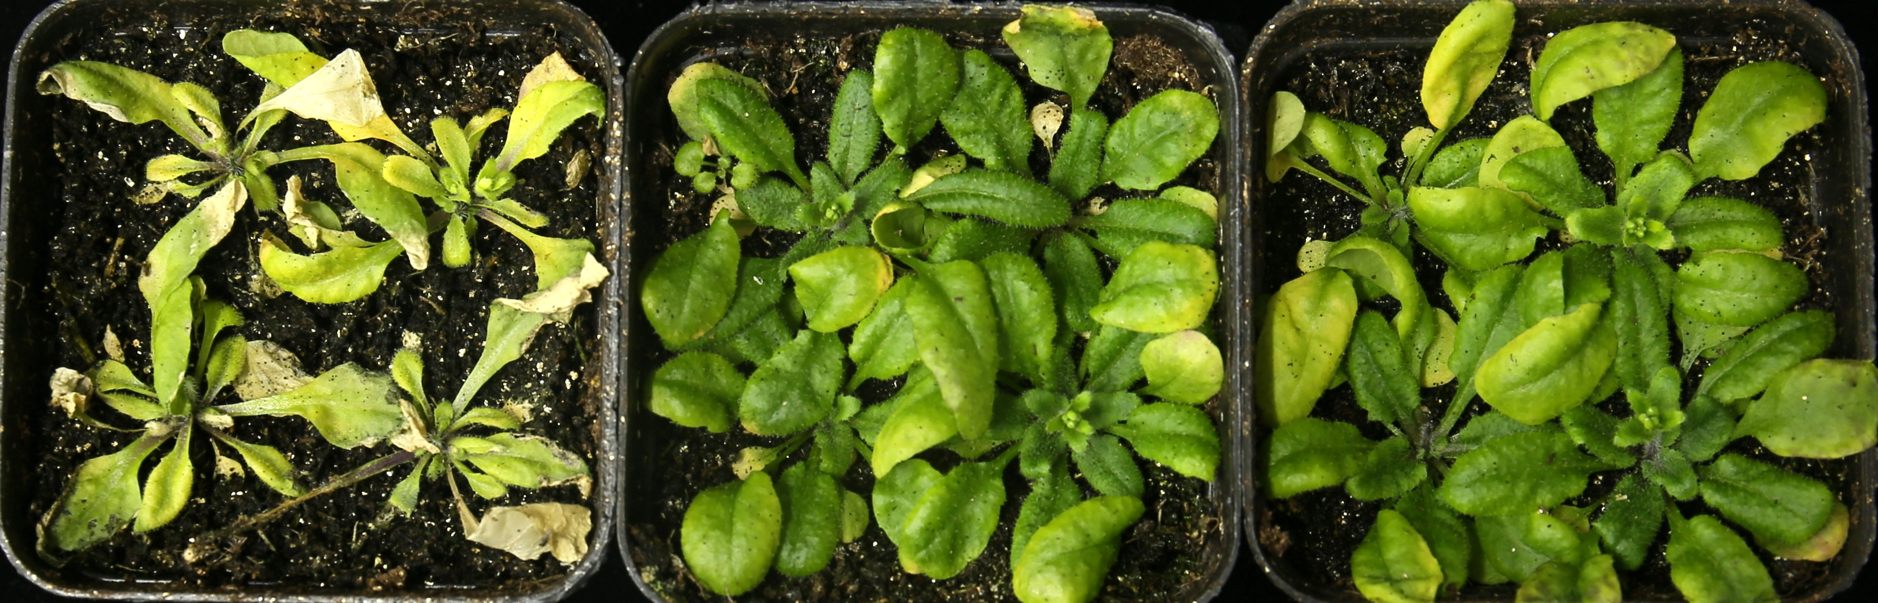
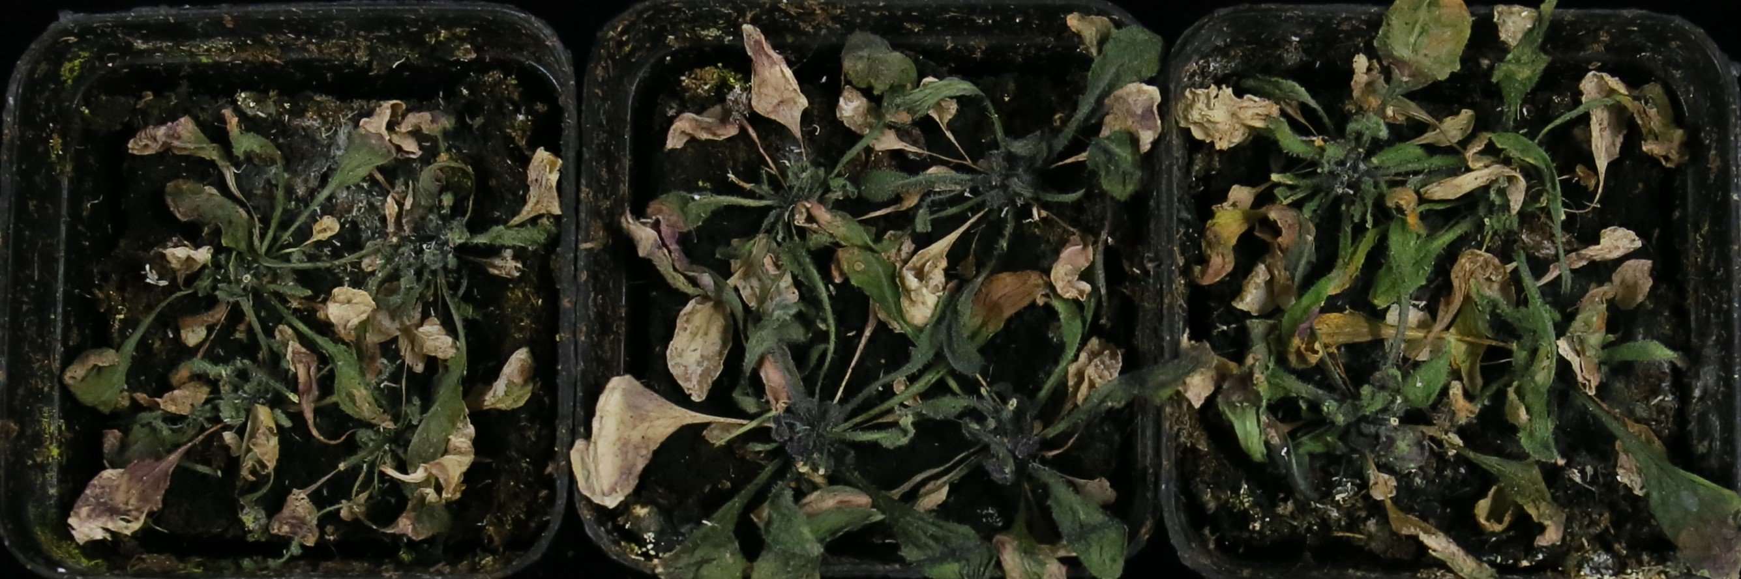
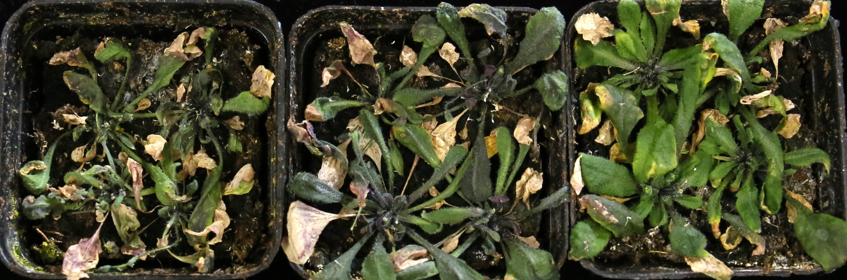
A
E
WT OE-3 OE-5
WT OE-3 OE-5
WT OE-3 OE-5
WT OE-3 OE-5
1/2 MS
100 mM NaCl
350 mM Man
B
C
Re-Water Drought Salt Normal
Fig. S4 AhIRX7 enhances tolerance to salt and drought stress in Arabidopsis. A The responses of AhIRX7 transgenic and WT Arabidopsis plants were identified after two weeks cultivation in pots under normal conditions, 300 mM NaCl or drought stress followed by re-watering for three days. The maximal photochemical efficiency of photosystem II (PSII) was measured as (Fv/Fm). The false color code depicted at the bottom of the image ranges from 0 (red) to 1 (purple). B–E The chlorophyll fluorescence parameters include Fv/Fm (maximum light efficiency) (B), Y(NPQ) (light protection index) (C),φPII quantum Efficiency II (PSII) index (D), Y(NO) (light damage index) (E) for WT and overexpressing Arabidopsis plants under normal conditions, salt and drought treatment. Data are presented as mean ±SE (n = 3). Two-tailed Student’s t-tests were performed (**P < 0.01).

Slide 5
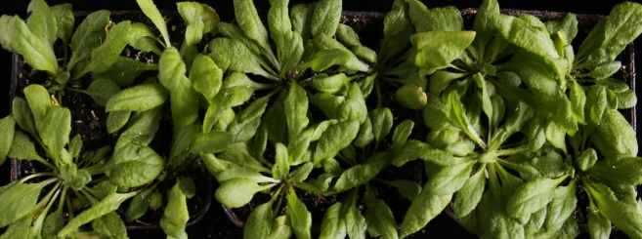
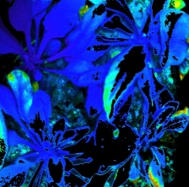
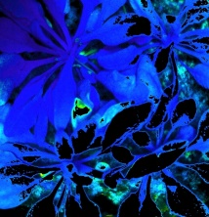
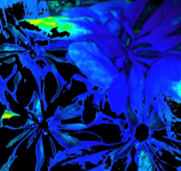
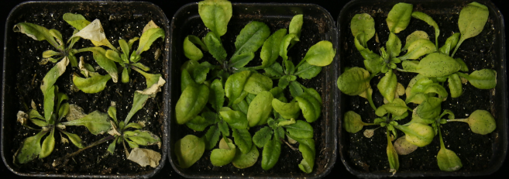
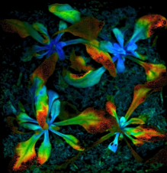
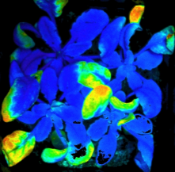
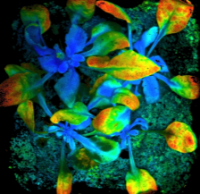

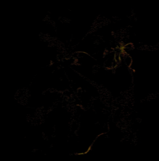
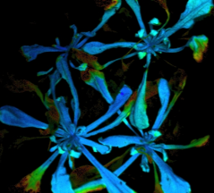
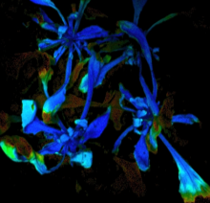
A
B
C
Drought Salt Normal
D
E
Fig. S5 Phenotypic and physiological trait variations in transgenic Arabidopsis subjected to normal, salt, and drought stress conditions. A The phenotypes of transgenic lines and WT seedling plants after one week of growth on 1/2 MS medium supplemented with NaCl or Mannitol. B–C Measurements of primary root length (B) and fresh weight (C) for AhIRX7 transgenic lines and WT plants, respectively. D Morphological analysis of transgenic and WT plants under different conditions. All plants were cultured under normal conditions for two weeks, 300 mM NaCl stress for three weeks, and drought stress for three weeks under in pots followed by re-watering for three days. Survival rates were counted under different treatments. Data are presented as the mean ± SE (n = 3). Two-tailed Student’s t-tests were performed (**P < 0.01).

Slide 6
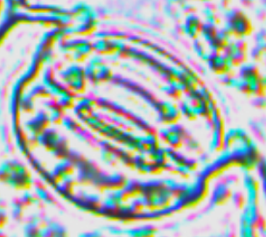
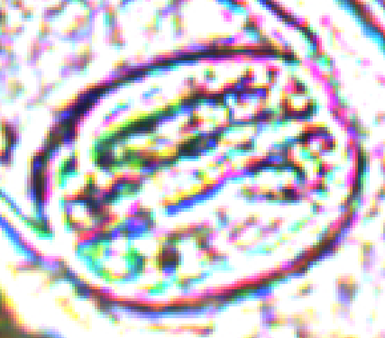
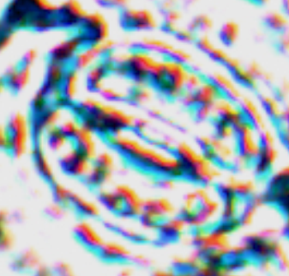
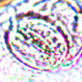
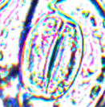
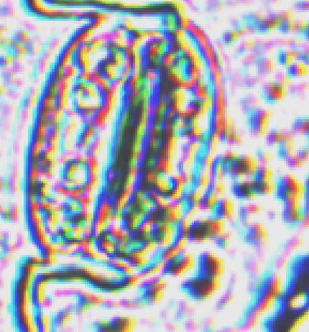
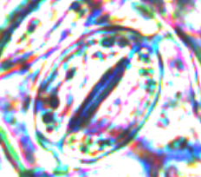
A
B
WT OE-1 OE-2
C
1ųm
Fig. S6 The stomatal responses of transgenic peanut and WT plants under normal conditions, salt and drought stress treatment. A Rate of water loss. B Stomatal apertures of 3-week-old pot-grown AhIRX7 transgenic and WT plants under normal conditions, 300 mM NaCl or 30% PEG6000 treatment for 2 h. Bar = 1ųm. C Measurement of stomatal aperture (width/length). Two-tailed Student’s t-tests were performed (*P < 0.05, **P < 0.01).

Slide 7
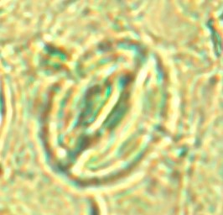

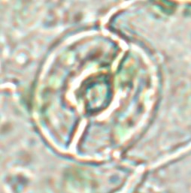
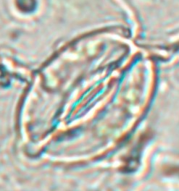





A
B
WT OE-3 OE-5
C
10 ųm
Fig. S7 The stomatal responses of transgenic Arabidopsis and WT plants under normal conditions, salt and drought stress treatment. A Rate of water loss. B Stomatal apertures of 4-week-old pot-grown AhIRX7 transgenic and WT Arabidopsis plants under normal conditions, 300 mM NaCl or 30% PEG6000 treatment for 2 h. Bar = 10ųm. C Measurement of stomatal aperture (width/length). Two-tailed Student’s t-tests were performed (*P < 0.05, **P < 0.01).

Slide 8


















A
WT OE-3 OE-5
WT OE-3 OE-5
Normal
Salt
Drought
B
NBT
DAB
C
D
E
Fig. S8 Detection of H₂O₂ and O²⁻ accumulation in transgenic and WT Arabidopsis plants under normal, salt and drought stresses. A–B Leaves of AhIRX7 transgenic and WT Arabidopsis plants were stained with NBT (A) and DAB (B) after three weeks of cultivation under normal condition, NaCl, and drought treatments. (C–F) Analysis of the activity of enzyme related to ROS scavenging, as well as the levels of proline (Pro) and MDA in WT and overexpression lines under normal conditions, NaCl and drought treatment. Data are presented as mean ±SE (n = 3). Two-tailed Student’s t-tests were performed (**P < 0.01).

Slide 9
A
B
C
D
E
F
G
H
Fig. S9 The expression levels of eight stress-responsive genes in the leaves of AhIRX7 transgenic and WT seedlings pot-grown were analyzed for 4 weeks under different conditions. The expression level of stress-responsive genes was included POD, SOD, CAT, AAO, NCED, LOX2, APX and DHAR. Data are presented as mean ±SE (n = 3). Two-tailed Student’s t-tests were performed (**P < 0.01).

